Slide 1
Module 4, Part 2 –Sustainability Smart Grid Implementation Issues
We will now examine how Smart Grid is expected to support “sustainability benefits.” Once again, our focus will be on current sustainability issues facing the Pacific Northwest.

Slide 2


Five Key Concepts:
Delicate balancing act. A power system must balance energy generation with its use at all times.
Peak use times strain the system. At certain times of the day, energy use peaks, such as when everyone wakes up in the morning and starts turning on appliances. This causes strain on the system. Peaks are also seasonal; the PNW is a winter peaking region but our summer peaks are also becoming more significant.
Energy
used
Energy
generated

Slide 3
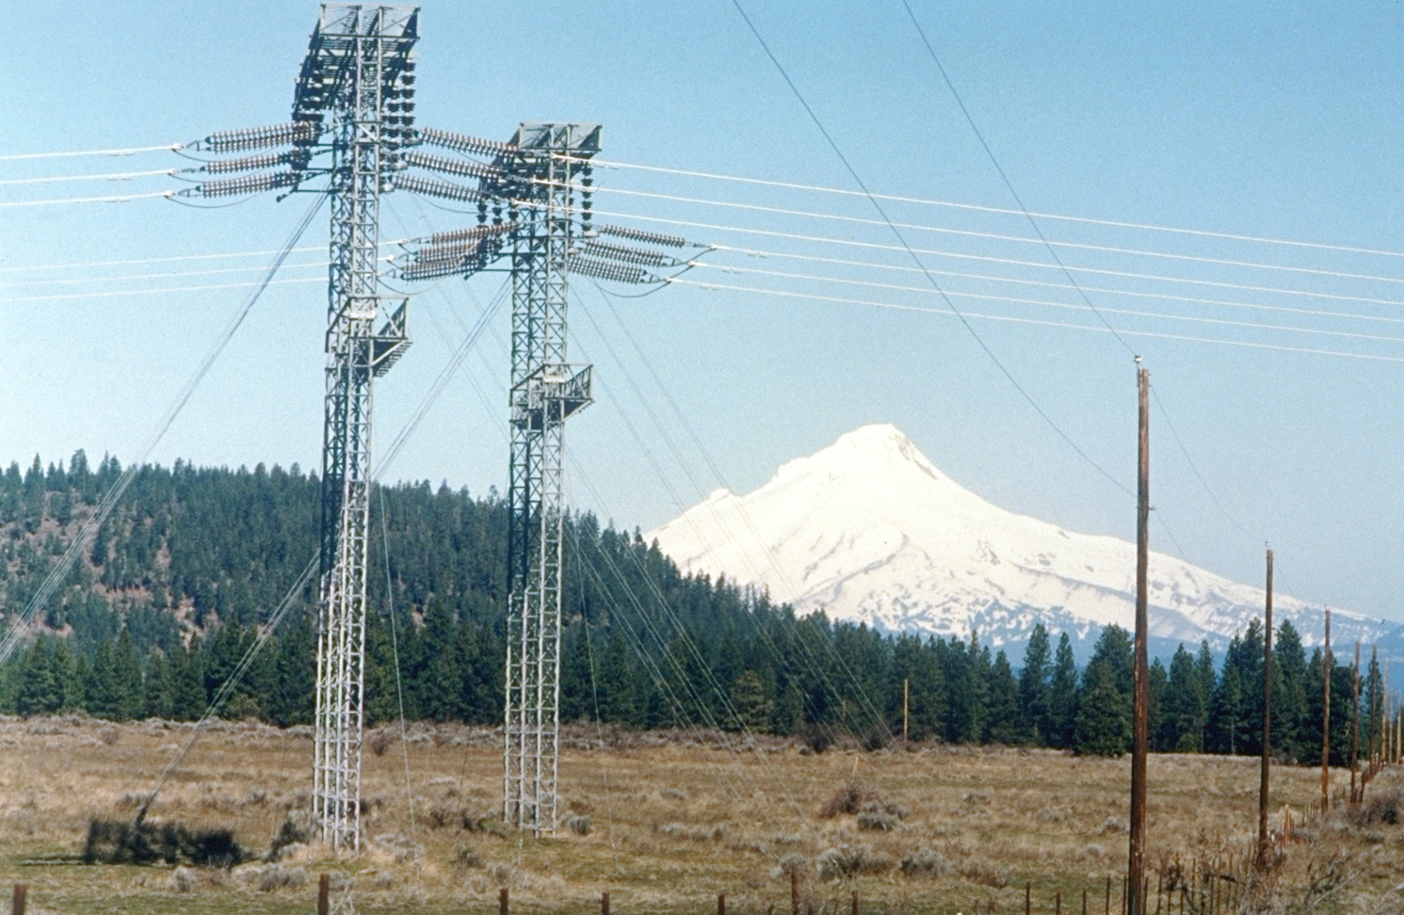
3) Grid operators are expected to deliver an invisible product that cannot be stored to customers who expect to receive it the very same second they decide they want it.
Since electricity cannot be stored, at least not as electricity, the grid must be managed to ensure that supply and demand are closely matched at all times. Matching generation and demand within acceptable limits is necessary to ensure that the power system is stable and the lights stay on.

Slide 4
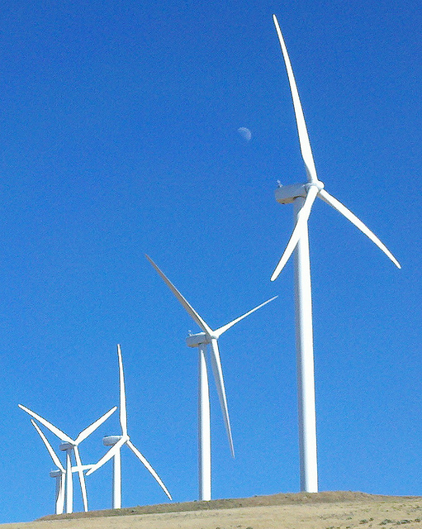
4) Grid stability problems stem from the volatility of demand, the variability of energy supplies (especially hydro and wind), and the difficulty in accurately forecasting both supply and demand over different time intervals.
5) Grid stability problems existed before we added more variable and less predictable renewable resources, such as wind to the system, but they are even more significant now.

Slide 5
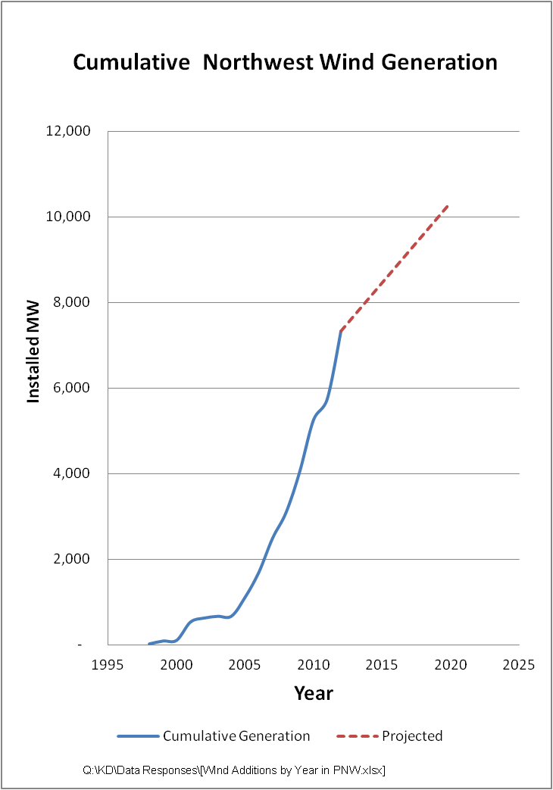
Rapid Growth of Wind Generation
State Renewable Standards
Idaho (Exec Order)
25% by 2025
Montana
5% for 2008 ‐ 2009
10% for 2010 – 2014
15% for 2015 and beyond
Washington
3% by 2012
9% by 2016
15% for 2020 and beyond
Oregon
5% by 2011
15% by 2015
20% by 2020
25% for 2025 and beyond
California
20% by 2013
25% by 2016
33% by 2020
$12 billion capital investment and ~$100 million annually to BPA in wheeling and integration revenues.

Slide 6
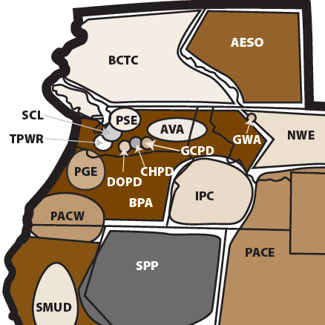
Pacific Northwest Has Many Balancing Authorities The largest of these is the BPA Balancing Authority
Source: WECC

Slide 7
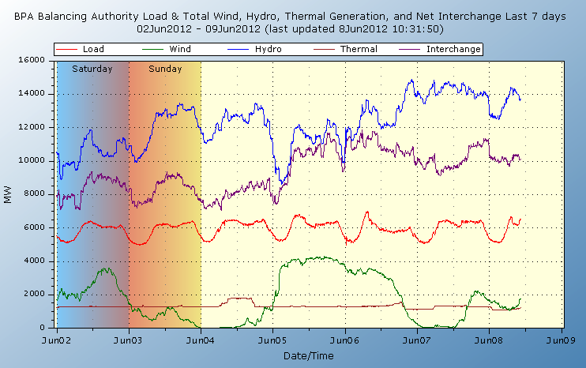
Variability in Hydro, Wind and Total Load
hydro
inter-
change
total load
wind
thermal
Source: BPA
Notes:
Note the load, amount of wind, and lots of hydro

Slide 8
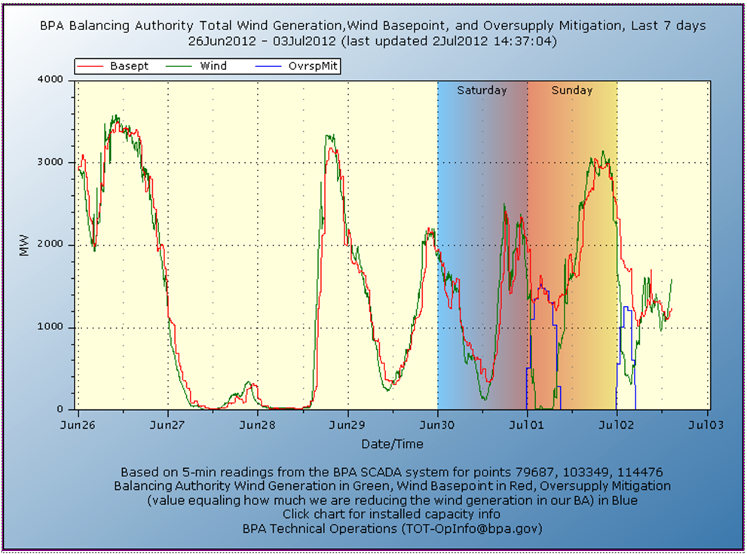
Example of Wind Variability
Source: BPA

Slide 9
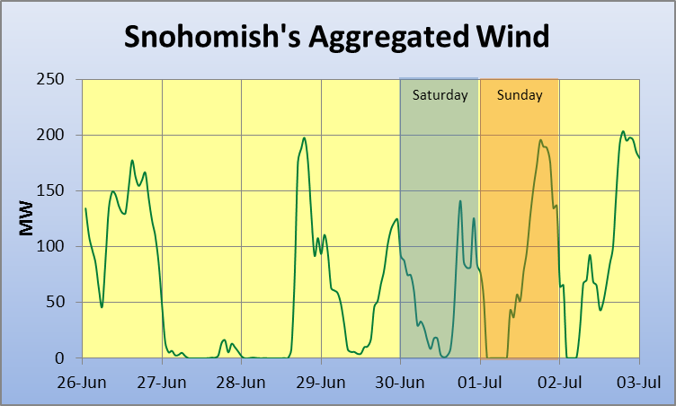
Wind Variability Is Not Limited to the Columbia Basin

Slide 10
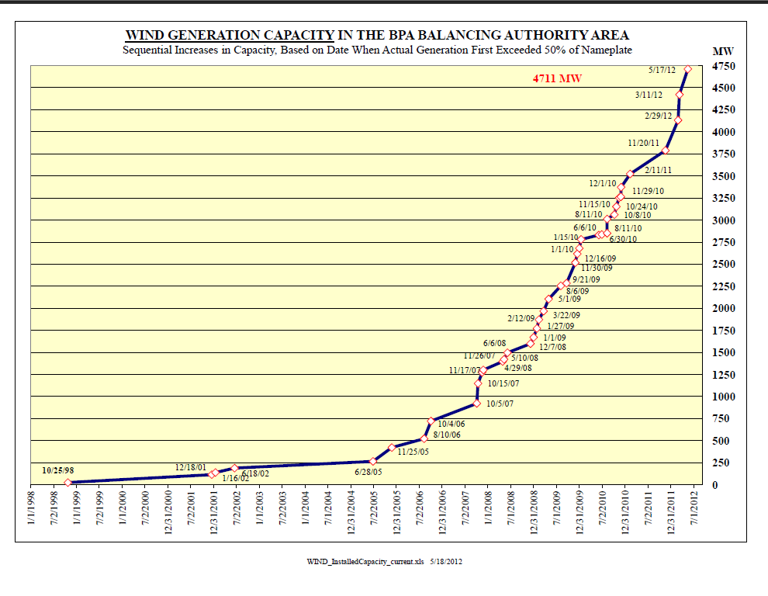
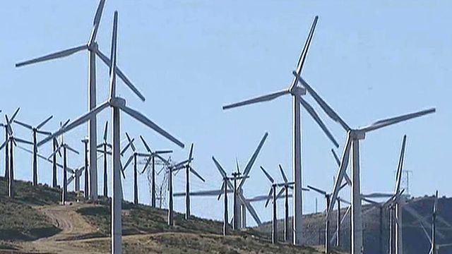
Rapid Growth in Wind Generation in BPA’s Balancing Authority
Installed wind capacity is approaching 50 percent of BPA’s total load
Not much geographic diversity; most wind in BPA’s balancing authority
Nearing limits of hydro system to provide balancing reserves
Slide courtesy of BPA
Notes:
Hydro operations analytics shows that the system can only support 5,000 megawatts.
Columbia river gorge –dotted with windmills
Venturi affect
No geographic diversity

Slide 11
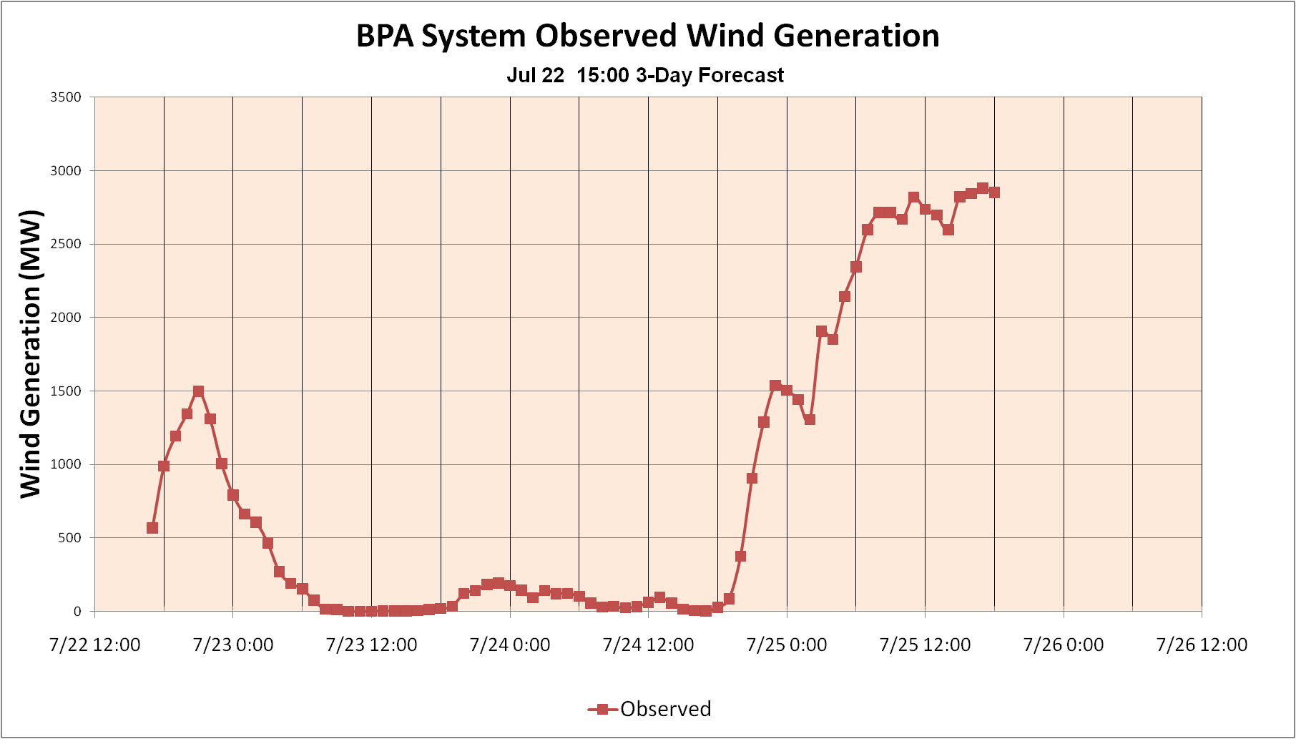
Wind Presents Two Major Challenges
1. Wind output is a variable

Slide 12
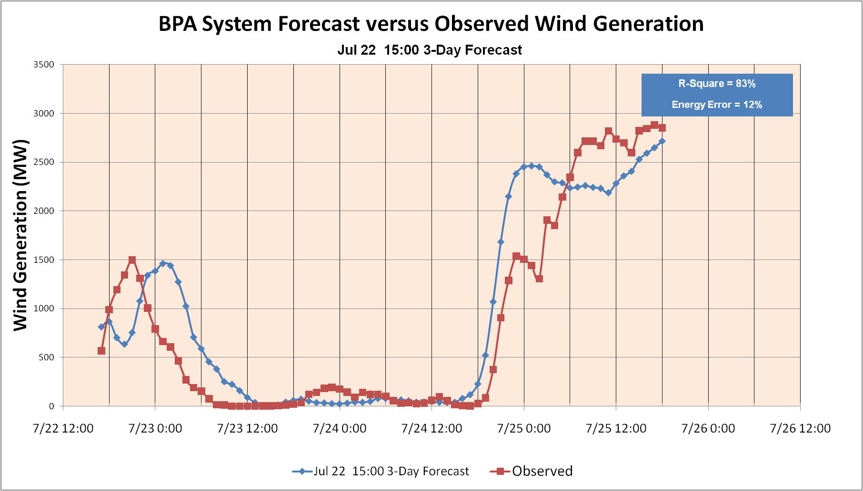
2. Wind is not entirely predictable

Slide 13
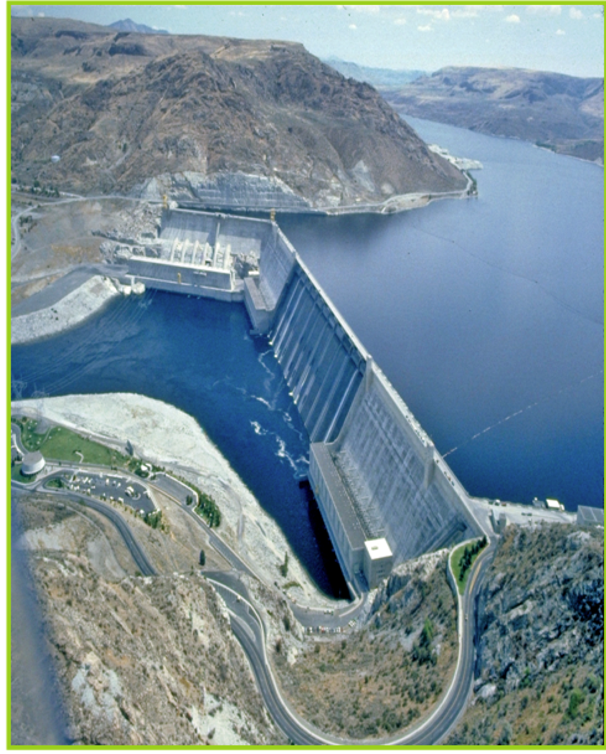
Our Region’s Hydro System is “Oversubscribed”
The region’s hydro system must meet multiple needs:
Power, irrigation, navigations, water supply, flood control, recovery of salmon populations
A relatively new need is to supply “Balancing Reserves” to help integrate wind generation. It essentially serves as a large storage battery.
Our hydro system’s ability to supply Balancing Reserves is limited to roughly 5,000 MWs of wind.

Slide 14
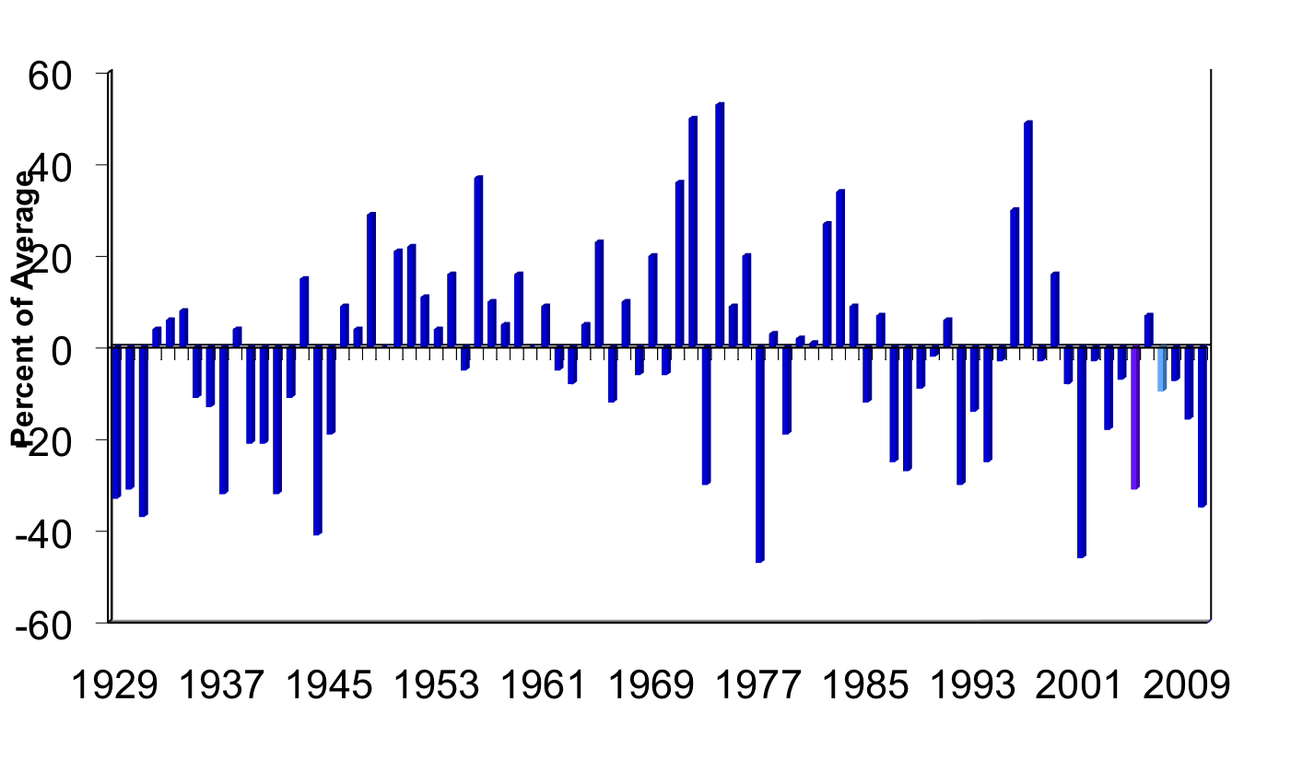
Our Hydro System is also Unpredictable
Historical Runoff at The Dalles Dam
Source: Northwest Power and Conservation Council
Notes:
This slide illustrates the variability in the amount of water that flows in the Columbia River from year to year.
An average year would appear on this chart as a bar with zero height.
In the driest year (1977) the runoff was almost 50 percent lower than the average.
In the wettest year (1974) the runoff was nearly 50 percent greater than the average.
It is difficult to tell from this slide whether or not a pattern exists, although there are clearly dry periods and wet periods.

Slide 15
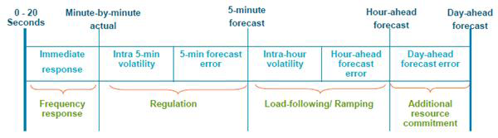
Examples of Grid Flexibility Needs & Services
Source: Navigant, July. 2012

Slide 16
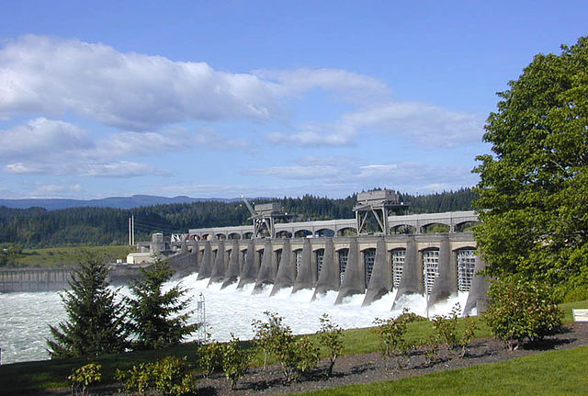
Grid operators use “ancillary service” products to help maintain the stability of the grid in the face of dips and surges in the balance of electricity demand and supply.
The traditional approaches: use the hydro system and/or natural gas-fired combustion turbine plants to ramp up or ramp down to match changes in energy demand. These present other significant problems.

Slide 17
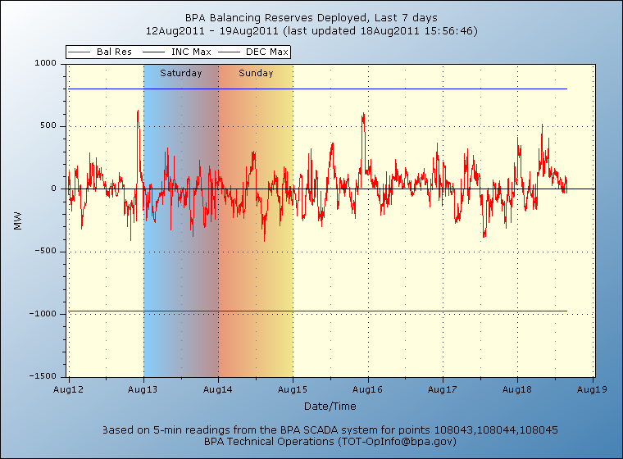
Federal Columbia Basin Hydro Resources Provide Substantial Balancing Services
Generating 1,000 MW of energy above minimum flows on light load hours just in case the wind picks up so hydro can back off to absorb it.
Can we do better?
Slide concept courtesy of Ken Dragoon, NWPCC

Slide 18
Federal Columbia River Hydro Resources Provide Substantial Balancing Services
Yes! Can and did. BPA holds roughly the same level of reserves today as a year ago, with about 33% more wind on the system.
But much more can be done!
Holding 800 MW of reserve generating capability on hydro system during the day (and night) in case wind falls off rapidly.
Can we do better?

Slide 19

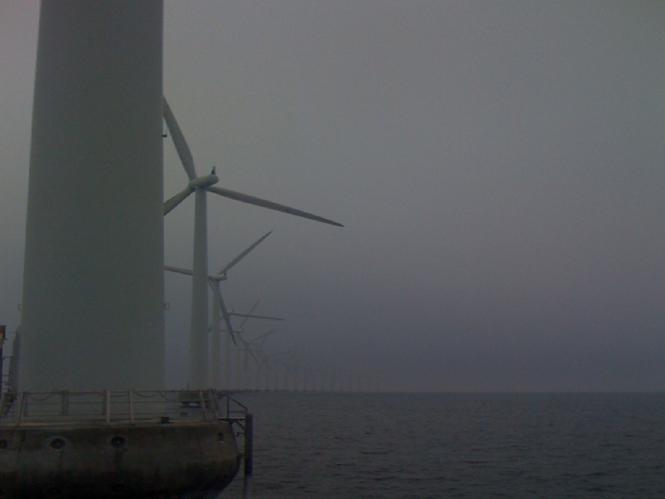
Time for a New Paradigm?
Denmark generates 20% of its generation from wind power, targeting 50% from wind by 2025.
Moving from a power system where supply responds to demand, to one where demand responds to supply
Henrik Bindslev, Risø National Laboratory

Slide 20
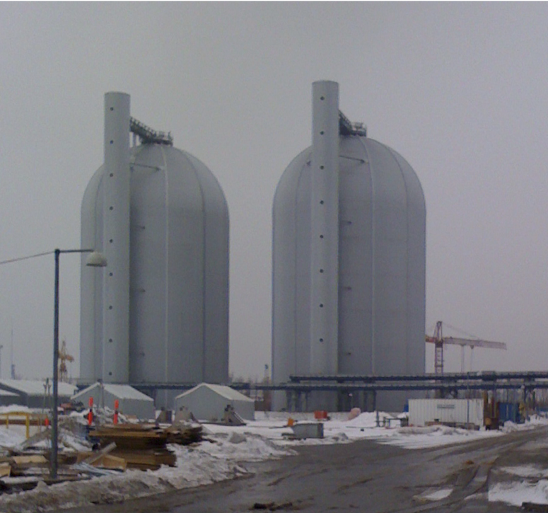
Avedøre District Heating Hot Water Storage Units
About 12 hours @570 MW of storage from the CHP plant serving Copenhagen.
Nearly 50,000 cubic meters of storage capacity.
Equivalent to storage capacity of a quarter million all-electric vehicles.

Slide 21
Can We Do the Same in the Northwest? Specific Details – No; Basic Approach - Yes
Northwest does have very little district heating
Seattle Steam >30 MW, university campuses, other cities, and military bases
We have large electric water heating loads
There are an estimated 4 million electric water heaters in the Northwest, representing 2,000 MW of load and perhaps 4,000 MW of decremental reserve capability.
We have other flexible loads that offer great potential
Cold-storage warehouses
Municipal water pumping, data servers, and more

Slide 22
Distributed Energy Resources & Smart Grid
DER Types
Distributed Generation(DG): backup generators, solar, biogas, small wind, small hydro, microturbines, CHP
Demand Response(DR): direct load control, critical peak pricing, smart appliances
Storage: batteries, EVs, thermal, pumped
Smart Switching
DER are adaptable to support variable supply

Slide 23
We Need to Test New Flexible Demand Response & Storage Strategies that are Enhanced by Smart Grid
Recruit power consumers who are willing and able to alter their electric loads to help provide balancing services.
Find creative ways to capture the inherent flexibility in activities and end-use loads that are part of a customer’s regular routine.
Provide customers with “opt-out” options.
Reward customers with financial and other incentives when they follow through and deliver cost-effective wind integration or other grid services.

Slide 24
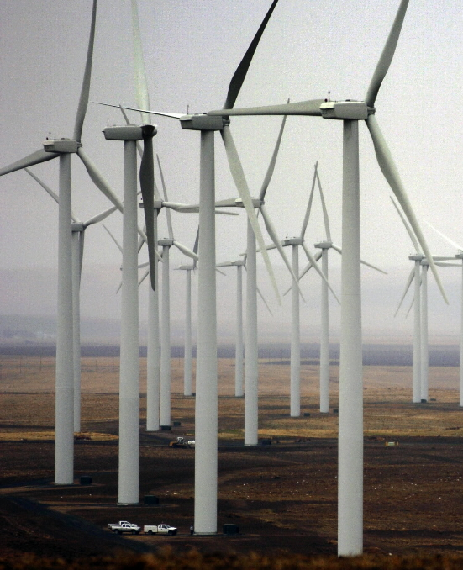
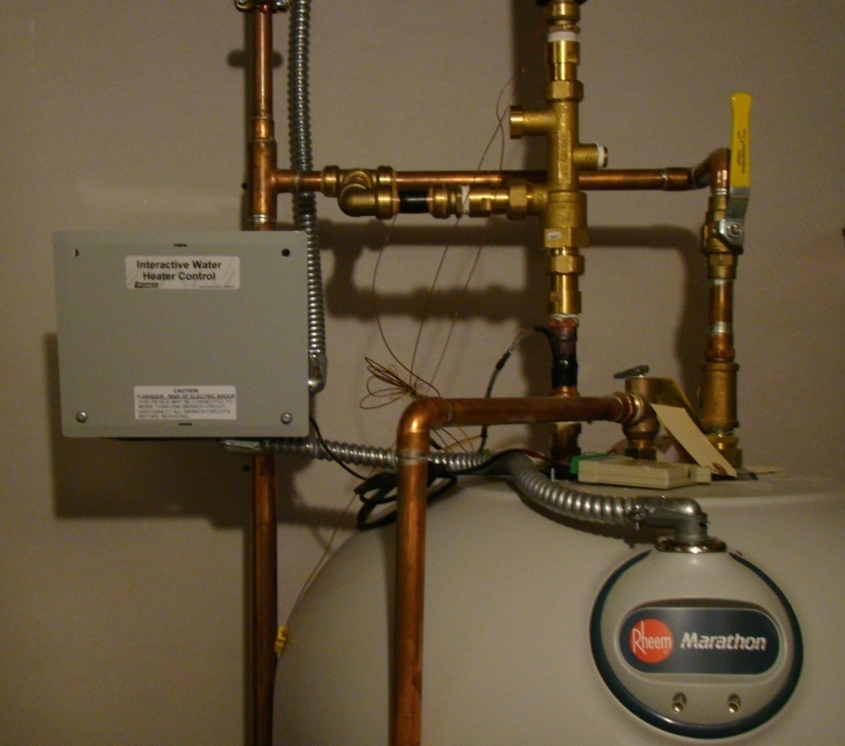
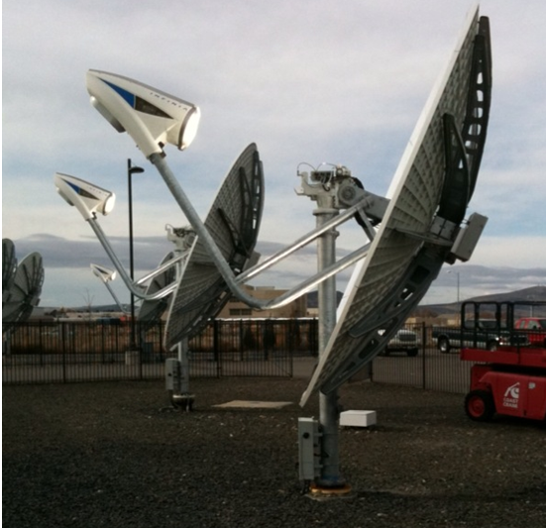
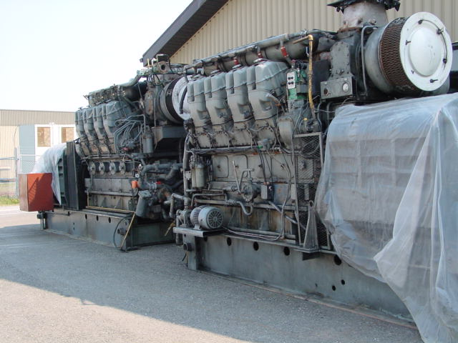
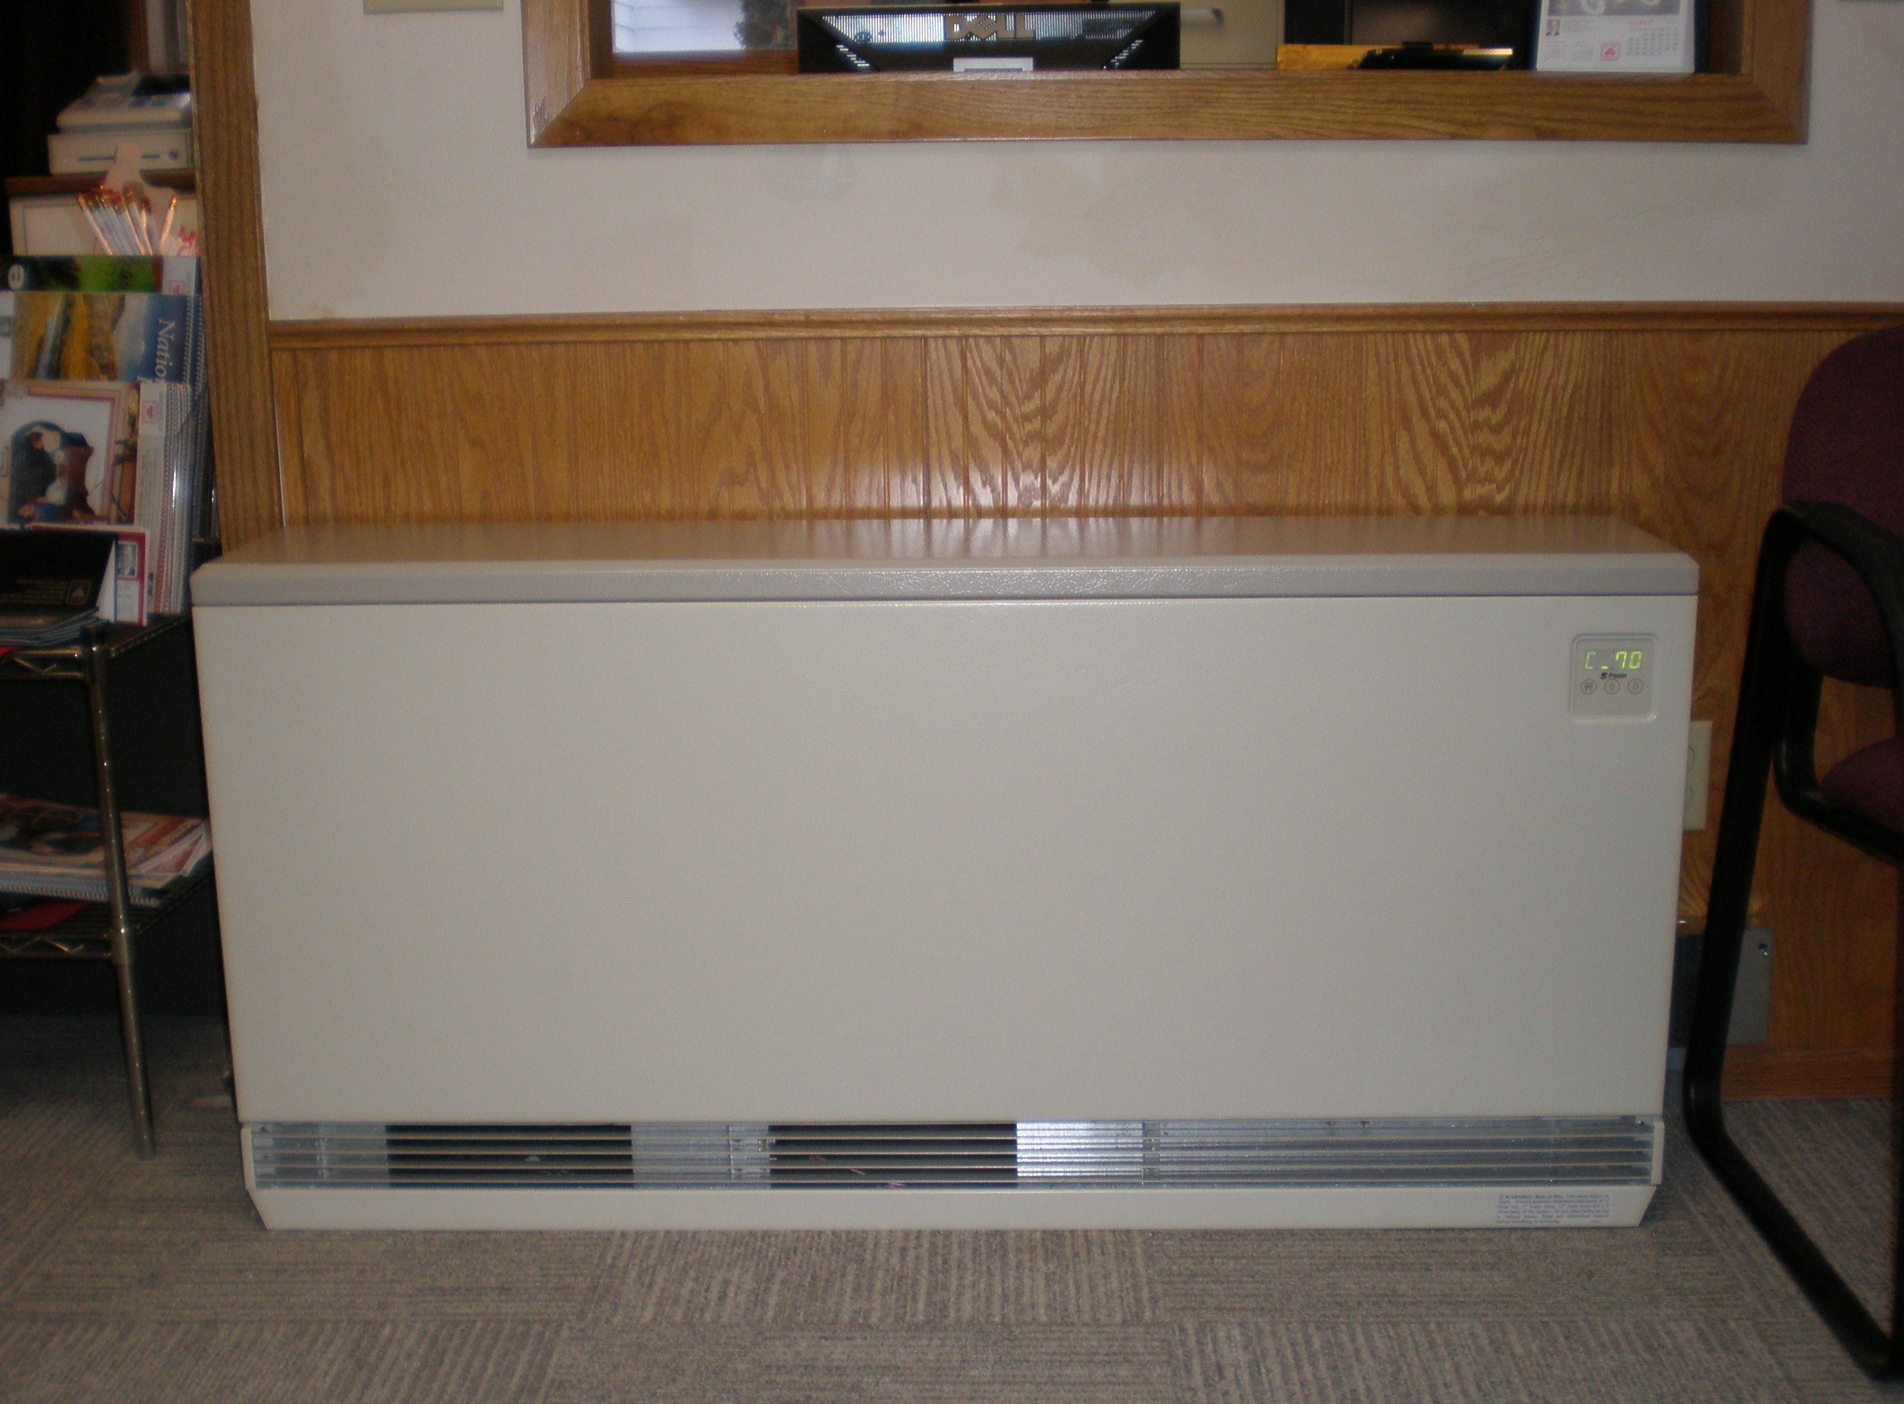
Testing Smart Grid & Demand Response
Utilities are testing: Can Reduced & Increased Load Support the “Integration” of Wind?
Electric water heaters (residential and commercial)
Cold storage
HVAC (thermostats)
Industrial processes (and electric boilers)
Irrigation
Municipal water pumps
Battery storage
Building energy management systems
Space heating (thermal storage)
In-home displays
Photos courtesy of BPA
© 2011 PGE

Slide 25
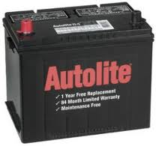
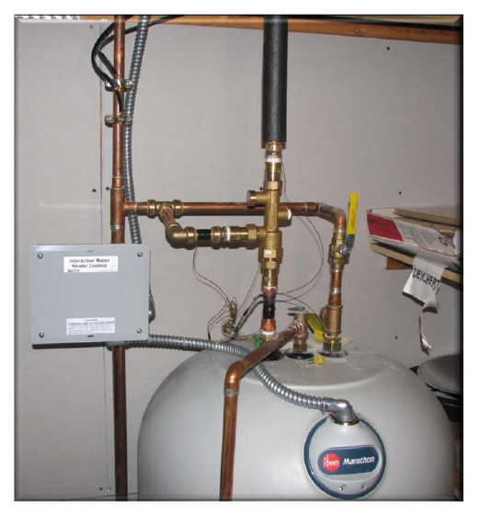
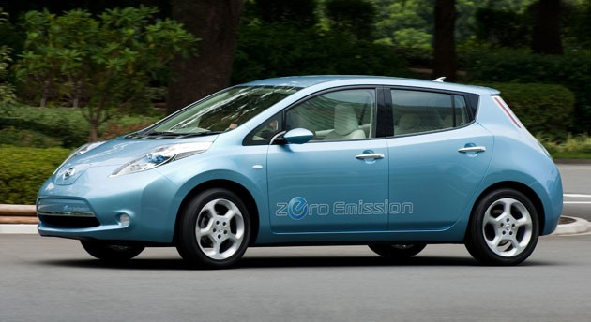
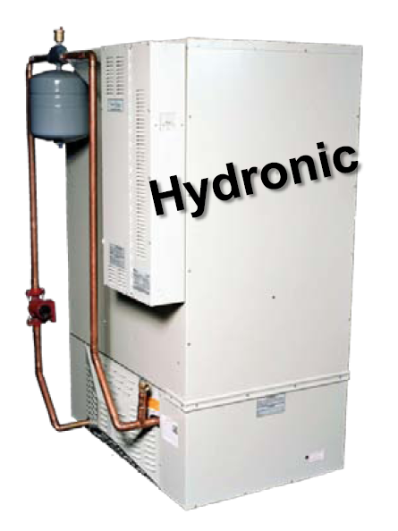
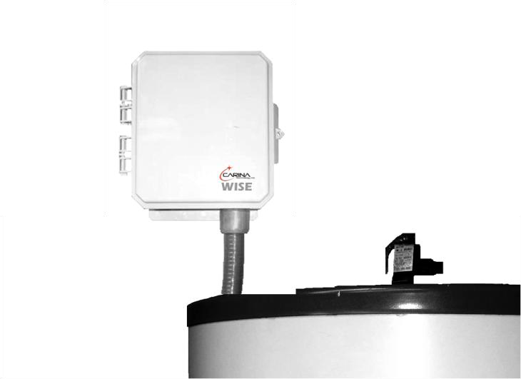
Examples of Residential End-Use Storage Options
Steffes controller on a 105 gal. water heater with a mixing valve for consumer safety. 26 kWh; cost $2,000; $77/kWh
Car Battery 1 kWh;
cost $100; $100/kWh
EV Car Battery
24 kWh; cost $9,500;
$395/kWh
Electric Thermal Storage Furnace “Rock Box”
240 kWh; cost $6,000;
$26/kWh
Carina controller on a 50 gallon heater
13 kWh; cost $500;
$38/kWh
Slide courtesy of EcoFys
Notes:
25
Normal thermostats in Marathon WH are rated to 150F.
Marathon warranties 170F,
Mixing Valve Honeywell, Steffes tests them before going out.
Normal 50 tank holds 8.3 kWh (120F),
50 gal tank holds (13 kWh (170F)
Normal WH stores 9 kWh,
170F 105 gal stores 26 kWh

Slide 26
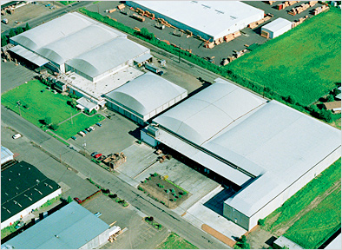
Example - Industrial Cold Storage Warehouse
5 facilities Total Peak Load of 4 MW, Freezer space 22-million cubic feet
Represents more than 1 million home freezers
Slide courtesy of EcoFys
Notes:
26

Slide 27
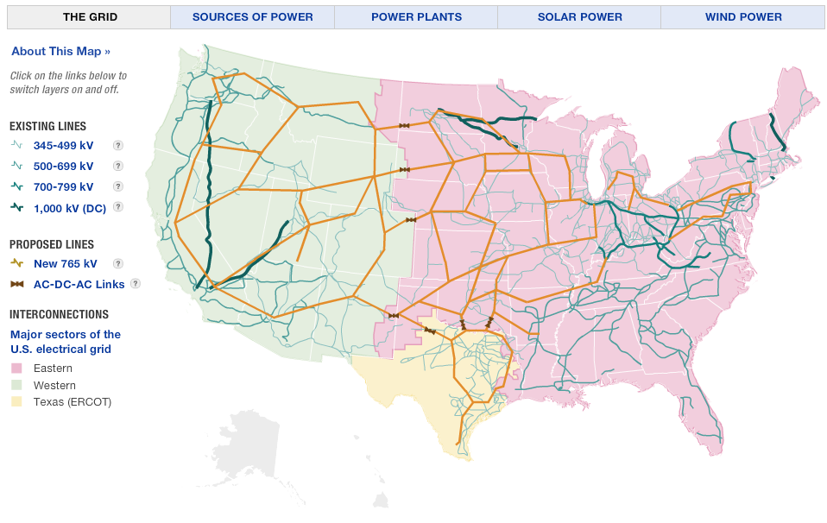
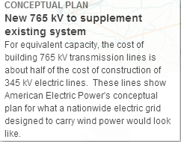
Proposed New Transmission ”Super-Grid” for Wind

Slide 28
Typical NW Utility Daily Load Shape

Slide 29
Base Load & Peaking Generation Design
Peaking
Peaking
Base Load

Slide 30
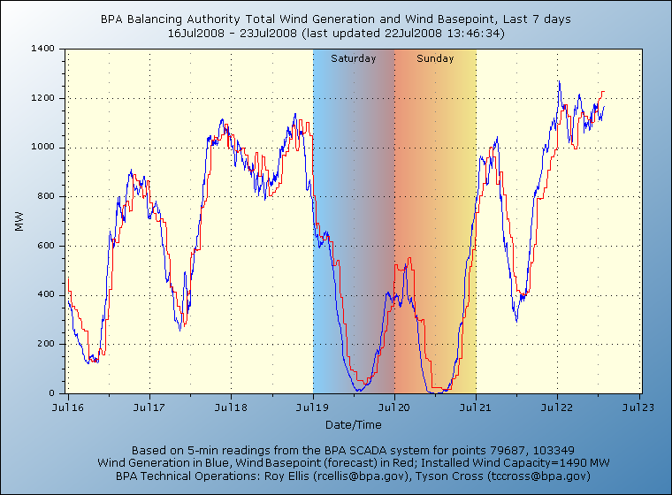
Wind Production – 2700 MWs in PNW

Slide 31
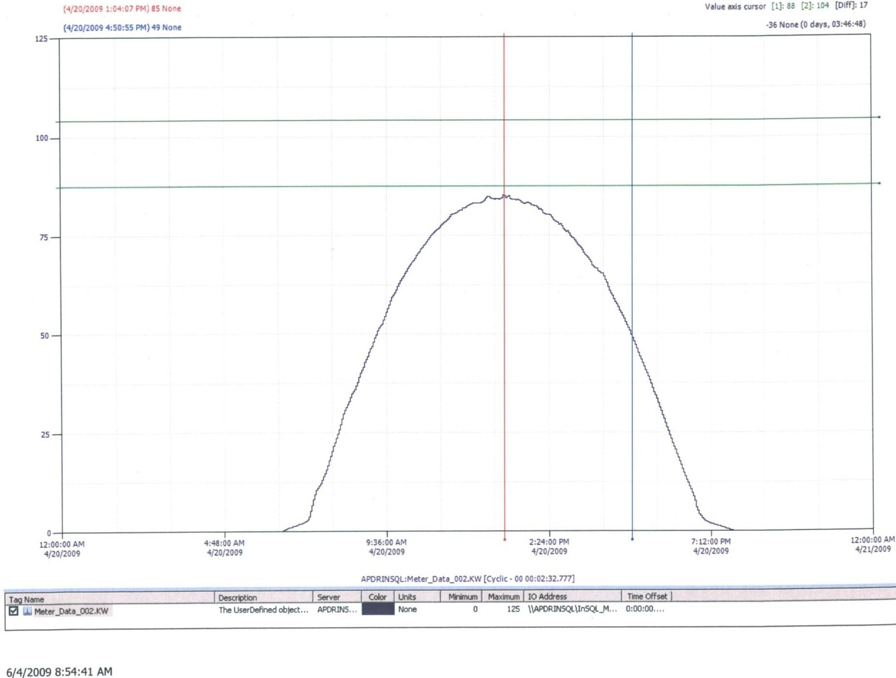
Ideal Solar Production Curve

Slide 32
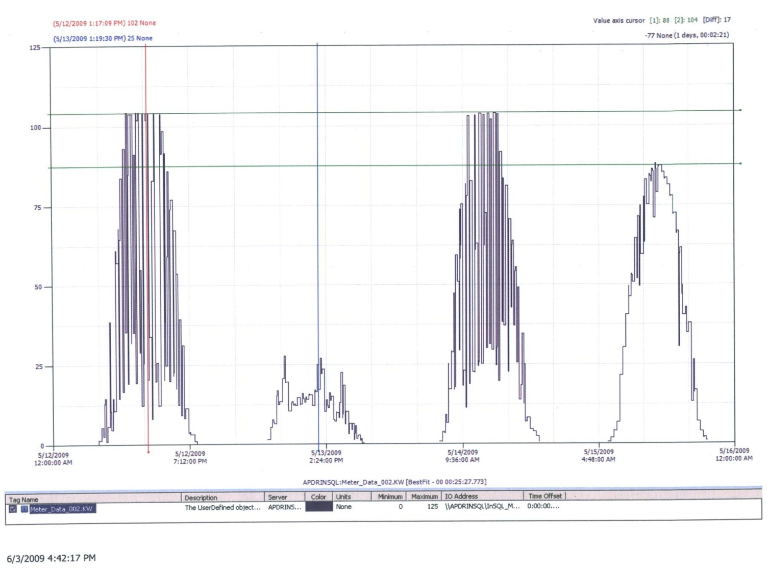
Northwest Typical Production

Slide 33
Daily Load & Solar Don’t Match

Slide 34
Smart Grid Technique #1 “Storage”

Slide 35
Smart Grid Technique #2

Slide 36
Smart Grid Technique #2 Demand Response

Slide 37
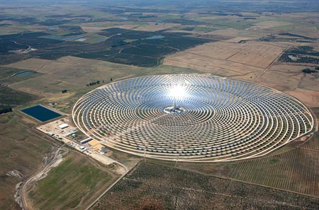
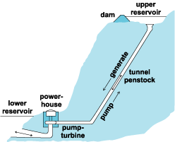
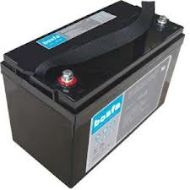
Practical Types of Energy Storage
Thermal energy storage technology involves two separate types:
End-use thermal energy storage reduces the electricity consumption of a building’s heating or air conditioning systems during periods of peak energy demand by using hot or cold storage in underground aquifers, ice tanks, water heaters or other storage materials.
Solar thermal energy storage for solar thermal power plants involves heating synthetic oil or molten salt using solar energy. Once the substance heats, it can support electricity generation during cloudy periods and up to 10 hours past sunset.
Pumped Hydro - typically involves pumping water from a low-lying reservoir during periods of low demand for electricity, typically at night, to a higher-elevation reservoir or lake. (Largest US: Bath County Virginia 3,003 MW & Ludington Michigan 1,872 MW)
Compressed air energy storage (CAES) utilizes electricity to inject high-pressure air into underground geologic cavities or aboveground containers.
Rechargeable Batteries represent the most commonly-recognized type of energy storage and are seeing the most growth and investment. Batteries use a reversible chemical reaction to store energy. Several different types of large-scale rechargeable batteries exist, including sodium sulfur (NaS), lithium ion, lead acid, and flow batteries.

Slide 38
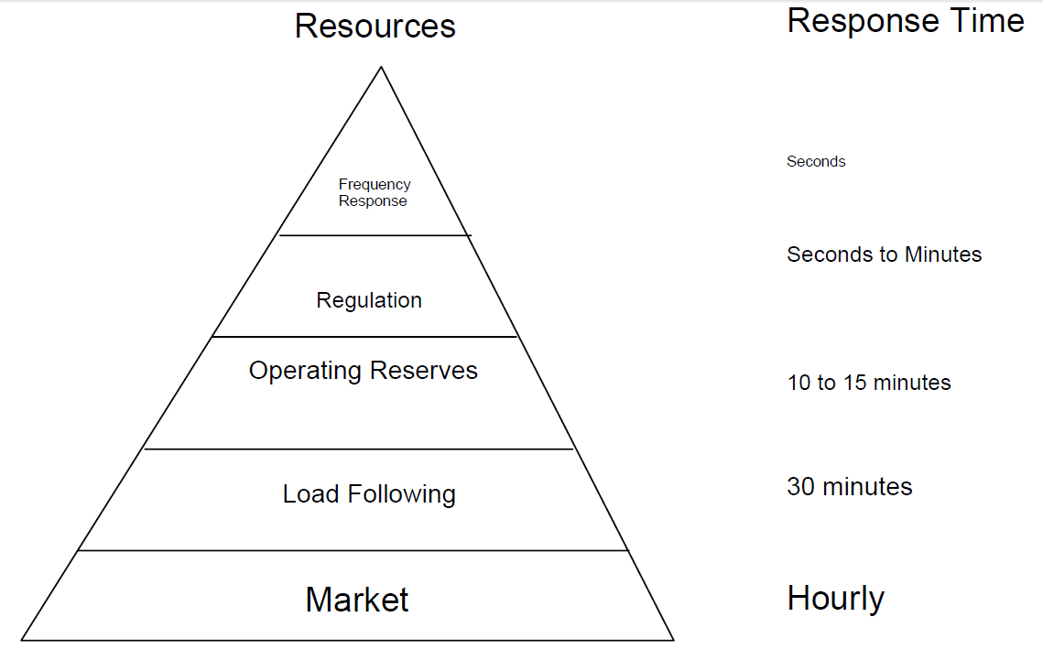
Energy Storage Uses
Peak Load Reduction – Operate as a peaking plant
Energy Shifting – Store wind when it blows, generate when wind stops
Energy Shaping – Reduces large swings that occur with wind and solar
HRZ Creation – Supports microgrid by providing ride-through
Real-time Load Balancing
Source: North American Reliability Council, Frequency Response White Paper

