Slide 1
Module 2 Introduction and Overview
This module will provide an overview of and introduction to Smart Grid. It will:
Introduce many definitions
Examine why its definition is being contested
Introduce the key characteristics and benefits
Examine the key reasons behind Smart Grid development
Include examples primarily from the Pacific Northwest
Notes:
Here is what I plan to cover in this module. As you can see, it will demonstrate that there are multiple definitions of the Smart Grid.
It will offer some important and representative definitions of the Smart Grid.
We will explore why the definition is being contested by different stakeholders.
It will introduce some of the key characteristics and benefits of the Smart Grid that were developed by a team of experts assembled by the US Department of Energy.
It will spend quite a bit of time examining many of the key reasons for the development of the Smart Grid in recent years.
And, as will often be the case in this training, it will draw primarily on examples from the Pacific NW region. After all this training is funded by the Pacific Northwest Center of Excellence for Clean Energy. The faculty live and work in the Northwest and we will assume that at most of our audience does too.

Slide 2
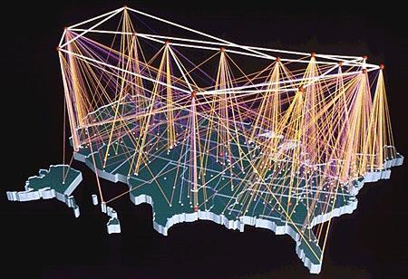

Smart Grid May Transform the Electricity Industry
Notes:
Some of you may remember the telecommunications industry around 1980. I do, and I can tell you:
The phone booth was a ubiquitous feature of the American landscape, a stationary symbol of an industry legendary for its reliability. In those days, about the only way to make a phone “portable” was to pull it out of the wall.
Innovation – if you could call it that –involved having a choice of the regular big black phone, something called the slim-line phone, Princess phone, the Mickey Mouse phone & not much more.
And customer choice was a matter of what weekend you chose to make that slightly cheaper long-distance call to relatives.
When Congress passed the Telecommunications Act of 1996 it established a national policy framework designed to accelerate private sector deployment of advanced information technologies and services. As a result, the telecommunications industry was transformed.
Communications became digitized, markets were created, innovation encouraged, and a new era of customer empowerment and choice inaugurated.
The potential exists for a similar transformation and opportunity in the provision of electricity embodied in a set of concepts, business models, and technologies that are increasingly referred to as the Smart Grid.

Slide 3
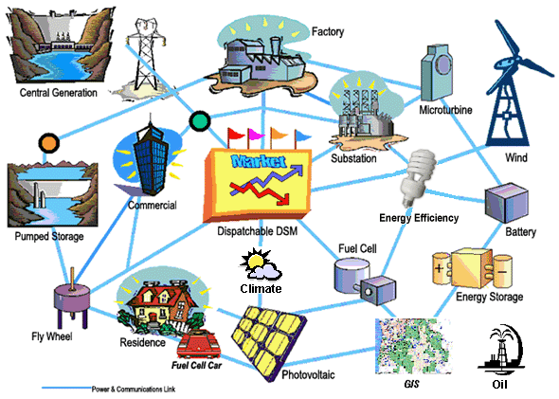
An Early Depiction of the Smart Grid (which BPA called the “Energy Web”)
Source: BPA
Notes:
One might think with all the talk about, and money being spent on the Smart Grid, there would be a pretty clear understanding, at least among the experts, about what the Smart Grid is and what it is not.
In fact, this is not the case.
Almost every evening before I offer a Smart Grid training class of any sort, I visit the modern day source of conventional wisdom known as Wikipedia and check out the article on the Smart . That article has changed dramatically over the last five years, but it has always begin with a bold heading that says something like “the neutrality of this definition and this article is in dispute.”
I just checked today and found, to my amazement, that the warning is no longer there. However, early on, the article notes that “there are many smart grid definitions, some functional, some technological, and some benefits-oriented.”
It goes on to say that the origin of the term is still in dispute. Some say the first time it was used was, at least in a professional article, was in 2005 piece in the IEEE Power & Engineering Magazine. That article, titled “Toward a Smart Grid” was written by two professors of professor of electrical and computer engineering at the University of Minnesota, by the names of S. Massoud Amin and Bruce Wollenberg . It is included in your list of references.
That may be true, but I know the concept of what we now call the smart grid has been around much longer than that. I was first introduced to the concept in 1996 or 97 by some friends and innovative thinkers at the Bonneville Power Administration. They called it the “energy web” at the time and the basic concept of all grid resources being intelligent and communicating with one another is central to our understanding of the Smart Grid today. ” That depiction
evolved and matured over time.
This slide shows an early depiction of the “Energy Web” that is still available in the achieves of BPA’s website.
There are several reasons for the fact that the definition of the Smart Grid is in dispute.
First, the Smart Grid is still fairly new, amorphous, and different, and thus hard to define. In fact, attempting to define the Smart Grid at this still early stage is almost the equivalent of trying to define the Internet before we had web browsers. We do have a vision and a general idea, but we are bound to be wrong in many respects when we project very far in the future. Certainly we will be wrong about at least the details.
Second, the development of the Smart Grid and related concepts such as Demand Response, Distributed Generation, and Storage, is likely to involve many hundreds of billions of dollars How it is defined matters to the utilities, technology providers, regulators, environmental groups, consumer advocates, policy makers and other stakeholders.
Why? Because how you define the problem influences the range of viable solutions to the problem. So the definition of the Smart Grid and the problems it is expected to solve is being contested by the stakeholders themselves. Stakeholders want the problem defined in a way that enhances the prospects of their preferred solutions to the problem.
Third, the Smart Grid is relatively cool, sexy, and lucrative right now. Maybe not as much as it was four or five years ago, but it still pretty darn cool. Then Presidential candidate Obama talked about the Smart Grid on The Tonight Show with Jay Leno. He helped put the Smart Grid on the national agenda. What’s more, $3.4 billion in federal government grants were authorized and set aside for the Smart Grid through the American Recovery and Reinvestment Act of 2009 (often called the Stimulus Act, Naturally, entrepreneurs want their technology or application to be viewed as falling under the Smart Grid so they have a better chance at receiving access to federal grants or private capital.
As a result, it is not surprising that several years ago, the Electric Power Research Institute, which provides R&D support for the electric utility industry, identified at least 80 different definitions of the Smart Grid in the professional literature. I suspect there are even more definitions today.

Slide 4
Congress Tried a “Functional” Definition
Smart Grid includes:
Optimizing grid operations and resources to reflect the changing dynamics of the physical infrastructure and economic markets.
Cyber security
Using and integrating distributed resources, demand-side resources, and energy efficiency resources.
Deploying smart technology for metering.
Communications of grid operations and status.
Distribution automation
Integrating “smart” appliances and other consumer devices.
Deploying and integrating advanced electricity storage and peak-shaving technologies.
Transferring information to consumers in a timely manner to allow control decisions.
Developing standards for the communication and interoperability of appliances and equipment connected to the electric grid.
Identifying and lowering barriers to adoption of smart grid technology, practices, and services.
Notes:
4
In 2007, Congress passed the Energy Independence and Security Act, and in that law, Congress called for the development of a Smart Grid.
Congress had no more idea than the rest of us about Smart Grid would look like, so it did its best to provide a functional definition of what the Smart Grid should do.
It is a fairly impressive definition since it provides a reasonable general vision, but Congress realized that the definition would need a lot more work as the concept evolved.

Slide 5
What is Smart Grid? The definition is being contested Here are five representative definitions
Smart Grid is:
The overlaying of a unified communications and control system on the existing power delivery infrastructure to provide the right information to the right entity (e.g., end-user devices, T&D system controls, customers, etc.) at the right time to take the right action.
- Electric Power Research Institute (EPRI)
Notes:
So since the definition of the Smart Grid is still in dispute, I have decided to select 5 representative definitions that will give you a sense of some of the competing definitions.
This one is from the Electric Power Research Institute (EPRI). I mentioned earlier that EPRI in an independent, nonprofit organization that conducts research, development and demonstration (RD&D) relating to the generation, delivery and use of electricity. Most of its members are electric utilities, so it should not be surprising that this definition keeps the electric utilities in the drivers seat. It is a perfectly reasonable definition but it also a “utility-centric” definition.

Slide 6
Smart Grid is:
2. The application of digital information technology to the electric power grid to optimize power generation, delivery, and use.
Smart Grid employs digital technology in three ways:
Intelligent devices monitor and measure what is going on;
Two-way communications allows those devices to talk to each other and to the control center;
Advanced control systems let computers make low-level decisions automatically while allowing human operators to visualize and control large areas from a central station.
-Jesse Berst, founding editor, Smart Grid News
Notes:
This definition comes from Jesse Berst, the founding editor of Smart Grid News, a vital and free source about the Smart Grid that is available on the Internet. Earlier in his career, Jesse was a featured columnist at leading computing magazines, including Computerworld, Computer Reseller News, InformationWeek and PC Week and authored or co-authored ten books on personal computing and software
In my opinion, his excellent definition emphasizes the IT and digital side of the Smart Grid,

Slide 7
Smart Grid is:
The transformation from a centralized, producer-controlled network to one that is less centralized and more consumer-interactive. The move to a smarter grid promises to change the industry’s entire business model and its relationship with all stakeholders, involving and affecting utilities, regulators, energy service providers, technology and automation vendors and all consumers of electric power.
-U.S. Department of Energy
Notes:
This is one of several definitions of the Smart Grid from the US Department of Energy. It focuses more on the potential transformative power of the Smart Grid. It emphasizes what it calls the transformation from a centralized utility-controlled model to one that is more decentralized and more consumer-interactive. It talks about changing the industry’s entire business model. One could say it is very optimistic and “Obamaesque” in its vision.

Slide 8
Smart Meters are:
4. … expensive devices that allow electric companies to track and control electricity usage in an individual household…Many consumers believe the meters are inaccurate, or that their usage data is not being transmitted correctly…Utilities will encourage customers with smart meters to sign-up for high “time of use” rates in order to reduce peak demand.
- The Utility Reform Network
Notes:
This definition comes from The Utility Reform Network, or TURN, a utility watchdog and consumer advocacy organization that is a formidable advocate on behalf of utility ratepayers in California, especially those from low-income underserved communities. I could not find a definition of the Smart Grid on TURN’s website, but I did find this not very flattering definition of smart meters which connect customers to the rest of the Smart Grid.

Slide 9
Smart Grid is:
5. The Energy Internet: When ET meets IT.
In my vision, Smart Grid would be:
…like nothing you have ever seen or experienced before. It would feel like all the power systems in your home or business were communicating with all the information systems, and that they had all merged into one big seamless platform for using, storing, generating, and even selling clean electrons.
It would feel like the information technology revolution and the energy technology revolution, IT and ET, had merged into a single system. It would feel like you’re living with an “Energy Internet.”
-Thomas Friedman, Pulitzer Prize winning columnist, chapter 10 of Hot, Flat and Crowded, 2008
Notes:
This is my favorite definition. It comes form one of my favorite authors and columnists, Thomas Friedman, and can be found in his excellent book, Hot, Flat and Crowded, published in 2008. It is worth reading carefully, but I will let you do it when it suits you. I have often cited Friedman’s definition as a good place to start when asked by reporters or others do define the Smart Grid – “The Energy Internet: where energy technology (ET) and and information technology (IT) merge into a single system. “ A brilliant use of words.

Slide 10
What is Smart Grid?
It is not a “thing” or an end-state.
It is a combination of values, characteristics, concepts, technology, and business models that many believe will enable society to move toward a new “vision” of the electric grid.
It involves the application of digital processing communications, and control to the power grid.
It uses digital information technology to support two-way or multiple-way flow of electrons and information.
It will support and enable technologies and objectives that will benefit consumers, utilities, society, and the environment.
Smart Grid is also about a “process” or a “journey” that will proceed over several decades.
- Jeff Hammarlund
Notes:
I am not going to let myself of the hook completely. I will try to offer my own best definition at the moment even though it continues to evolve.
I see the Smart Grid not as a thing or an end state but as a process of journey that will proceed over decades. You might say it is as much a verb as a noun. The current grid is a technological marvel that is far from dumb. But it is getting smarter and will continue to do so in ways we have only begun to imagine.
Technological innovation is key to the development of the Smart Grid but there is much more to it than technology. The Smart Grid involves the blending of values, characteristics, concepts, new business models, and new technologies that many believe will enable society to move toward a new vision on the electric grid.
It certainly involves the application of digital processing, communications, and control to the grid. And it does so by using digital information technology to support two-way and even multiple-way flow of both electrons and information.
It advocates are convinced it will support and enabler technologies and objectives that will benefit consumers, utilities, society as a whole, and the environment.
When I am in a reasonably optimistic mood, I can buy into that vision. I can see it as the “great enabler” since it certainly has the potential to enable and support many benefits that society seems to want. It can make energy efficiency programs more effective. It can support the integration of intermittent and less predictable wind and solar energy, it can enhance energy storage, and even though the Smart Grid is “fuel blind, it can reduce the need for natural gas fired “peaker” plants and their resulting carbon emissions.
When I am feeling less sanguine about our ability to get our collective act together, when I question our ability to use technology wisely to benefit rather than exploit humanity and the environment, my enthusiasm for the Smart Grid tends to wane.
I wish you could tell me what you think about the Smart Grid at this point. Maybe some other time.

Slide 11



Smart Grid Also Involves Merging Two Different Infrastructures and Cultures
Electrical Infrastructure
“Intelligence” Infrastructure
Notes:
11
One thing is clear: the Smart Grid requires collaboration among two very different industries or infrastructures.
The electrical infrastructure, whose dominant players are the electrical utilities. Traditionally, electric utility industry has been quite conservative and risk-adverse. This is very understandable given the fact that it is a closely regulated industry whose number one priority is to ensure a stable and reliable system that will keep power flowing and the lights on.
And the intelligence infrastructure dominated by the IT companies that are, by nature, much more entrepreneurial, competitive, and willing to take risk even if this involves backing out of some dead ends and trying something else.
Watching these two industries try to dance together, as they must for the SG to develop, has been interesting.

Slide 12
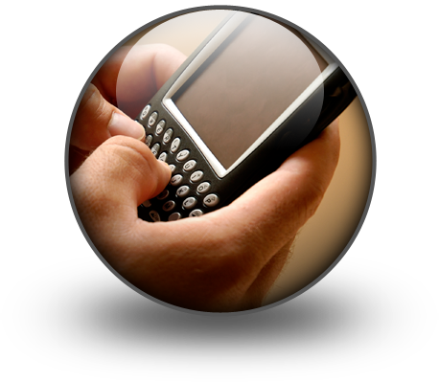
What’s so Smart about a Smart Phone?
Reservoir of
useful information
#1
Reservoir of
useful information
#2
One or More
Reservoirs of
Information
Ubiquitous Communication Connectivity
An Application
A Timely, Informed Decision !
A User Interface
Notes:
Now it is your turn to speak. What is the difference between a Smart Phone like the one I have in y right hand and my old “clam-shell” shaped cell phone like the one I have in my left hand ( come on, use your imagination!)
Write down a couple of phrases.
Some people respond that the key difference is all the applications that are available with the Smart Phone. These apps connect you to many different reservoirs of information that stored somehow in “the cloud’ but can reach you almost instantaneously. So you can quickly find out what the top rated pizza joint in a given neighborhood is no matter what city you are visiting.

Slide 13
Example of a Smart Grid App
Reservoir of
your meter
information
Reservoir of
your home
Information
*
*
Ubiquitous Communication Connectivity
*
*
App detects abnormal appliance usage
*Just one catch; no standards exist for access to this information
An Application
Timely, report of broken appliance !
A User Interface
Notes:
The same principle applies to the Smart Grid. If, for example, one of your home’s or facilities’ major electric appliances goes haywire and starts using electricity when it should be off, that information can be sent to the cloud, compared with your typical meter data, and you can get a valuable warning, or perhaps the appliance’s settings can be adjusted remotely or, if appropriate, the appliance can be turned off entirely.
The catch is that for this and hundreds of other examples to work, new standards need to be developed to ensure that all parts of the system can communicate with each other. Those standards are under development but it takes time and it is now easy to get everyone on the same page. We want to get to “plug and play” interoperability mode but we are not there yet. We will also need a lot more apps than we have now.

Slide 14
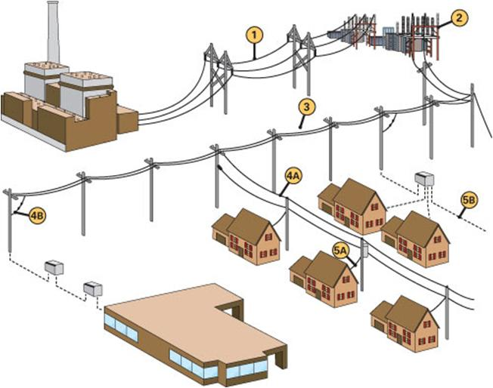
The Traditional Electric Grid
Central station power plants
Low load factor
Consumers don’t see real price of energy
Lower energy efficiency, renewable energy, and distributed resource integration
Notes:
The traditional grid is certainly not dumb. It does a lot of things very well, but it is based on 20th century design requirements. It matured in an era when expanding the grid in one was the only option, and visibility within the system was limited. Historically, the traditional grid has had one overriding mission: keep the lights on in a way that is safe and reliable.
Among its deficiencies: it relies on central station power plants that are more vulnerable to terrorist attack, it tends to promote a low load factor, meaning that there are more peaks and valleys in consumption patterns and utilities need to set aside more “peaker” plants that they must service and maintain but may use only 5% or the time or less.
Consumers aren’t given accurate information showing then that is costs much more to generate electricity during times when everybody else wants it (peak periods) and that it cost much less to generate during periods of low electricity consumption when it can be produced entirely by base-load plants that are essentially always running.
Cost-effective energy efficiency is not being fully realized, renewable energy is not being supported and integrated into the grid, and distributed resource options are not being tapped.

Slide 15
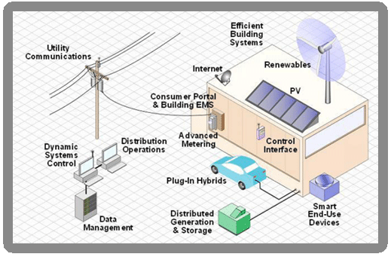
One Conception of a Local Smart Grid Network
Notes:
The Smart Grid is expected to integrate generation from both directions – home or business and central station plant – and move it as needed to meet load, while incorporating solar panels, wind farms, fuel cells, plug-in hybrid electric vehicles, and other energy sources. Perhaps my two favorite features of the SG are these:
it enables customers to be part of the solution on some important societal problems (starting with reducing the need for utilities to build fossil-fuel fired peaking plants) and
it provides a way for customers to be rewarded financially if and when they decide to be a part of the solution.

Slide 16
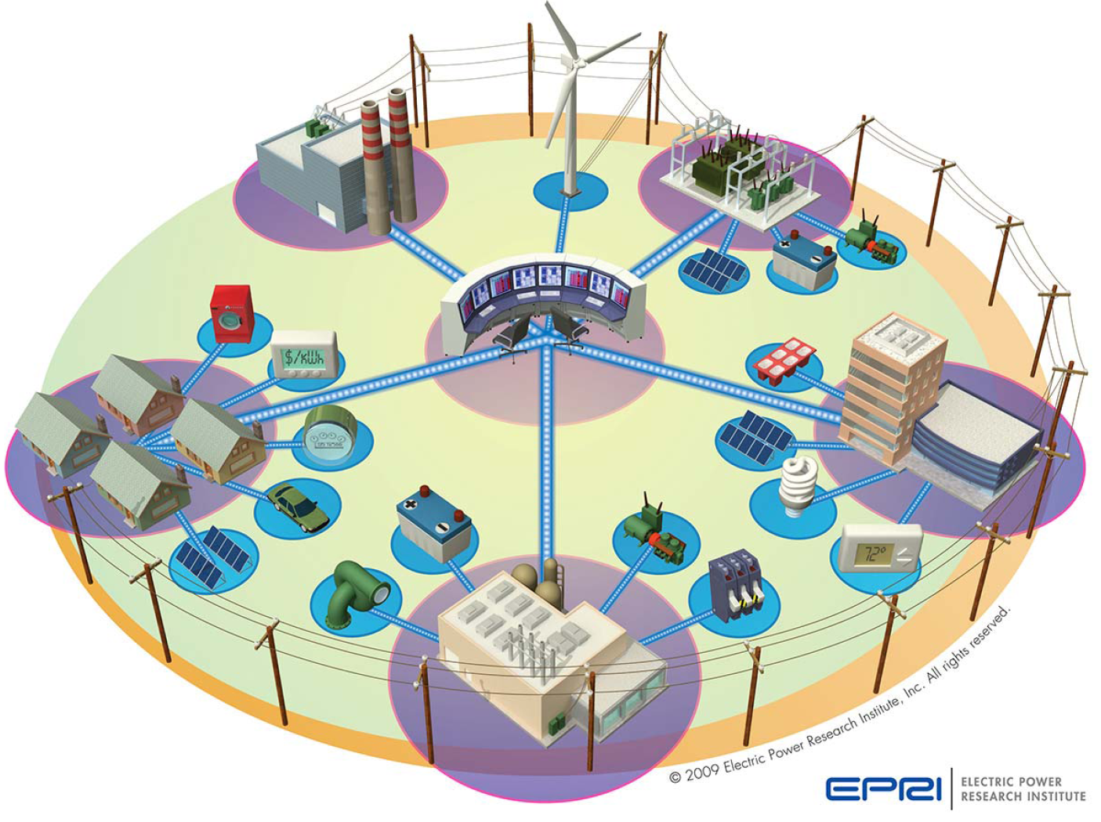
One Conception of a Smart Grid Community
Notes:
The Smart Grid will involve many customers or users, each with their own electric power needs, and with different ways they can contribute through demand response, distributed generation, and power storage programs. The SG will help determine the most efficient way to distribute the power that each customer generates or uses.

Slide 17
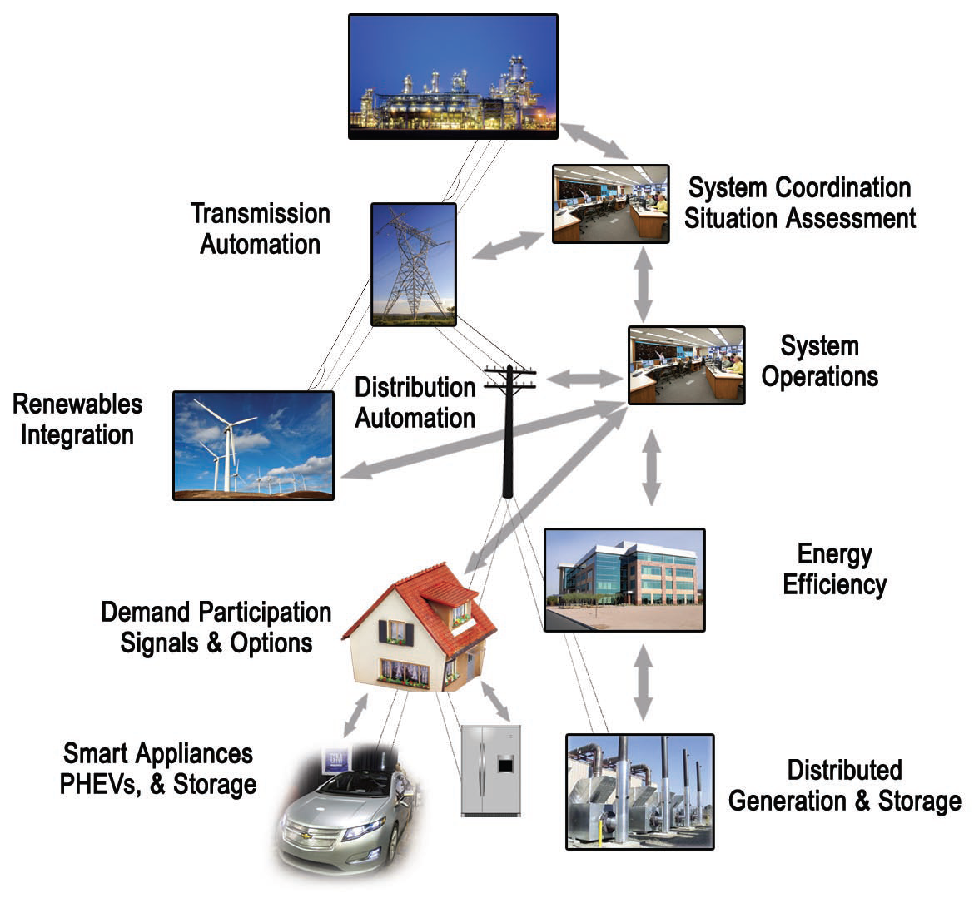
The Broad Scope of Smart Grid
Source: U.S. DOE, Smart Grid System Report, 2009
Notes:
Most experts agree that is helpful to view the Smart Grid as consisting of three distinct components:
1. An interstate transmission “sustainable transmission grid” that will transport clean utility- scale renewable energy long distances to market,
2. A digital “smart distribution grid’ to deliver this electricity efficiently to local consumers; and
3. On-site resources located at your business, school, or residence. These resources could include Smart appliances and other electrical devices that can be cycled on and off based on price-signals that reflect the actual cost of power at a particular moment. They could also include on-site renewbles, micro-turbines, or generators that are often called distributed generation.

Slide 18
Potential Entry of Smart Grid Applications Over Time
Today
Advanced Meter Infrastructure (AMI)
Demand response
Grid optimization and distribution automation
Distributed generation and storage
Smart charging of PEVs and integrated vehicle-to-grid (V2G) systems
Advanced utility control systems, future applications and services (portals, markets)
Tomorrow
Notes:
This is my best guess of how different Smart Grid “applications” will emerge over time. Time will tell whether I am right or not.

Slide 19
Key Characteristics of Smart Grid
Enables active participation by consumers.
Accommodates all generation and storage options.
Enables new products, services, and markets.
Provides power quality for the digital economy.
Optimizes assets and operates more efficiently.
Anticipates and responds to system disturbances (self-heals).
Operates resiliently against attack and natural disaster.
Notes:
This seven characteristics of a smoothly functioning the Smart Grid was developed by a team of experts assembled by the US Department of Energy and published in aDOE document called What Is the Smart Grid. It is worth taking some time to understand these so here goes.
First, it will enable active participation by consumers.
The smart grid will give consumers information, control, and options that enable them to engage in new “electri- city markets.” Grid operators will treat willing consumers as resources in the day-to-day operation of the grid. Well- informed consumers will modify consumption based on the balancing of their demands and resources with the electric system’s capability to meet those demands.
Second, it will accommodate all generation and storage options. It will seamlessly integrate all types and sizes of electrical generation and storage systems using simplified interconnection processes and universal interoperability standards to support a “plug-and-play” level of convenience. Large central powerplants including environmentally friendly sources, such as wind and solar farms and advanced nuclear plants, will continue to play a major role even as large numbers of smaller distributed resources, including Plug-in Electric Vehicles, are deployed.
Third, it will enable new products, services, and markets. The Smart Grid will link buyers and sellers together – from the consumer to the Regional Transmis- sion Organization. It will support the creation of new electricity markets from the home energy management system at the consumer’s premise to technologies that allow consumers and third parties to bid their energy resources into the electricity market. The Smart Grid will support consistent market operation across regions.
Fourth, it will provide power quality for the digital economy. It will monitor, diagnose, and respond to power quality deficiencies resulting in a dramatic reduction in the business losses currently experienced by consumers due to insufficient power quality.
Fifth, it will optimize asset utilization and operate efficiently. Operationally, the Smart Grid will improve load factors, lower system losses, and dramatically improve outage management performance. The availability of additional grid intelligence will give planners and engineers the knowledge to build what is needed, when it is needed, to extend the life of assets, to repair equipment before it fails unexpectedly, and to more effectively manage the work force. Operational, maintenance, and capital costs will be reduced thereby keeping downward pressure on prices.
Sixth, it will anticipate and respond to system disturbances (self-heal). It will heal itself by performing continuous self-assessments to detect and analyze issues, take corrective action to mitigate them and, if needed, rapidly restore grid components or network sections. It will also handle problems too large or too fast-moving for human intervention.
And finally seventh, the Smart Grid will operate resiliently against attack and natural disaster. The Smart Grid will incorporate a system- wide solution that reduces physical and cyber vulnerabilities and enables a rapid recovery from disruptions. Its resilience will create an image that intimidates would-be attackers. It will also be less vulnerable to natural disasters

Slide 20
Expected Benefits of Smart Grid
The U.S. Department of Energy believes Smart Grid will provide major improvements over the traditional grid in six key areas:
More reliable
More economic
More environmentally
friendly
More secure
More efficient
Safer
Notes:
The Department of Energy team also developed this list of six ways the Smart Grid is expected to provide major improvements of the traditional grid. I will explain what I think they meant by each of these benefits.
First, enhanced reliability.
There have been five major blackouts in the US over the past 40 years, three of which have occurred in the past 10 years. More blackouts and brownouts are occurring due to the slow response times of mechanical switches, a lack of automated analytics, and “poor visibility” – sometimes called a “lack of situational awareness” on the part of grid operators.
This issue of blackouts has far broader implications than simply waiting for the lights to come on.
Think:
plant production stopped,
perishable food spoiling,
traffic lights dark,
and credit card transactions rendered inoperable.
In many areas of the country, the only way a utility knows there’s an outage is when a customer calls to report it.
The Smart Grid is expected to enhance reliability by reducing outage duration and frequency and improving power quality.
Second, provide economic benefits.
With advanced components and widespread communication supporting market operations and providing full visibility of data to all, a smarter grid is expected to create and support new and more robust electricity markets. It should encourage new market participants, enabling a variety of new load management, distributed generation, energy-storage, and demand response opportunities.
Two-way communication between buyers and sellers should help reduce grid congestion and unplanned outages, and help establish the real price for electricity at different times during the day.
The Smart Grid is also expected to support more customer choice and control. For example:
•Two-way communication between customers and utilities should give customers the ability to see what electricity they use, when they use it, and how much it costs.
• Time-varying pricing signals should allow customers the option to participate in new power markets based on clear supply and demand prices.
And, if they prefer, customers will still have the option of simply setting their controls at pre-determined levels and going about their business as usual.
Third, more environmentally friendly.
According to estimates from the DOE funded Pacific Northwest National Lab, the Smart Grid is likely to decrease annual electric energy use and utility sector carbon emissions at least 12 percent by 2030.
The report shows a direct link between the smart grid and carbon emissions. It evaluates how different functions of the smart grid could provide substantial reduction in energy use and carbon emissions - both directly by using new technology and indirectly by making renewable energy and efficiency programs more affordable and potentially larger.
According to the report, by fully utilizing a Smart Grid, the nation could prevent the equivalent of 442 million metric tons, or 66 typical coal power plants' worth, of carbon emissions from entering the atmosphere each year
Fourth, support security.
When the East Coast blackout of 2003 occurred – the largest in US history – those citizens not startled by being stuck in darkened, suffocating elevators turned their thoughts toward terrorism.
And for good reason.
The current grid’s centralized structure leaves us open to attack.
In fact, the interdependencies of various grid components can bring about a domino effect – a cascading series of failures that could bring our nation’s banking, communications, traffic, and security systems, among others, to a standstill.
The Smart Grid’s integrated communications infrastructure is expected to support detection and mitigation of both cyber and physical threats.
It should be able to provide timely information to rapid response teams.
And, due its diversity and more robust nature, it should be reduce the impact of an attack at any one point and allow for more options to get around the point of disruption.
Fifth, support More Efficient Asset Utilization & Operation.
Most utilities, even those in the hydroelectricity rich, Pacific Northwest, now have peak load problem. We used to be able to handle peak loads by just running more water through the turbines at our hydro plants. Unfortunately, our region’s hydro potential is pretty much tapped out; we have gotten all the hydro we are going to get.
So what is this peak load problem? While supply and demand is a bedrock concept in virtually all
other industries, it is a concept that gives the traditional grid fits.
Why? Because, unless and until we make major advances in its storage, electricity must be consumed the moment it’s generated.
Without being able to know what customer demand for power will be precisely, at a given time, utilities have a heck of a time knowing the ‘right’ amount of power supply they need to have available to deal with every contingency. This is particularly true during episodes of peak demand, those times of greatest need for electricity during
a particular period.
Imagine its a blisteringly hot summer afternoon. With countless commercial and residential air conditioners cycling up to max, demand for electricity is being driven higher and higher, to its “peak.”
Another typical peak period for Northwest utilities is the coldest days and nights in the winter. In fact, our highest peak periods are almost always in the winter since many Northwesterners still heat with electricity.
Without a greater ability to anticipate, without knowing precisely when demand will peak or how high it will go, utilities must bring generation assets (typically called peaker plants or peaking plants) online to ensure reliability and meet peak demand. (typically these are natural gas fired CTs)
Sometimes older and always difficult to site, peakers are expensive to operate – usually requiring natural gas fuel bought on the more volatile and expensive “spot” market.
Old or not, additional peakers generate additional greenhouse gases, degrading the region’s air quality.
Compounding the inefficiency of this situation is the fact that peaker plants are generation assets that typically sit idle for most of the year. The problem is these idle plants must be built and maintained, and that means we must pay for them in our power bills.
In making real-time, customer-initiated demand response a reality, the SG should make it possible to reduce the high cost of meeting peak demand.
It gives grid operators far greater visibility into the system at a finer “granularity,” enabling them to control loads in a way that minimizes
the need for traditional peak capacity.
Utilities can ask their customers participating in demand response, distributed generation, and energy storage programs to play the role that these expensive peaker used to perform.
In short, should help utilities defer capital investments in the peaker plants themselves, and it should defer the need for some of the investments that would otherwise take place in substations, and transmission and distribution lines that would otherwise be needed to serve this peak demand.
The Smart Grid should help utilities reduce maintenance and outage costs and extend the life of some of their assets.
And it should help them reduce electric line loses by encouraging distributed generation options that are closer to load centers.
These benefits should provide cost savings and downward pressure on rates for all customers. (I am not saying that rates will go down; but your overall utility bills should be lower than they would otherwise have been.)
And sixth, improve public and worker safety.
No doubt abut it, working with electricity is very dangerous. The ability to service equipment routinely rather than during an outage event should save lives.
Reducing outages should also allow traffic lights, elevators and other key social assets to fail less often, benefitting public safety.
So that’s it on the six key benefits.

Slide 21
Why Is Smart Grid Happening Now?
Pent-up need – fundamentally, the grid has changed little in 100 years
Electrification of the economy
Aging power plants and infrastructure
Climate change concerns
9/11 – Physical and cyber-security concerns
2003 Northeast blackout
Need to integrate into grid major wind and other intermittent renewable energy projects
6,000 MW in Columbia Gorge with more coming
Wind pause means shortage of power
Notes:
Why is the Smart Grid happening now? Here is at least a partial list. In the next few slides, I am going to focus on several of them.
According to an excellent DOE funded publication called The Smart Grid: An Introduction. that is included in among our recommended readings, in celebrating the beginning of the 21st century, the National Academy of Engineering set about identifying the single most important engineering achievement of the 20th century.
The Academy compiled an impressive list of twenty accomplishments that have affected virtually everyone in the developed world. What do you think the Academy decided was the Greatest Engineering Achievement of the 20th Century?
The Internet took thirteenth place on this list,
Highways took eleventh.
Number one on the list was electrification made possible by the grid, “the most significant engineering achievement of the 20th Century.”

Slide 22
Why Now? The Grid is Aging and Outmoded
Aging
70% of transmission lines are 25 years or older
70% of transformers are 25 years or older
60% of circuit breakers are 30 years or older (Source: U.S. DOE)
Outmoded
Designed in the 50s and installed in the 60s and 70s, before the era of the microprocessor.
Much of the equipment that makes up the North American grid is reaching the end of its design life.
EnergyBiz Magazine, Sept. 2005
Notes:
The US electric grid is rightfully called “the largest interconnected machine on earth.”
The problem is that except for its massive size, the grid has not changed fundamentally since its inception well over a century ago.
While there have been continual technological advances, it has not undergone the deep digital transformation that characterizes many industries.
The grid remains largely a one-way system of providing electricity to businesses and households on demand and, until recently, American utilities spent relatively little to update and upgrade the transmission system.
Let’s take a moment to compare the high voltage transmission system that carries power long distances with the Interstate Highway system that carries trucks and cars over long distances.
Both are roughly 150,000 miles.
Both were begun in the Eisenhower era and largely completed by the 1970s.
Both are essential to national security and prosperity.
And both are seeing “traffic” that far surpasses what they were designed to carry.
But the Interstate Highway system has been upgraded and maintained at taxpayer expense.
The transmission system gets upgraded only when an owner of a particular piece of the grid decides to take on the expense.
In some ways, this is like requiring a business or a homeowner to pay for the full cost of the repair or upgrade an Interstate highway that passes nearby, even though millions of others will also benefit. We have a disconnect here.

Slide 23
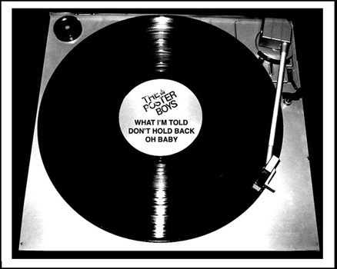
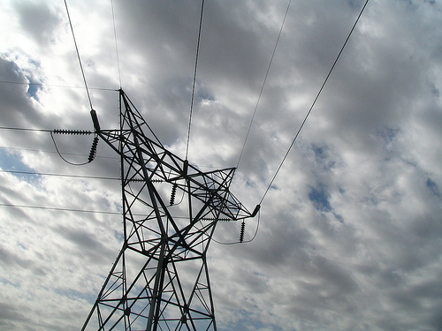
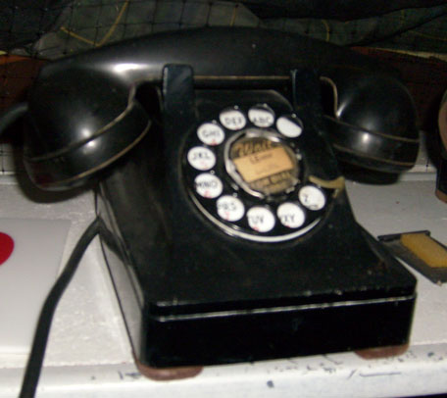


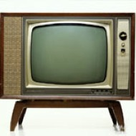
Technological Advancement
1950
slide concept courtesy of:
Notes:
To bring this point home, here are some photos showing the state of technology in the 1950s….

Slide 24

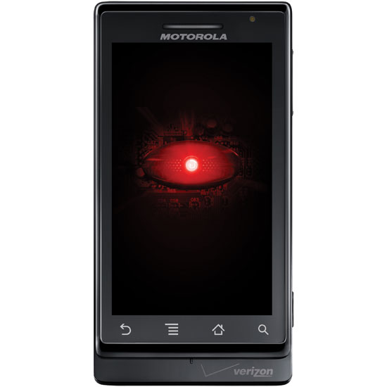

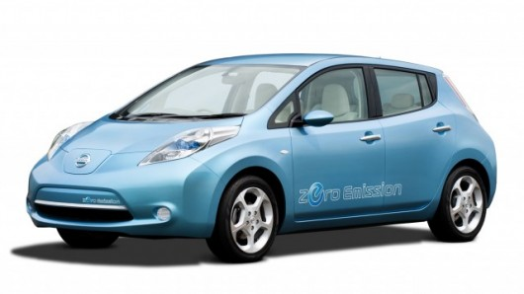
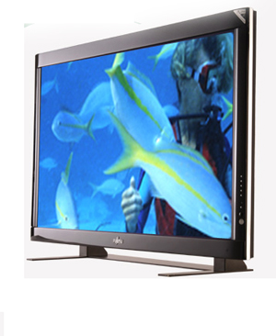
Technological Advancement
2013
Slide concept courtesy of:
Notes:
And here we are with today’s technology.
The inventors of each of the original technologies would barely recognize the current version of that technology, with one exception…Thomas Edison or Nicola Tesla would have no problem recognizing the grid (although, to be fair, they still be fighting over whether it should be DC (Edison) or AC (Tesla) (as in the famous “ Battle of the Currents.”)

Slide 25
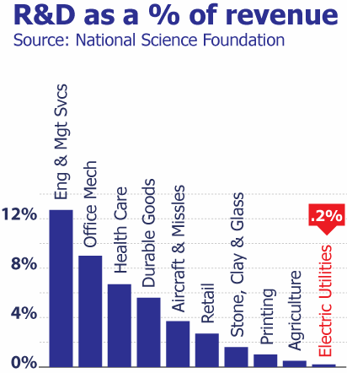
The Grid Has Been Underfunded
Why Now?
Less R&D than almost any other industry
0.2% of net revenues
1/20th the average of all U.S. industries
Living off the investments of the 60s and 70s
“Trust fund” has run out
Source: Jesse Berst ,Global Smart Energy
Notes:
The electric industry spends less on R&D than almost any other industry (0.2% of revenues) – less than the printing industry, and less than Stone, Clay and Glass industry.

Slide 26
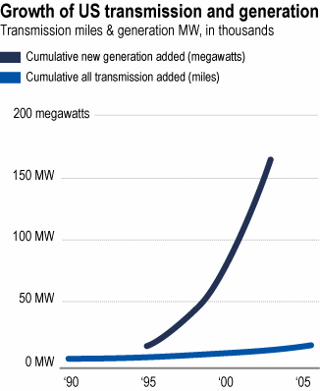
The Grid Is Under Stress
Why Now?
Never designed for bulk power shipments
Wholesale power transactions jumped 300% from 2000 to 2010. Insight Magazine, Oct. 2010
Blackouts, interruptions, near-misses increasing
Transmission loading relief events (near misses) up 1,000% from 1997 to 2002
Demand and supply grew dramatically but...
... transmission saw virtually no increase
Source: Jesse Berst, Global Smart Energy
Source: Global Smart Energy
Notes:
The grid was never designed to ship large amounts of power cross-country.
Yet bulk power transactions have jumped 300% in 6 years.
The US DOE estimates congestion cost electricity consumers and businesses an estimated $2 billion a year.

Slide 27
The Consequences
United States
Declining Load Factor
Load Factor = Avg. Load / Peak Load
EPRI and IEA data
Declining load factor
Assets are aging
Investment lags peak growth
Peak conditions < 1% of time
Operating risk, vulnerability
R&D spending is limited
U.S. outages up last 15 years
Grid modernization is inevitable
Need to invest “intelligently” in a
Smart Grid
US Annual Average Growth in Transmission versus Summer Peak Demand: 1982 - 2012
Notes:
The consequences are predictable: We face declining load factor, our outages have increased, and our economy is losing ground to those nations like China, and most European countries that are modernizing their grids.

Slide 28
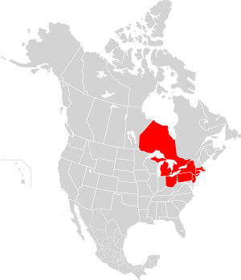
East Coast Blackout of 2003
The second most widespread blackout in history, after the 1999 Southern Brazil blackout.
Summary of Sequence of events:
A power plant shut down
Transmission lines sag into trees
A circuit breaker connecting FirstEnergy's grid with that of American Electric Power is tripped
Many transmission lines trip out, first in Michigan and then in Ohio
The eastern and western Michigan power grids disconnect from each other, then other grids separate
At the end of the cascading failure, 256 power plants are off-line, 85% of which went offline after the grid separations occurred, most due to the action of automatic protective controls.
Notes:
The East Coast Black Out was a major wake up call for Congress and many others. Perhaps even a blessing in disguise of sorts because it led to major new legislation, plus the appropriations of $3.4 billion.

Slide 29
Grid Not Located or Designed to Serve Renewable-Rich Areas
Why Now?
Congestion costs ratepayers ~$2B per year in NE U.S. (DOE, Nov. 2006)
Wholesale power transactions up 300% from 2000 to 2005. (Insight Magazine, Oct. 2005)
Oil Sands, Wind, Natural Gas
Coal, Wind
Wind
Coal
Congestion in the Eastern Interconnection
Renewables
Potential Future Congestion
Congestion in the Western Interconnection
Source: CERTS and LBNL
Slide concept courtesy of Jesse Berst
Notes:
Not surprisingly, for many years, transmission lines have been sited and built to bring power from large central plants - coal, oil or natural gas plants, nuclear plants, and in the NW, hydroelectric dams – to population centers.
Now, given our commitment to reduce our consumption of fossil fuels to help address climate change, it is national and state policy to increase the amount of power generated by wind, solar, and in time, wave, tidal and other renewable technologies.
The problem is we will not be able to achieve the percentages of renewables we want without new transmission lines to bring that power to population centers.
If we were to place over a map of the grid on top of a map of where the sun shines and the wind blows the most, you would see very little correspondence.
That, combined with the other problems I have mentioned, has led to sever congestion and the need to build new transmission lines to help address our basic understructure needs.

Slide 30
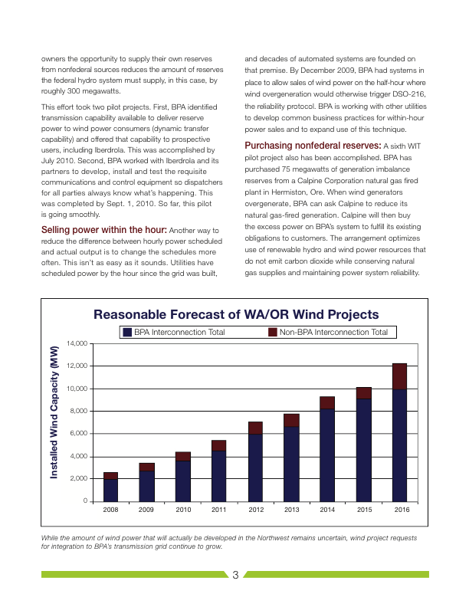
Why Now? NW Wind Energy Is Growing Dramatically
Source: BPA
Notes:
In general, wind and other renewable energy options are considered a good thing because they are cleaner than most options and lower our carbon emissions.
A little over half of the states, including all four NW states, have renewable standards that ratchet up the amount of electricity utilities need to acquire from renewable resources. (Idaho did this by Executive Order, the other states by legislation.) Utah established a goal for its utilities to produce or buy 20% renewable energy of their adjusted sales by 2025, to the extent that it is cost-effective to do so. While some have argued that Utah’s Renewable Portfolio Standard is more like a goal than a requirement, it is still something the utilities need to take seriously.
No one knows how much generation we are going to get from wind in the future but we are already very close to 6,000 MW in the NW. If all existing projects and transmission connections requests are granted (which is not likely), we would jump up to 14,400 MW. I have seen projections by some wind experts as high as 16,000 MW by 2020.
As we will see in a later module, the Smart Grid can play an important role in supporting the efficient use and integration of more wind energy.

