Slide 1
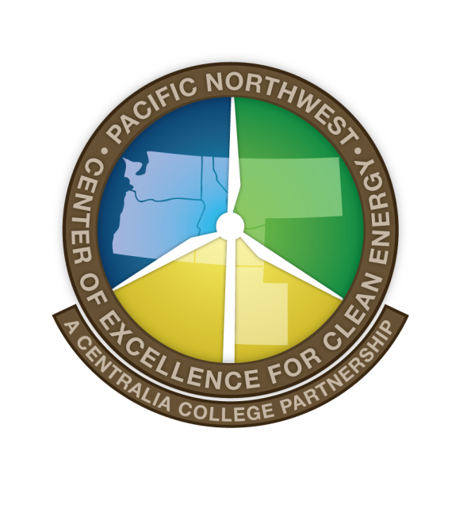
Smart Grid Train the Trainer
Train the Trainer Curriculum Team:
Jeff Hammarlund, Ph.C.
Kevin Schneider, Ph.D., P.E.
Robert Topping, Ed.D.
Funding for this training was provided by the Pacific Northwest Center of Excellence for Clean Energy, with financial support from the American Recovery and Reinvestment Act of 2009 through the U.S Department of Energy under Award
Number DE-OE-0000398.

Slide 2
Module 1: A Guide to this Training
This module will: introduce the workshop’s content, describe how the training is organized, introduce the trainers, and introduce the Pacific Northwest Center of Excellence for Clean Energy - which is the sponsor of this and related Smart Grid Train the Trainer sessions.
Primary objectives:
Describe smart grid and why it is important
Introduce some of the key benefits, opportunities and challenges associated with its on-going development
Primary focus:
How smart grid can support more sustainable development
Issues that are particularly relevant to a Pacific Northwest audience

Slide 3
Summary of Workshop Content
Module 1: Guide to this training (Jeff)
Module 2: Introduction and Overview (Jeff)
Module 3: Current Grid Infrastructure and Key Opportunities for Modernization (Kevin)
Module 4: Two Illustrative Smart Grid Implementation Issues
How smart grid can address key existing shortcomings (Kevin)
How smart grid can enable sustainability benefits (Jeff)
Module 5: Regulatory Responses and Consumer Reactions to Smart Grid Proposals So Far (Jeff)

Slide 4
Summary of Workshop Content
Module 6: Case Studies
Pacific Northwest Smart Grid Demonstration Project (Jeff)
Transactive Control in the Pacific Northwest Smart Grid Demonstration Program (Kevin - slides courtesy of Dr. Ron Melton, PNSGDP Project Mgr, Battelle, PNW Division)
BPA funded demonstrations and pilots - Port Angeles is an example of a smart grid “Early Adopter” (Jeff)
Denmark (a nation that has committed to 50% of its electricity coming from
intermittent renewables - primarily wind - and uses a significant amount of hydro from its Scandinavian neighbors); case study focuses primarily on island of Bornholm as a testing ground (Jeff)

Slide 5
Workshop Content (continued)
Module 7: Smart Grid Occupations and Career Guides (Bob)
Module 8: Conclusion and Wrap-Up (Bob)

Slide 6
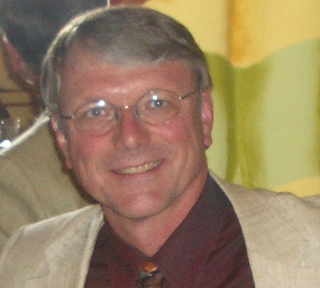
Train the Trainer Faculty: Jeff Hammarlund
Adjunct Professor, Mark Hatfield School of Government, and Senior Research Fellow, Center for Public Service, Portland State University
Co-founder and lead faculty of nation’s first smart grid graduate course
Chair, Smart Grid, Demand Response and Electric Vehicles Team, Oregon Ten-Year Energy Plan
Senior positions with U.S. Senate Energy and Natural Resources Committee, U.S. Department of Energy, Southern California Edison, a NW utility trade association, and energy consulting firms
Owner of Northwest Energy and Environmental Strategies and chair of Oregon Caucus, NW Energy Coalition
Jeff Hammarlund, MA, MS, PhD Candidate
Adjunct Professor & Senior Research Fellow, Portland State University hammarj@pdx.edu
Notes:
Jeff Hammarlund
For this training I will your primary guide on smart grid policy issues. Here is some information about my relevant background.
I have transitioned to academia late in my career, after over 40 years working in a number of positions, primarily in the energy industry. When I teach, I am able draw from my experiences working for the US Senate Energy and Natural Resources Committee, the Office of Policy, Planning and Evaluation in the US Department of Energy, my five years developing and managing energy efficiency programs at Southern California Edison, my time as senior policy analyst with a Northwest utility trade association, and my years in senior management positions at two national energy consulting firms. My experience first as deputy mayor and later as an energy policy advisor to a number of elected officials at the state ad national levels has also helped me become a better and more informed teacher of energy policy.
I teach several graduate and professional development courses in energy policy at the national and regional levels, including regular graduate courses sponsored by Portland State University, and special short courses serving the future leaders of Bonneville Power Administration and Northwest utilities, state and regional energy agencies, and major Northwest law firms who have significant energy related practices. Some of these courses are offered through the university and others through my “boutique-sized” consulting firm.
One of my favorites is a two term course called Designing the Smart Grid for Sustainable Communities that was created in 2008. I have been told it is the first such course in the nation. It is deigned to serves two audiences:
Graduate students in engineering, information technology, public administration/policy, urban planning, business, economics, law, and related fields; and
Senior level and mid-career professionals from the utility, information technology, public administration, architecture, urban and transportation planning, business, legal, and related communities who are interested in getting up to speed on the smart grid as a part of their professional development. Funding support from local utilities and IT companies, have allowed me to assemble a first rate multidisciplinary faculty team and entice many of the top smart grid experts in the nation to participate as guest speakers.
Much of what I have learned about the smart grid comes from teaching this course and from learning from the other faculty members, guest speakers and students.
I am also able to draw on my recent experience as the chair of the Smart Grid, Demand Response, and Electric Vehicles Working Group established by Oregon’s Governor with the charge of helping him develop Oregon’s Ten-Year Energy Plan, as a member of a Demand Response Task Force established by the Western Governor’s Association, and chair of the Oregon Caucus of the NW Energy Coalition.
Finally, I am doing things a little differently. After teaching graduate courses for a number of years, I am finally completing my PhD dissertation toward the end of my career with funding support from the Bonneville Power Administration.
Now lets meet the other two members of the Train the Trainer faculty team.
(Kevin will speak from his slide, then Bob)

Slide 7
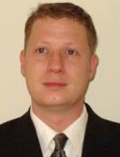
Train the Trainer Faculty: Kevin Schneider
Sr. Research Engineer, Energy & Environment Directorate, Pacific Northwest National Laboratory, Battelle Seattle Research Center, Seattle, Wash.
Main areas of research are distribution system analysis and power system operations.
Adjunct faculty member, Washington State University; Affiliate Assistant Professor, University of Washington; and licensed Professional Engineer in Washington state.
Chair, IEEE Distribution System Analysis Sub-Committee
Kevin Schneider, Ph.D., P.E.
Sr. Research Engineer,
Pacific Northwest National Laboratory
kevin.schneider@pnnl.gov
Notes:
Kevin P. Schneider (M’06, SM’08) received his B.S. degree in Physics and his M.S. and Ph.D. degrees in Electrical Engineering from the University of Washington. His main areas of research are distribution system analysis and power system operations. He is currently a research engineer at the Pacific Northwest National Laboratory, working at the Battelle Seattle Research Center in Seattle Washington. Dr. Schneider is an Adjunct Faculty member at Washington State University, an Affiliate Assistant Professor at the University of Washington, and is a licensed Professional Engineer in Washington State. He currently serves as the Chair for the IEEE Distribution System Analysis Sub-Committee.

Slide 8
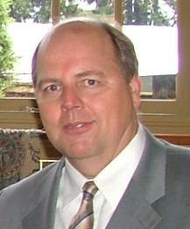
Train the Trainer Faculty: Robert Topping
Director for Strategic Industry Partnerships at the Regional Education Training Center in Elma, Washington.
Identifies and qualifies key smart grid technology workforce competencies within a five-state region.
Focus is on talent development, succession planning and safer work practices in the future energy and manufacturing industry sectors.
Robert Topping, Ed.D.
Director of Strategic Partnerships
Regional Education & Training Center
rbot@scgsolutions.biz
Notes:
Robert Topping, Ed.D.
Robert “Bob” Topping earned his Doctorate Degree from Oregon State University, in Community College Leadership. Dr. Topping, is currently serving as the Director, for Strategic Industry Partnerships, at the Regional Education Training Center in Satsop, Washington. In this role, Dr Topping, is charged with identifying and qualifying key Smart Grid Technology workforce competencies within a five-state region that will drive talent development, succession planning and safer work practices in the future energy and Manufacturing industry sectors.
Dr. Topping is a project- based and results-oriented executive with expertise in strategic workforce talent development, succession planning, and industry-based training partnerships. His doctoral dissertation addresses state-of-the-art designs for workplace learning, career education, and workforce competency-based talent development. Within his dissertation, he focused on the role of higher education in learning processes, design features, and major issues that affect workforce and succession planning in the energy industry. With that as a foundation, he has provided leadership and direction to many strategic workforce initiatives for public/private partnerships in Oregon, Washington, Idaho, Montana and Utah.
Dr. Topping has been instrumental in advancing competency-based learning models within industry as a strategy for how community colleges can connect Career and Technical Education (CTE) programs to industry workforce needs. He has worked directly with industry and community colleges to form sustainable partnerships to design, develop, pilot, and implement multiple broad-based Energy Industry workforce initiatives, two of which were awarded a “Center of Excellence” recognition.
Beyond his 20 plus years of experience at the collegiate level, Bob Topping brings 26 years of hands-on-experience in the construction industry. During this time in his career, he held a variety of positions within the industry, from apprentice to “Master Craftsman”, culminating in the “Golden Hammer Award” for exceptional Project Management of multiple complex projects.

Slide 9
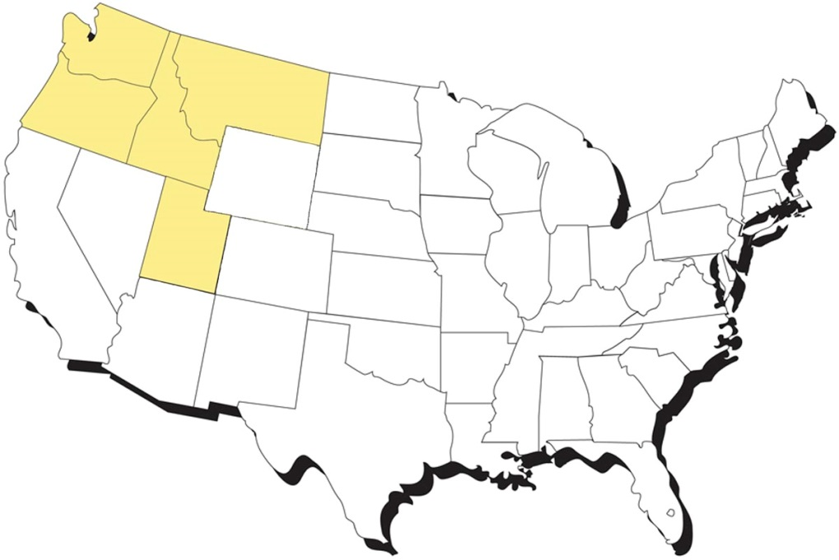

Our Sponsor: The Pacific Northwest Center of Excellence for Clean Energy at Centralia College An Important Partnership Among Northwest Community Colleges, Universities, BPA, Utilities, National Labs, Industry and Labor
Avista Utilities
Puget Sound Energy
Portland General Electric
Idaho Power
Seattle City Light
Tacoma Electric Utilities
NorthWestern Energy
Bonneville Power Administration
PNNL
Energy Northwest
Centralia City Light
TransAlta
IBEW 77 & 125
Washington State Labor Council AFL/CIO
Notes:
[Nutter—Segue into industries involvement and the who’s who list.]
Some of the major players in the energy industry are involved in the Center of Excellence in active or advisory capacities. The industry in the region is really a network of partners that interact in the Bonneville Power Administration region.

Slide 10
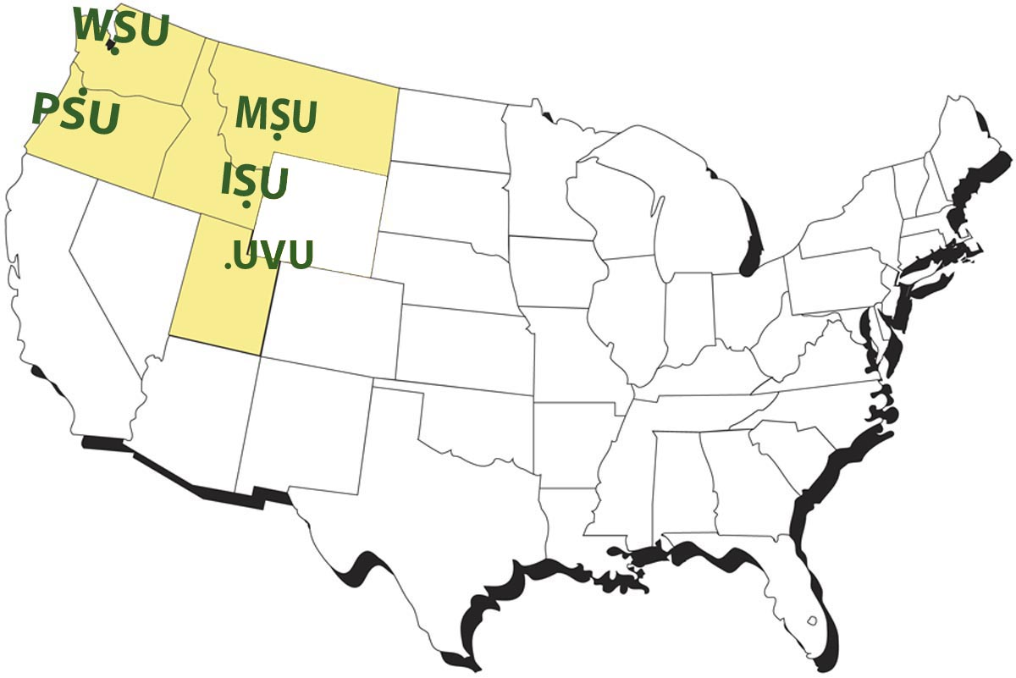
Anchor Partner Universities
Washington State University Energy Program
Portland State University
Idaho State University Energy Systems Technology Center
Utah Valley University
Montana State University
15 Subcontractors:
Education and Training
Industry
Labor
National Lab

Slide 11
Project Objectives
Deliver Smart Grid Training
Create a Training Portal
Share Best Practices

