Slide 1
Module 5
Regulatory & Consumer Response to Smart Grid Proposals
An overview of relevant governance models and key features of the “regulatory compact” that impacts the electric utility industry.
Unique aspects of the Pacific Northwest’s power system.
Consumer concerns about one feature of Smart Grid – smart meters.
Two substantive issues that are proving much more difficult to address.

Slide 2
“Regulatory Compact” -1
Established by Congress in 1935
Electricity would be treated as an essential service that would be regulated.
Consumer-owned utilities would sell power at cost and be regulated by representatives of their customers.
Investor-owned utilities would sell power at cost. They would also have an opportunity (but not a legal guarantee) to earn a profit based on regulatory approval.
Notes:
With the exception of the municipal utilities regulated by city councils, the electricity industry in the U.S. began as an unregulated private enterprise. As electricity began to impact more and more lives, there was increasing recognition that power company activities needed to be subject to some form of public regulation. This led to a major national debate: Should electricity be treated as a commodity that can and should be produced and sold by private entrepreneurs for profit? Or as an essential public service like drinking water, mail delivery, police and fire protection, that should be provided to everyone at cost, or at least at a regulated rate?
With the exception of the municipal utilities regulated by city councils, the electricity industry in the U.S. began as an unregulated private enterprise. As electricity began to impact more and more lives, there was increasing recognition that power company activities needed to be subject to some form of public regulation.
After the Stock Market crash of 1929, the rise and fall of the holding companies that once controlled most of the nation’s IOUs, Congress passed two major laws in 1935. These laws, bolstered by later court cases, legal opinions, informal norms and practices established the outlines of a "regulatory compact" between the state and federal governments, electric utilities, and their customers.
Electricity would be treated as an essential service.
Consumer-owned utilities would sell their power at cost and provide an important “yardstick” against which the price and performance of the investor-owned utilities (IOUs) could be measured.
IOUs would also sell their power at cost; in addition, they would have an opportunity (but not a legal guarantee) to earn a profit in the form of a rate of return on their invested capital.

Slide 3
“Regulatory Compact” -2
All utilities would be granted “natural monopoly” status within assigned service territories.
In return, each utility would have an “obligation to serve” all customers in its service territory (unless they fail to pay their power bills).
State and federal utility commissions would regulate the investor-owned utilities.
In areas served by consumer-owned utilities, city councils, public utility districts, or rural cooperative boards would oversee and govern utility operations (“local control”).
Notes:
All utilities would be granted "natural monopoly" status within assigned service territories. They not have to compete with other electric utilities in their assigned area, and there would be no more need for duplicate wires and other expensive equipment.
In return, each utility would have an obligation to serve all customers in its service area.
State and federal utility commissions would regulate IOUs
In areas served by consumer-owned utilities, city councils, Public Utility District (PUD; People’s Utility District in Oregon) commissioners, and rural cooperative boards would be responsible for overseeing utility operations.

Slide 4
“Regulatory Compact” -3
Scope of state authority over Investor-owned utilities would vary from state to state.
At a minimum, state PUCs responsible for:
  retail rates and ensuring these rates are “just and reasonable”
  wholesale transactions and rates that occur in-state
Federal Regulatory Commission (FERC) - responsible for ensuring wholesale power transactions and rates transmitted across states are “just and reasonable.”
Security and Exchange Commission (SEC) - established to prevent holding company abuses.
Notes:
The scope of state authority over IOUs would vary from state to state.
At the very least, state PUCs would be responsible for establishing retail rates and ensuring that the rates for all customer classes are “just and reasonable” and for addressing wholesale transactions and rates that took place within the state. Many state regulators would also have authority over utility investment and debt, and some would oversee other facets of utility operation. This would be accomplished though an adversarial hearing process. As a general rule, the central issue in these cases would be the total amount of money the utility would be able to collect and how the rate burden would be distributed among the various customer classes (residential, commercial, and industrial.)
Federal regulatory commissions would be responsible for ensuring that wholesale transactions and rates for electric power flowing in interstate commerce are “just and reasonable” and for preventing a reoccurrence of holding company abuses. Since state regulatory commissions were established prior to federal commissions, the federal regulatory role was viewed as limited primarily to filling the regulatory vacuum that exists because of the constitutional limitation of state regulation on interstate commerce.
The federal regulatory functions would be split into the Federal Power Commission now called the Federal Energy Regulatory Commission or FERC) and the Securities and Exchange Commission (SEC). FERC has the principal functions at the federal level for the economic regulation of the electricity utility industry such as fair and equitable financial transactions, wholesale rate regulation, interconnection, and wheeling of wholesale electricity, and ensuring adequate and reliable service. SEC is responsible for preventing for preventing such holding company abuses as providing cross-subsidies, self-dealing, and pyramiding.

Slide 5
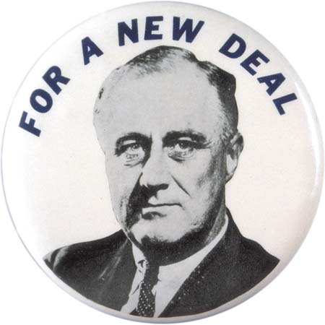
The Fathers of the “Regulatory Compact”
Notes:
The Regulatory Compact had many parents, but it is not too much of a stretch to say that it had two primary fathers. The gent on the left should be well known to you (FDR). The other father is the gent on the left and in the middle. On the left, he was being glorified as the Time cover boy for his efforts to build a vast empire of holding companies that owned many electric utilities and other companies throughout the nation.(The only larger holding company empire was owned by JP Morgan.) In the middle photo, the same gent is being tried for fraud and embezzlement after the 1929 Stock Market crash Who is this mystery man?

Slide 6

Samuel Insull – also know as
“The Monopoly Man”
Notes:
Thomas Edison’s one time secretary and right hand man, Samuel Insull He was tried three separate times in three different courts, and was acquitted all three times. After the third trial, he left the US for good. He died penniless in a Paris subway station. The Monopoly board game was introduced when Insull’s trials were front page news. Parker Brothers never paid him for his image.

Slide 7
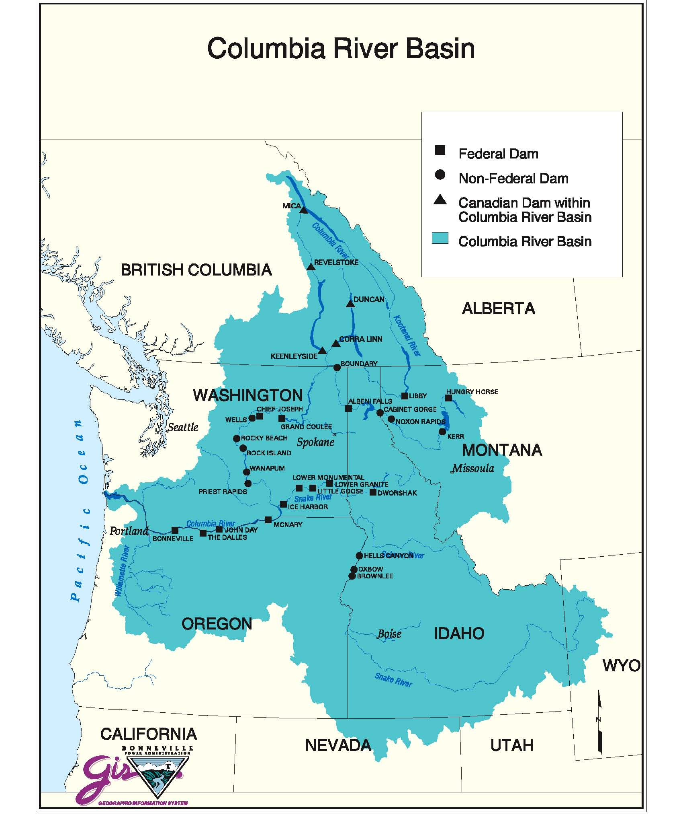
The Northwest’s Energy Profile
is Unique in Several Ways
Notes:
The Pacific Northwest is a unique region of the country in many ways and this is especially true when it comes to electricity. About half of our power comes from falling water. Many of the hydroelectric dams are owned and operated by two federal agencies (Corps of Engineers and Bureau of Rec.), and we have a federal power marketing administration called BPA that finances itself by selling that federal power and transmitting it to retail utilities through its massive transmission lines.
The NW Senators and House Members spend lots of time and political capital trying to explain why a one size fits all national energy policy may not always make sense when applied to the PNW.

Slide 8
Number of Distribution Utilities in Northwest by Type
Notes:
Roughly half of the electricity customers in the PNW are served by consumer owned utility (public power) and half by IOUs.
We have 8 IOUs in the PNW (eg Puget Sound Energy) and we have about 125 consumer owned utilities

Slide 9
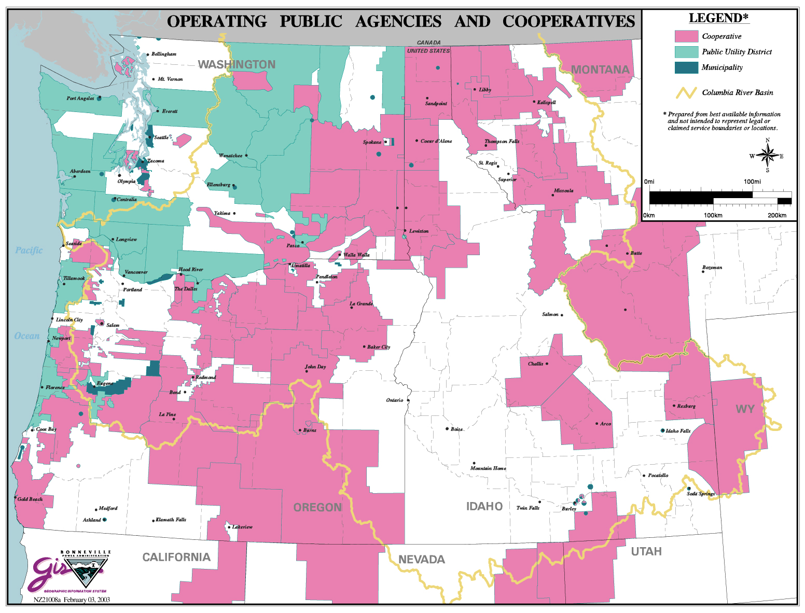
Northwest Public Power
Consumer-owned Utilities

Slide 10
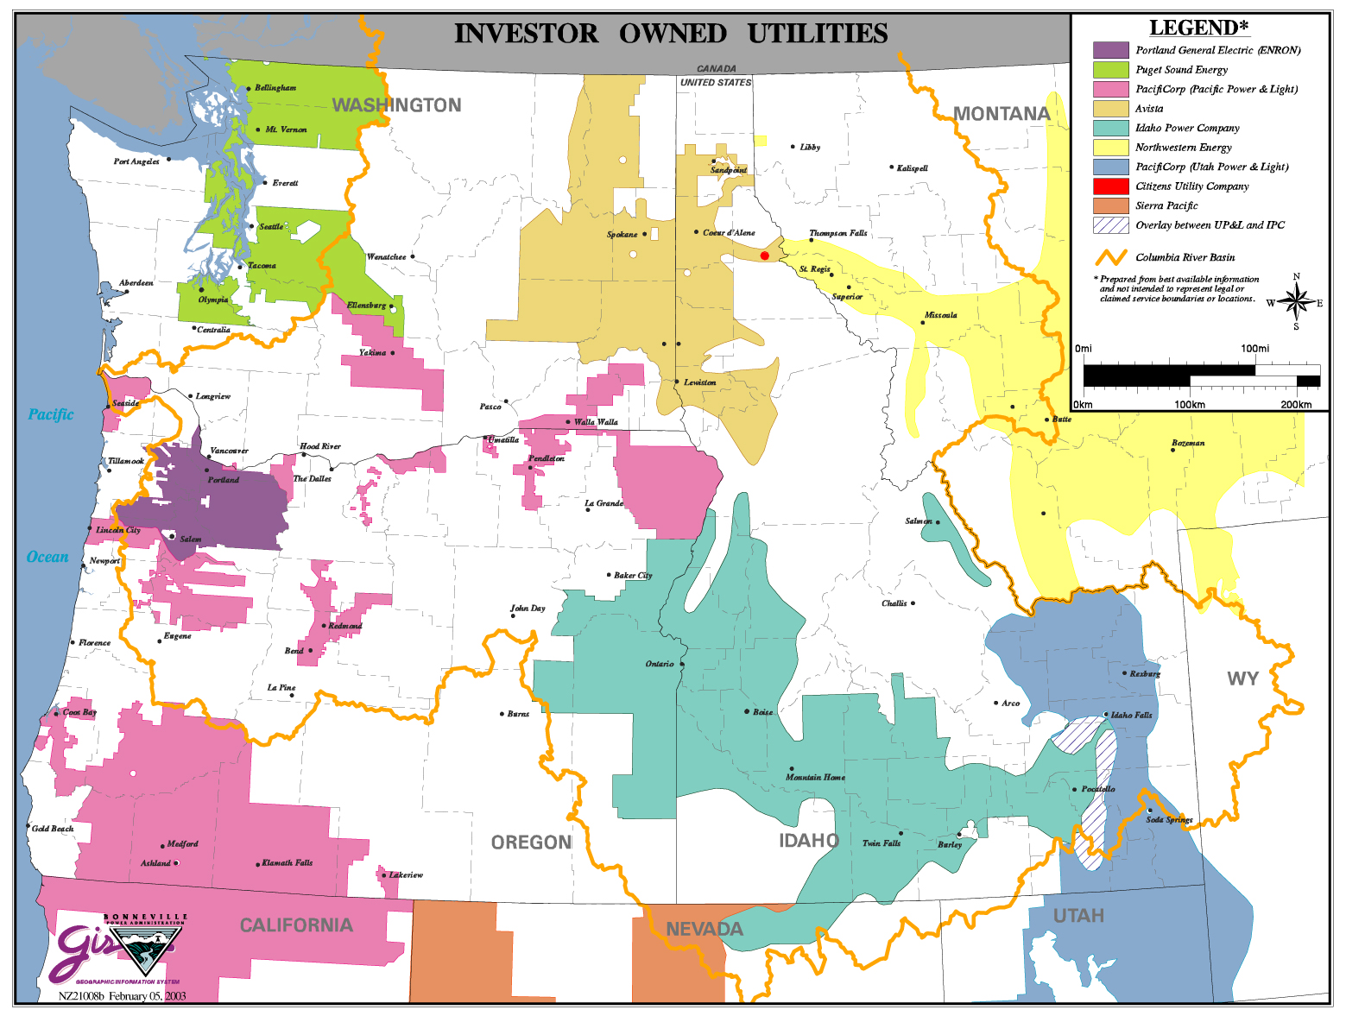
Service Territories of the 8 Northwest Investor-Owned Utilities

Slide 11
Common Consumer Concerns about Advanced (Smart) Meters -1
Concern 1: Smart meters are less accurate than analog meters
Response:
Smart meters are tested.
Public service commissions require meter manufacturers to supply independently certified testing results to prove accuracy.
  Utilities also perform field tests.
  Tests continue to document smart meters are accurate, often more accurate than analog meters.
Sources of next 6 slides: Smart Grid Consumer Collaborative, 2013 State of the Consumer Report and Myths and Fact: The True about Smart Meters
Notes:
Smart meters are rigorously tested for accuracy even before they leave the manufacturing plant.
Public service commissions require meter manufacturers to supply independently certified testing results to prove that their smart meters generate on-the-mark measurements.
Prior to installation, utilities repeatedly perform accuracy tests, often side-by-side with analog meters.
Repeated tests confirm that smart meters are accurate, in some cases even more accurate than analog meters.

Slide 12
Common Consumer Concerns about Advanced (Smart) Meters -2
Concern 2: Smart meters are a health threat because they communicate using wireless signals.
Response:
World Health Organization and other studies conclude small amounts of radio frequency (RF) energy produced by smart meters not harmful.
RF emitted by smart meters well below limits set by FCC and well below such common devices as cell phones, baby monitors, satellite TV, and microwaves.
Notes:
In-depth review of the scientific literature by the World Health Organization (WHO) revealed that the small amount of radio frequency (RF) energy produced by smart meters is not harmful to human health.
RF emitted by smart meters is well below the limits set by Federal Communications Commission and it is below levels produced by other common household devices like cell phones, baby monitors, satellite TVs, and microwaves.
In fact, you would have to be exposed to the RF from a smart meter for 375 years to get a dose equivalent to that of one year of 15-minutes-per-day cell phone use.
No credible evidence shows any threat to human health from RF emissions at or below RF exposure limits developed by the FCC. With over 25,000 articles published on the topic over the last 30 years, scientific knowledge in this area is now more extensive than for most chemicals.

Slide 13
Common Consumer Concerns about Advanced (Smart) Meters -3
Concern 3: Smart meters will not keep my data secure.
Response:
Utilities are using the same advanced security and encryption technology uses by banking, credit card, and cable industries.
Utilities are involved in national consortiums and work with national cyber-security organizations to regularly audit their systems to ensure privacy and security of smart meters.
Notes:
Just as the banking, credit card and cable industries have provided secure access to your information online, the utility industry is poised to do the same using advanced security and encryption technology to safeguard your data.
Utilities are involved in national consortiums and work with national cyber-security to regularly audit their systems to ensure privacy and security of smart meters.
The privacy of your data is protected now. Utilities work constantly to safeguard it. That will not change with the use of smart meters.

Slide 14
Common Consumer Concerns about Advanced (Smart) Meters -4
Concern 4: Smart meters are hazardous and increase the risk of fire and explosion.
Response:
Smart meters must meet safety requirements & standards in the National Electric Safety Code.
Public service commissions require independent certification confirming smart meters are safe and show resistance to heat, fire, voltages, surges, and self-heating.
Notes:
Smart meters must meet safety requirements and standards spelledout in the National Electric Safety Code (NESC).
Public service commissions require independent certification proving that smart meters are safe and show resistance to heat, fire, voltages, surges, and self-heating.
Companies that manufacture smart meters produce certifiably safe and reliable equipment. Nevertheless, smart meters should be installed and uninstalled only by trained professionals exercising standard safety precautions.

Slide 15
Common Consumer Concerns about Advanced (Smart) Meters -5
Concern 5: Smart meters are an invasion of privacy.
Response:
Smart meters measure how much energy we use, based on time of day, not how we use that energy. Unless we install a home energy management system, smart meters cannot tell whether the energy used is from your oven, air conditioner or hairdryer.
Utilities adhere to strict policies, following state laws regulating the use of personal information for business functions like billing and customer service.
Smart meters are a landmark change allowing two-way communication between our utility and us, much like cell phones and banking. Utilities keep our data private and secure, just like those industries do.
Notes:
Smart meters measure how much energy you use, based on time of day, not how you use that energy. Unless you install a home energy management system, smart meters cannot tell whether the energy used is from your oven, air conditioner, or hairdryer.
Utilities adhere to strict policies ,following state laws that regulate the use of personal information for business functions like billing and customer service.
Smart meters are a landmark change allowing two-way communication between your utility and you, much like cell phones and banking. Utilities keep your data private and secure, similar to those industries and similar to how it’s always been.

Slide 16
Common Consumer Concerns about Advanced (Smart) Meters -6
Concern 6: Smart meters don’t provide any consumer benefits.
All of the benefits go to the utility.
Response:
Smart meters measure and transmit our energy use directly to our utility, eliminating the practice of estimating bills. No more surprises on our electric bill.
Smart meters provide near real-time energy use information about how much, when, and in some cases, at what price we use energy. With this information, we should be able to take more control over our energy consumption – and our monthly bills.
Working as part of Smart Grid, smart meters improve power outage, detection, and notification. Smart meters electronically report the location of outages, so we no longer have to call the utility. This speeds service restoration and keeps us informed.
Notes:
Smart meters measure how much energy you use, based on time of day, not how you use that energy. Unless you install a home energy management system, smart meters cannot tell whether the energy used is from your oven, air conditioner, or hairdryer.
Utilities adhere to strict policies ,following state laws that regulate the use of personal information for business functions like billing and customer service.
Smart meters are a landmark change allowing two-way communication between your utility and you, much like cell phones and banking. Utilities keep your data private and secure, similar to those industries and similar to how it’s always been.

Slide 17
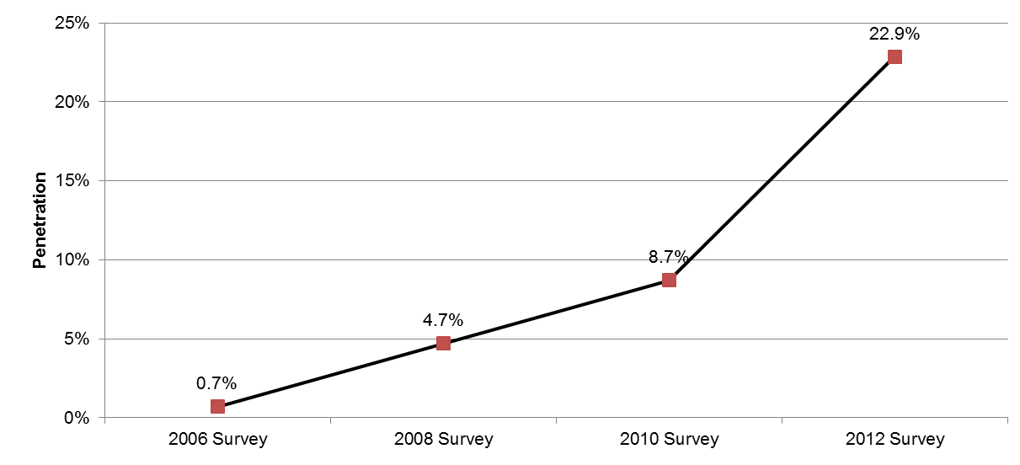
Estimates of Advanced (Smart) Meter Penetration Nationwide
^{Source: FERC,} ²⁰¹² ^{Assessment of} Demand Response and Advanced Metering
^{Staff Report}
Notes:
Despite these concerns, smart meters are being installed at an impressive rate.
According to the latest FERC report, between 2006 and 2012, 38 million smart meters (sometimes called advanced meters) were operating in the US by 2012. This is almost 23% of all meters, and it represents a 14 percentage point increase over 2010 levels. The West has the highest penetration rate of any region in the country at 42%. Puget Sound Energy is among the national leaders with a whooping 99.9% penetration rate. Source: FERC,2012, Assessment of Demand Response and Advanced Metering Report, December 2012

Slide 18
Estimates of Advanced (Smart) Meter Penetration by State
Five-state region within PNCECE’s Smart Grid Grant
State Total Meters Total Advanced Meters 2010 Penetration 2012 Penetration
Idaho 802,440 530,655 24.7% 66.1%
Oregon 1,874,339 960,151 25.2% 51.2%
Montana 563,920 20,101 4.8% 3.6%
Wash. 4,009,332 74,952 3.9% 1.9%
Utah 1,069,087 18,250 1.9% 1.7%
Other western states
Calif. 14,836,734 14,459,477 16.7% 70.5%
Arizona 2,977,092 1,046,410 29.1% 55.3%
Nevada 1,299,632 717,220 1.9% 55.2%
Wyoming 308,024 70,650 4.8% 22.95%
U.S. 165 million 38 million 8.7% 22.9%
Source: FERC, 2012 Assessment of Demand Response & Advanced Metering

Slide 19
FERC’s Definition of Advanced Meters
Meters that measure and record usage data at hourly intervals or more frequently, and provide usage data to both consumers and energy companies at least once daily. Data are used for billing and other purposes. Advanced meters include basic hourly interval meters, meters with one-way communication, and real-time meters with built-in two-way communication capable of recording and transmitting instantaneous data.
Source: FERC, 2012 Assessment of Demand Response & Advanced Metering

Slide 20
A Substantive Issue
Dynamic (or Time-Varying) Pricing
Examples - Time-of-use rates, critical peak pricing & real-time pricing:
Alerts customers that that not all kwh’s are created equal.
A kwh consumed at 2 pm on a hot summer day or at 6 pm on a cold winter night costs much more to generate and deliver than a kwh at
2 am when there is a lot of excess wind generation.
Proponents say flat rates are wrong because they give customers the wrong signal and they do not reflect the real costs of providing them power. Utilities have been misinforming consumers for a century.
Getting customers to understand “the truth” is going to be very difficult.

Slide 21
Common Objections to
Dynamic Pricing
Major objections to dynamic pricing from some consumer groups
Disproportionately harms low-income customers, seniors, and people with disabilities who tend to stay home more, and people who don’t participate in “digital revolution.”
Also harms people with medical conditions requiring monitoring equipment, people with young children, and small businesses that are unable to curtail peak period usage.
It is unjust because the wealthy and technically savvy can adjust and even lower their bills at the expense of other consumers.

Slide 22
Response from
Dynamic Pricing Supporters
Under present rate designs, nearly all customers pay the same flat rate per unit of electricity regardless of the quantity or time of use.
It is more expensive to serve customers who use relatively more energy during peak periods and less during off-peak periods. The “peakier than average” customers are subsidizing the “less peakier than average customers” without knowing it.
Dynamic pricing would eliminate these “cross subsidies” and provide customers with the accurate economic signals.
Many environmentalists support dynamic pricing for another reason: “peaking plants” are almost always less efficient and emit more greenhouse gases and other pollutants. They are also expensive to maintain for brief periods of use.

Slide 23
The Verdict ?
Unclear
Evidence is just beginning to emerge
The data that has come out so far is conflicting and contradictory

Slide 24
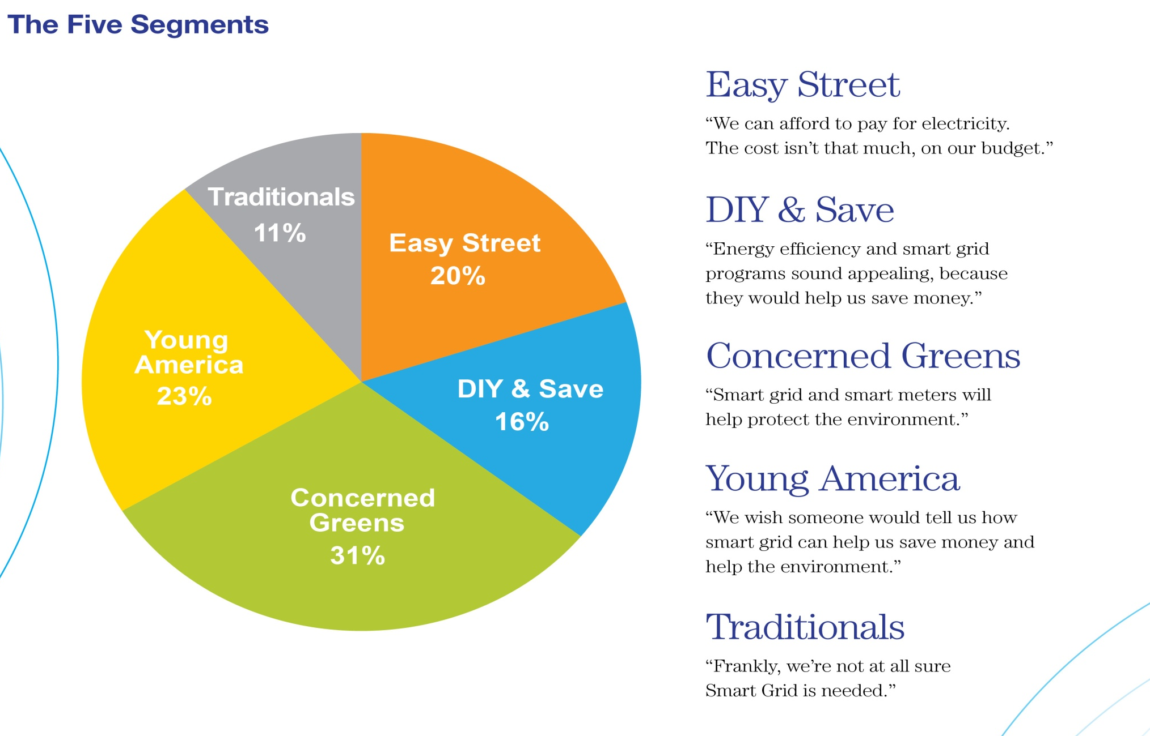
Research from Smart Grid
Consumer Collaborative
Source: 2012 Smart Grid Consumer Collaborative

Slide 25

Source: 2012 Smart Grid Consumer Collaborative

Slide 26

Source: 2012 Smart Grid Consumer Collaborative

Slide 27

Source: 2012 Smart Grid Consumer Collaborative

Slide 28

Source: 2012 Smart Grid Consumer Collaborative

Slide 29

Source: 2012 Smart Grid Consumer Collaborative

Slide 30
Another Substantive Issue
Public utility commissions are unclear how to deal with Smart Grid investments (by utilities).
Challenges of alignment include:
Time horizon
Externalities
Jurisdiction
Decentralization
Uncertainly
Cost-recovery and risk associated with Smart Grid investments
Notes:
Time horizon: Smart Grid technologies evolve (but do not necessarily become functionally obsolete) at a faster rate than traditional power sector equipment.
Externalities: Smart Grid benefits flow well beyond the boundaries of evaluation that have been utilized historically, both within and beyond the realm of utility regulation.
Jurisdiction: Smart Grid investments, which take place largely at the state-regulated distribution level, can impact both investment decisions and operations of generation, transmission, and of consumers in ways that extend beyond the jurisdiction of state regulators.
[De]centralization: Smart Grid technologies enable distributed intelligence and resources, localized energy resources, and decentralized information that challenge the traditional top-down, supply- biased, deterministically-planned, one-way electricity paradigm and requires clarification of roles, responsibilities, cooperation, and competition among government, utility, third-parties, and consumers.
Uncertainty: Smart Grid systems introduce technological, economic, and operational uncertainties – both positive and negative – which utility regulation tends to discourage and for which it is often unprepared.
Cost-recovery and risk associated with Smart Grid investments. Utilities are hesitant to invest in new equipment such as Smart Meters or other Smart Grid related technologies unless they believe that they will be able to meet the “used and useful” regulatory test. Some regulators are unwilling to allow the utility to recover its costs in rates unless and until smart grid technologies are proven (chicken and egg). Why place all the risk on the ratepayers rather than the utility shareholders?
New approach is to share the risks, costs and rewards.

