Slide 1
Module 4
Smart Grid Implementation Issues
This module will dig deeper into Smart Grid implementation issues. It will focus on two key issue of particular interest to the PNW:
How Smart Grid is expected to address major shortcomings of the existing grid.
How Smart Grid is expected to support “sustainability benefits.”

Slide 2
How Smart Grid is expected to address major shortcomings of the existing grid

Slide 3
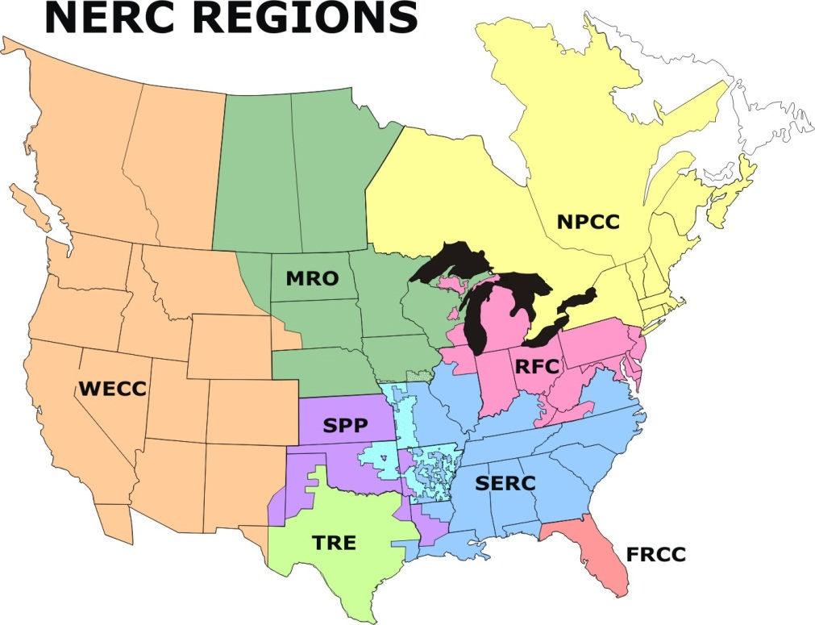
High Level Organizing Entities
North American Electric Reliability Corporation (NERC):
  Non-governmental organization, granted legal authority to enforce reliability standards
Federal Energy Regulatory Committee (FERC):
  Regulates interstate transmission of natural gas, oil, and electricity, as well as natural gas and hydropower projects
  Independent federal entity
Western Electricity Coordinating Council (WECC):
  Regional entity responsible for coordinating bulk electric system reliability, day-to-day operation and long-range planning
Notes:
NERC: http://www.nerc.com/page.php?cid=1|9|119
FERC: https://www.ferc.gov/about/about.asp
WECC: http://www.wecc.biz/About/Pages/default.aspx

Slide 4
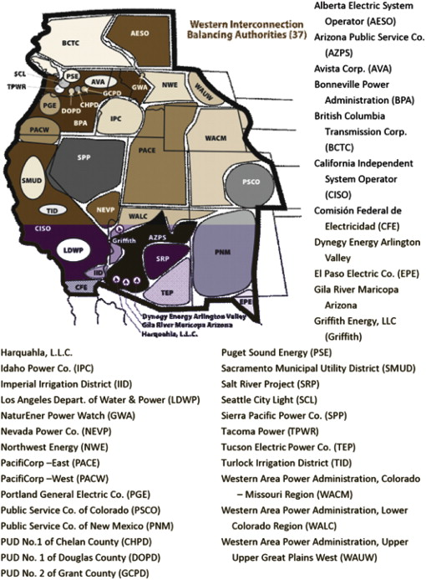
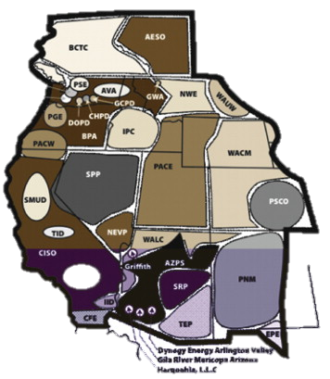
Western Interconnection
Balancing Authorities
Balancing Authorities (BA):
  Are responsible for ensuring that generation and load match at all times
  Support interconnection frequency in real-time
  Control all transmission operations
  Are responsible for long-term planning and capacity expansion
Unlike in most of the country, there is no active market for wholesale power transactions in the PNW
Notes:
Maps: http://www.sciencedirect.com/science/article/pii/S0301421510008712

Slide 5
Long term planning
Capacity expansion
Years to decades
Hydro resource management
Planned maintenance
planning
Days to weeks
Operations planning
Unit commitment
Economic dispatch
Hours to Days
dispatching

Slide 6
Optimal power flow
Manual operation
minutes
load following
Frequency control
Automatic generation control
Governors
seconds
regulation
No active controls
Mechanical inertia of turbines and motors stabilizes
msec
stability

Slide 7
TELEMETRY & COMMUNICATIONS EQUIPMENT
BREAKER/SWITCH STATUS INDICATIONS
SYSTEM MODEL DESCRIPTION
NETWORK TOPOLOGY PROGRAM
UPDATED SYSTEM ELECTRICAL MODELS
STATE ESTIMATOR
DISPLAY TO OPERATOR
POWER FLOWS, VOLTAGES, ETC.
ANALOG MEASUREMENTS
GENERATION RAISE/LOWER SIGNALS
GENERATOR OUTPUTS
DISPLAY TO OPERATOR
BAD MEASUREMENT ALARMS
REMOTE TERMINAL UNITS IN SUBSTATIONS
AGC
BASE POINTS AND PARTICIPATION FACTORS
ECONOMIC DISPATCH CALCULATION
BASE POINTS, PARTICIPATION FACTORS, OPTIMAL VOLTAGE, TRANSFORMER TAPS, LOAD SHEDDING
PENALTY FACTOR CALCULATION
STATE ESTIMATOR OUTPUT
OPF
SECURITY CONSTRAINED OPF
CONTINGENCY ANALYSIS
CONTINGENCY SELECTION
POTENTIAL OVERLOAD & VOLTAGE PROBLEMS
OVERLOAD & VOLTAGE PROBLEMS
DISPLAY ALARMS

Slide 8
Hourly Loads as Fraction of Peak, Sorted from Highest to Lowest
90%
generation
75%
5% = ~400 hrs/yr
distribution
5%
(8,760 hrs)
25% of distribution & 10% of generation assets (transmission is similar),
worth of 100s of billions of dollars, are needed less than 400 hrs/year!

Slide 9
Challenges of the Existing Grid
Transmission:
Intermittent renewables
Significant investments for peak periods
Transmission congestion
Stability
Losses due to Reactive Power flows
Distribution:
Distributed generation
Losses due to Reactive Power flows
Notes:
Single slide – transmission on left, distribution on right, then transition into which technology will address them

Slide 10
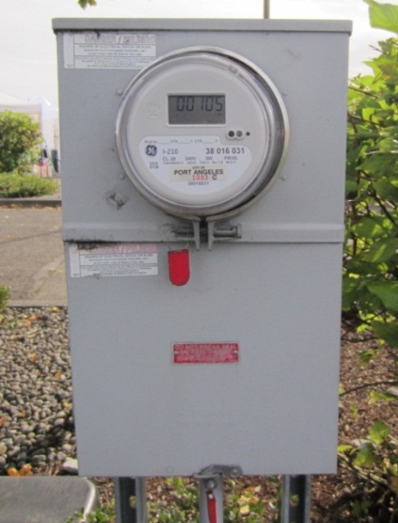
Enhanced Monitoring & Controls
Increased bi-directional communication enables many technologies:
  Advanced Metering Infrastructure
  Human Machine Interface
  Phasor Measurement Units
  Flexible AC Transmission Systems: Transmission limits adjust to physical conditions
  Supervisory Control and Data Acquisition: grid and distribution feeder elements monitored and optimized
A challenge: create robust and flexible standards for communication

Slide 11
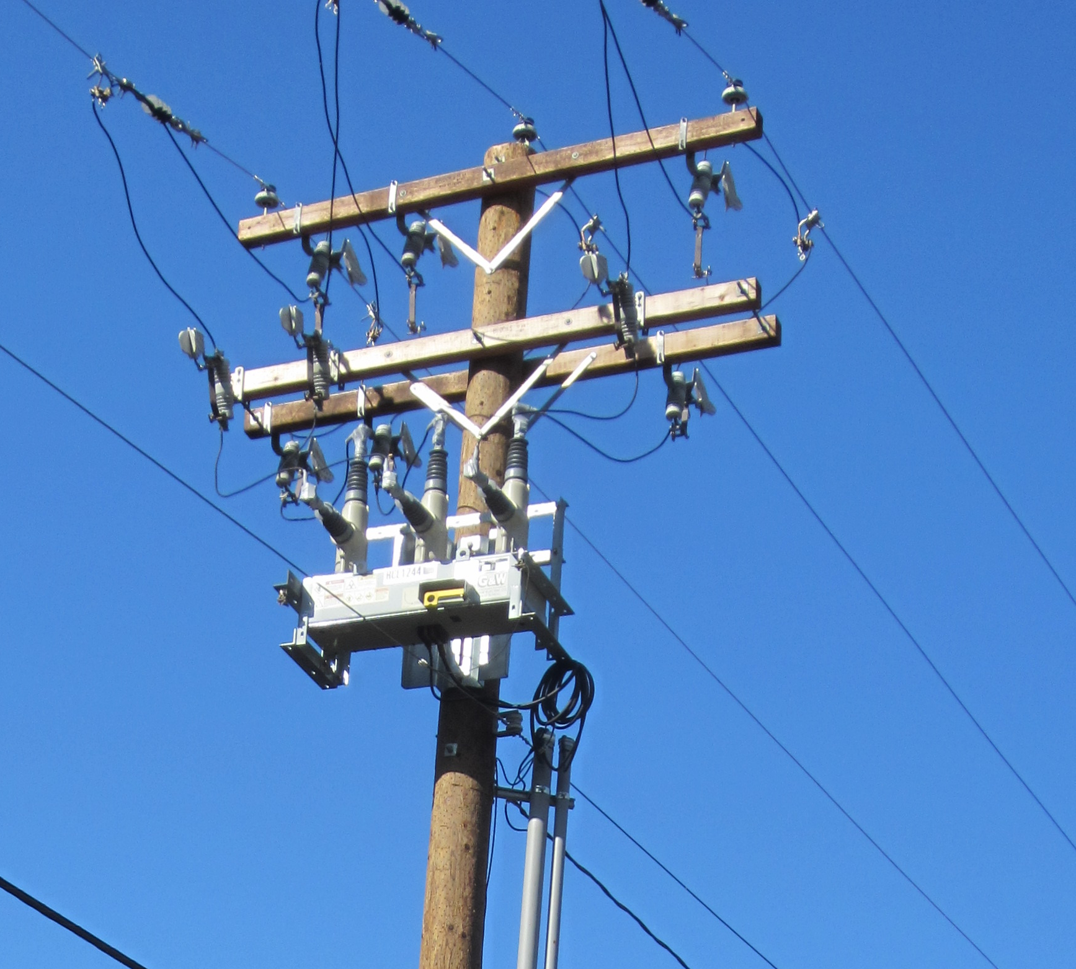
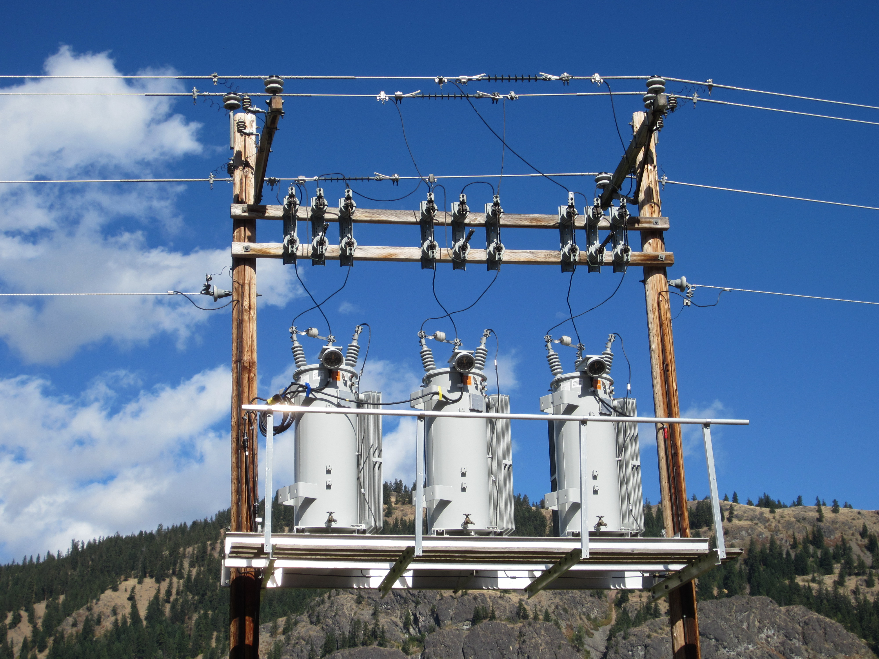
Distribution Automation
Volt-VAR Optimization
Capacitor Automation
Reclosers and Sectionalizers
Distribution Management Systems
Fault Detection Identification and Reconfiguration
reclosers
regulators

Slide 12
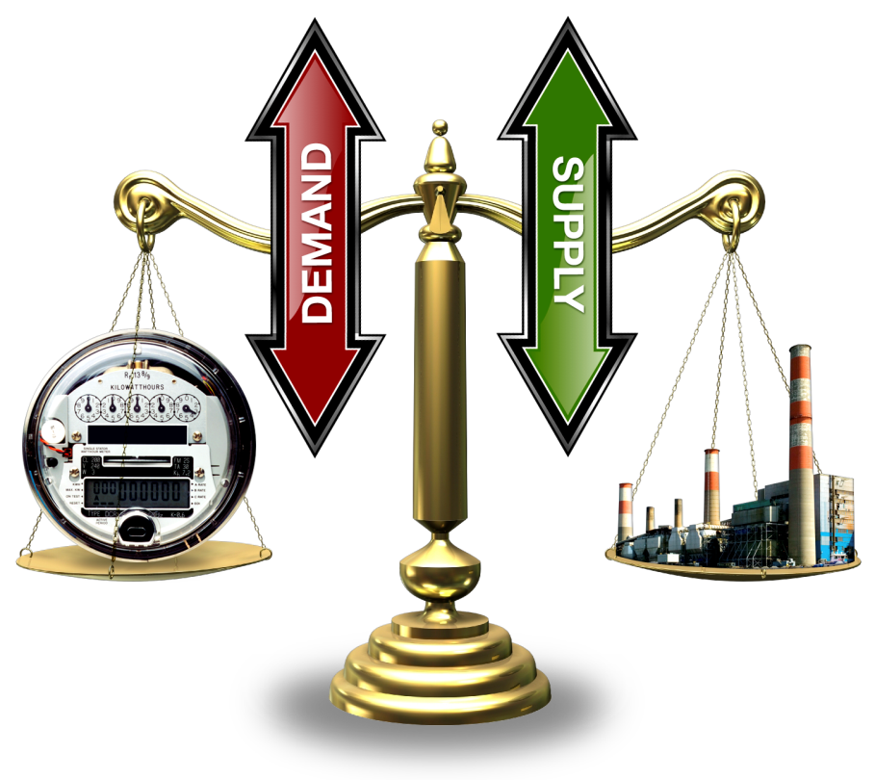
Demand Response
Traditionally, load has not participated in balancing process
In-demand response schemes, load actively responds to a signal of electricity availability, typically a price signal:
  Real time market
  Time of use
  Critical peak pricing
  Direct load control
Demand response can be used for:
  Peak load reduction
  Regulating services
  Emergency conditions

Slide 13
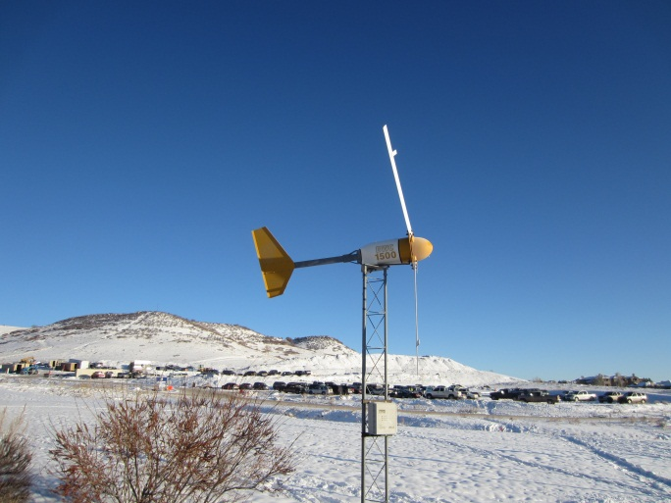
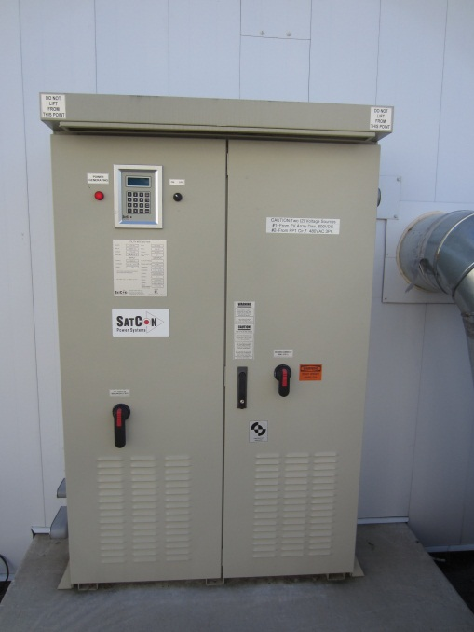
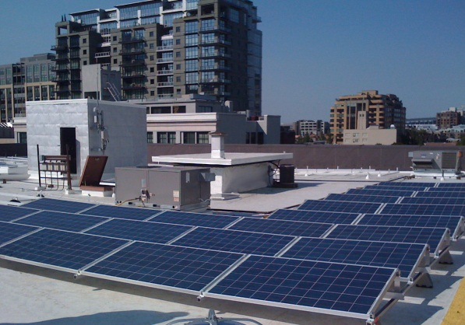
Distributed Generation
Many advantages:
  Decrease carbon emissions through the use of local renewables
  Increase efficiency through Combined Heat and Power (CHP)
  Transmission investment deferral
  Reduced line losses
More complex monitoring and control schemes needed on distribution feeders:
  Power flow in both directions
  Voltage control more difficult
  Safety devices must be redesigned
  Net metering
NREL
ORNL
Renewable Northwest Project

Slide 14
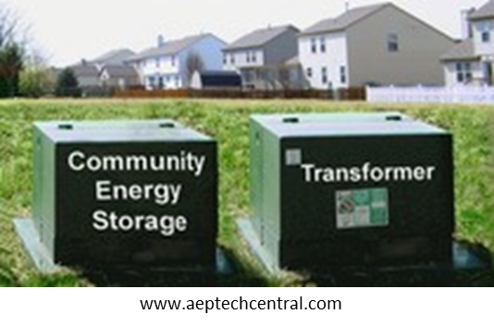
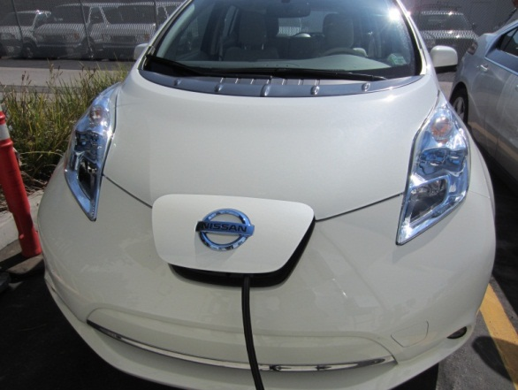
Electric Vehicles / Energy Storage
Energy storage loosens the requirement that generation and load must be matched at all times:
  Peak shaving
  Regulation and stability
  Intermittent renewables
Electric vehicle batteries:
  May add stress to the system if charging adds to peak
  May help in peak management and regulation if able to act as flexible storage
Nissan Leaf

