Slide 1
Cascadia Earthquake Readiness Workshop
June 19, 2014
Notes:
Thank you, Jim. We all appreciate the great hospitality of Centralia College.
As you can see, there are many logos on this slide, which represent the organizations that sponsored this workshop. All those logos represent a cross section of industries in the Northwest, and they remind me of the interdependencies we need to account for in planning for a Cascadia Eargthquake.
A special thanks to the COE for Clean Energy Director Barbara Hins Turner, who took me under her wing and made it possible to hold this workshop.
Thanks also to COE for HLS & EM Director Linda Crerar for her guidance and support.
COE for Marine Manufacturing & Technology Director Ann Avary
Construction COE Director Shana Pescheck
COE for Aerospace & Advanced Manufacturing Director Mary Kay
CREW Executive Director Heidi Kandathil
Before I give you an overview of today’s program, I wanted to let you know a little bit about me and why I’m here - Self Intro
Critical Infrastructure Program Manager for the Corps of Engineers Portland District; Registered Professional Engineer
30 years experience in the Coast Guard as an Emergency Manager and Civil Engineer
As the President of the Portland Post of the Society of American Military Engineers, I felt a burning sense of responsibility to mobilize engineers so we can better address the impending Cascadia Earthquake and Tsunami – in large part because of my role as Portland District CI Program Manager, and also because I’m a father, and a husband, and I’m deeply concerned about the safety of my family and other families in the Northwest.

Slide 2
Overview
Legislative Perspective
Executive Panel
The Triple 3 Resilience Target
Breakout Sessions
Ports and Waterways
Emergency Management Scenarios
Energy Education and Training
Critical Energy Infrastructure
Report Out and Next Steps
Notes:
Legislative Perspective
Executive Panel
Break
The Triple 3 Resilience Target
Lunch
Breakout Sessions
Ports and Waterways
Emergency Management Scenarios
Energy Education and Training
Critical Energy Infrastructure
Break
Report Out and Next Steps

Slide 3
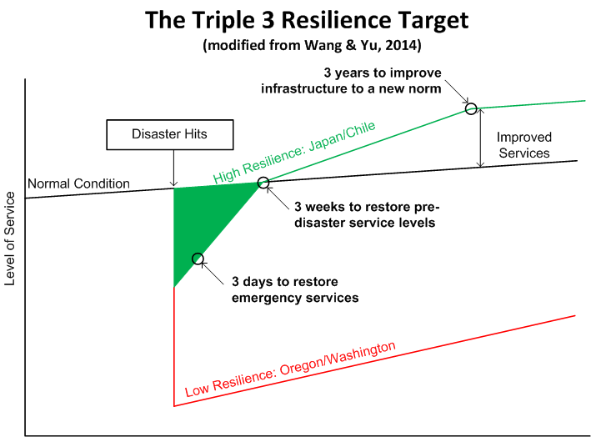
Notes:
The Triple 3 Resilience Target: recently proposed by Yumei Wang & Kent Yu
They were instrumental in the development of the 2013 Oregon Resilience Plan.
The plan showed long time frames for infrastructure services to be restored after a Cascadia earthquake.
One example is the estimated 18-36 months for Oregon Healthcare facilities to restore pre-disaster service levels
The proposed targets are just that: proposed shorter targets for restoration of infrastructure services to maintain our standard of living.
This is a big, complicated issue – we’re not going to agree on everything today, but we have the right people here to make real progress on identifying how we can achieve The Triple 3 resilience Target.
Months Valley Coast
Fire 2 36+
Police 4 36+
Healthcare 18 36+
Comms 6-12 6-12
Electricity 1-3 3-6
T1 Highways 12-36 12-36
Fuel ? ?
Water 6-12 36+
Waste Water 36+ 36+
Schools 18 18

Slide 4
Cascadia Earthquake Readiness Workshop Report Out Achieving The Triple 3 Resilience Target
Ports & Waterways Critical Energy Infrastructure Emergency Management |  |  | Scores 1: easy/low cost, 5: hard/high cost
Problem/Roadblock | Solution | Priority | Funding | Political Capital | Metrics
Notes:
This slide shows what I’m asking Breakout Session Moderators to report on at the end of the day.
Since we can’t attend all three sessions, this will give us a great opportunity to hear about actions that need to be taken to achieve The Triple 3 Resilience Target for Ports & Waterways, Critical Energy Infrastructure and Emergency Management.
We’re far from achieving the 3 day/3 week/3 year targets, and they seem short.
But if you need emergency surgery in the hours after the Cascadia Earthquake, you won’t be satisfied to hear that hospitals will be ready for business in 3 months, or 3 days: even 3 hours will seem like a lifetime.
We need to make a list of roadblocks to The Triple 3 Resilience Target, then focus efforts on those so a Cascadia Earthquake is a manageable disaster, instead of a catastrophe that will paralyze the Northwest.
Review Form.

Slide 5
Workshop Outcomes
Prioritized action list to meet The Triple 3 Resilience Target for:
Ports and Waterways
Emergency Management
Critical Energy Infrastructure
Consider interdependencies with other sectors
Notes:
I love to talk, but we need to do more than talk today.
The workshop outcome we seek is simple to state, but hard to accomplish: We want to start the worklist so we can achieve The Triple 3 Resilience Target
Resilient infrastructure results in life safety & supports our economy to achieve a high standard of living.
We are the people who can make sure we maintain that standard of living even after a Cascadia event.
I know that many of you have worked hard so we’re prepared for and can respond to a Cascadia Earthquake.
Right now many earthquake response plans use restoration deadlines like “as soon as possible.”
We need to do better than that: we need to set definite targets and then energetically pursue meeting those targets.
That’s why I believe we need to adopt The Triple 3 Resilience Target.
Our collective wisdom and efforts will move us closer to our goal of a resilient Northwest.
Though we can make significant progress today, this will take more than a few hours of work, so we plan to hold another Cascadia Resilience workshop next year.
The Founding Fathers pledged their lives, fortunes and honor to each other.
I want you to pledge your time and energy to work with us before our next workshop so that in one year we can make measurable progress toward a more resilient Pacific Northwest.
It’s a matter of life or death.

