Slide 1
Substation and Distribution Automation
Module 7: Energy Storage and Electric Vehicles

Slide 2
Module 7 Overview
Part 1: Overview of energy storage
Part 2: Energy storage uses
Part 3: Electric vehicles

Slide 3
Part 1: Overview of Energy Storage
Background
Forms of Energy Storage
Chemical storage
Physical storage
Deployments of Energy Storage
Grid connected
Grid influencing

Slide 4
Background
Because of the variability of the end-use load central generation plants must adjust their output to maintain the generation and load balance.
Generation and load must be balanced at all times because of the lack of large scale energy storage, with the exception of rotation kinetic energy of generators.
The problem is further compounded by the introduction of large amounts of variable output renewable generation such as wind and solar PV.
While these problems can be solved with a “big iron” approach of building more central generation and more transmission, environmental and economic concerns often make the permitting of new generation and the siting of new transmission costly and difficult.
Energy storage applications offer the option of incorporating new technologies and communication systems to more efficiently operate the system, as opposed to building capacity.

Slide 5
Background Cont.
Energy storage technology can help enhance system reliability, aid power transfer, and maintain system stability.
Ideally, Energy Storage Technology could:
Load leveling: supply load outside of ideal generation hours.
Islanded operations: supply load during transmission or distribution interruptions.
Ramp rates: allow generators to balance load at their normal speed.
Voltage control: correct load voltage profiles with rapid reactive power control.
Dynamic stability: rapidly damp oscillations.
Spinning reserve: respond to sudden load changes.

Slide 6
Forms of Energy Storage
Chemical Storage
Sodium Sulfur
Lithium Ion
Lead Acid
Zinc Bromine
Vanadium Redox
Nickel Cadmium
Nickel Metal Hydride
Physical Storage
Fluid (pumped hydro and compressed air)
Momentum (flywheels)
Thermal (ice and molten salts)
Electromagnetic fields (super conductors and capacitors)

Slide 7
Chemical Energy Storage
Batteries are one of the familiar energy storage technologies but their technology maturity varies depending on the chemistry.
Primary Battery: These are one use cells and once the energy is discharged they are discarded.
Secondary Battery: Energy is stored in a chemical reaction and discharged through the reverse of the reaction.
Battery lifetimes will vary based on operation, short cycling and high temperatures can reduce the effective life of a battery.
There are environmental concerns because of chemicals involved.
Efficiency will decrease with rate of charge or discharge because of internal resistance and/or efficiencies of chemical reactions.

Slide 8
Battery Internal Resistance
Here we will examine the representative internal resistance of a lead acid battery.
Internal to the battery case there are lead and lead sulfate plates that are in a solution of sulfuric acid.
For the current to flow it must pass through both plates and the electrolyte.
Since these elements are not idea, they have an associated resistance, which will change based on state of charge.
When power is drawn from the battery some energy is dissipated in the internal resistance in the form of heat.
Because of the non-linear relationship of the losses, this battery type can provide more power when slowly discharged.

Slide 9
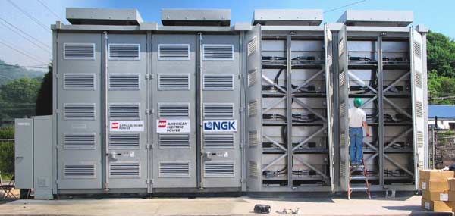
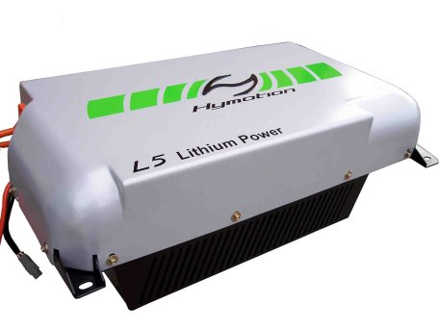
Battery Technologies
Sodium Sulfur (NaS)
High power output
High efficiency
Good cycle life
Low maintenance
Commercially immature
www.technoologyreview.com
Lithium Ion (Li-ion)
High energy density
Recycled/Reused PHEV batteries
Rapidly developing technology
Relatively expensive
Low cycle life
www.greencar.com

Slide 10
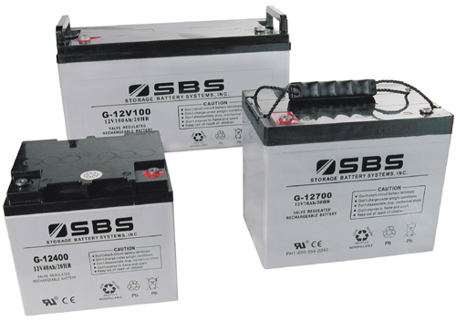
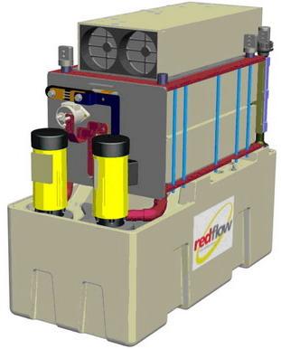
Battery Technologies Cont.
Lead-Acid (L/A)
Commercially very mature
Low cost of installation
Low conversion efficiency
Very poor cycle life
Low energy density
www.sbsbattery.com
Zinc Bromine (ZnBr)
Easy relocation
Commercially immature
Medium cycle life
Medium cost
Larger footprint
www.wikipedia.org

Slide 11
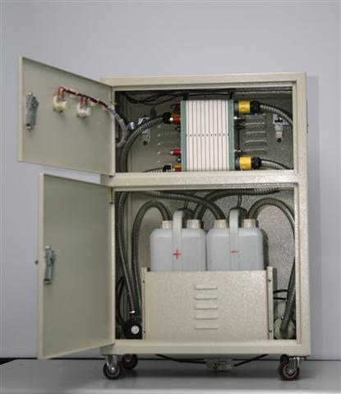
Battery Technologies Cont.
Vanadium Redox Battery
Fast load response
High efficiency
Good cycle life
Commercially immature
Low energy density
www.flikr.com
Other Technologies
Nickel Cadmium (NiCd)
Nickel Metal Hydride (NiMH)

Slide 12
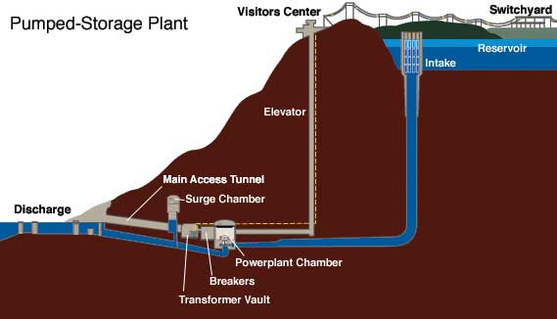
Physical Energy Storage: Fluid Storage
Pumped Hydro: Pumped Hydro plants store and generate energy by moving water between reservoirs at different elevations.
When electricity demand is low, water is pumped to the upper reservoir, then during high electricity demand, water is released into the lower reservoir through turbines which generate energy.
4. http://hydro.org/tech-and-policy/technology/pumped-storage/

Slide 13
Physical Energy Storage: Fluid Storage Cont.
Compressed Air (CAES): Energy is stored when air is compressed, cooled, and stored at high pressure in a sealed container. That stored energy is converted back to electricity by using the compressed air in a turbine.
Compressed air is stored in large underground caverns.
There are limited areas where large subterranean caverns for this type of operation are available.

Slide 14
Physical Energy Storage: Momentum
Flywheel:
Storage system where energy is stored in the kinetic energy of a rotating mass– a rotor that converts energy between electrical and mechanical forms.
In the flywheel system, the rotor operates in a vacuum.
Steel-rotor systems rely mostly on mass of rotor, while composite (resin/glass or resin/carbon-fiber) flywheels rely more on a higher angular velocity.
Advantages:
Minimal operation and maintenance (O&M) requirements
Compact and self-contained
No hazardous chemicals or flammable gasses
Disadvantages:
Challenges related to rotating energy equipment
site selection, material selection and testing
1. Boyes, J.D.; Clark, N.H.; , "Technologies for energy storage. Flywheels and super conducting magnetic energy storage," Power Engineering Society Summer Meeting, 2000. IEEE , vol.3, no., pp.1548-1550 vol. 3, 2000

Slide 15
Physical Energy Storage: Thermal
Ice Energy
The is not direct connection to the grid via an inverter.
Water is frozen during off peak times when the load is low.
Water is then circulated through the frozen housing on peak to produce chill water for cooling.
With this procedure thermal energy storage in the form of frozen ice is ideal for load shifting.

Slide 16
Physical Energy Storage: Thermal
Molten Salt:
Molten Salt Storage
Typically transmission level
Tied to solar-thermal plants or waste-heat producers
Can be hundred of MW
Energy is collected from a field of heliostats and the energy is used to heat molten salts.
The high temperature salts can then be used to boil water in a conventional steam system or stored for later use.
Molten salts are used because of their high specific heat capacity.
These installations can be used for a number of functions:
Off-peak power production
Power output stabilization
Base loading as in the case of Solar 2

Slide 17
Physical Energy Storage: Magnetic Fields
Superconducting Magnetic Energy Storage (SMES):
SMES has a coil of superconducting wire that the direct current flows through, creating the magnetic field that stores the energy without converting it to chemical or mechanical forms.
Must operate at cryogenic temperatures to stay superconductive
Advantages:
Can both release large quantities of power and fully recharge quickly, thus is efficient and economical
Highly mobile devices
No hazardous chemicals or flammable gasses
Disadvantages:
Produce large magnetic fields
Potential to rapidly pressurize if coils become non-superconducting
Cryogenic temperatures are not safe for people to come into contact with
1. Boyes, J.D.; Clark, N.H.; , "Technologies for energy storage. Flywheels and super conducting magnetic energy storage," Power Engineering Society Summer Meeting, 2000. IEEE , vol.3, no., pp.1548-1550 vol. 3, 2000

Slide 18
Physical Energy Storage: Electric Fields
Ultra Capacitors:
Stores energy electrostatically by physically separating positive & negative charges—unlike batteries which do so chemically.
Advantages:
Very fast charge and discharge times
Long operational life– may be charged and
discharged hundreds of thousands of times
High efficiency
Environmentally friendly
Disadvantages:
Low energy density
Commercially immature
http://www.nrel.gov/vehiclesandfuels/energystorage/ultracapacitors.html

Slide 19
Grid Connected Energy Storage - Transmission
In these applications the stored energy can be connected directly to the grid via an inverter.
Transmission
Sodium Sulfur
Pumped hydro
Compressed Air
Flywheels
Uses
Support renewable generation
Short-term backup
Fast response load pickup
Grid stabilization

Slide 20
Grid Connected Energy Storage - Distribution
Similar to the transmission level, in these applications the stored energy can be connected directly to the grid via an inverter.
Distribution
Sodium Sulfur
Lead Acid
Community Energy Storage
NiMH/Li-ion
Secondary use of PHEV batteries
Uses
Demand/generation shifting
Renewables integration
Short-term backup
Fast load pickup
Islanding

Slide 21
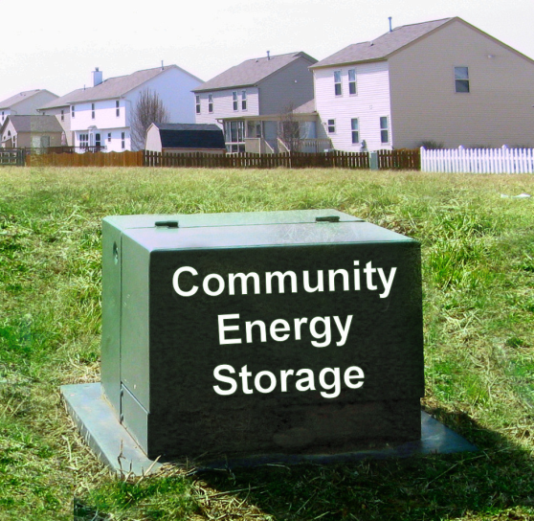
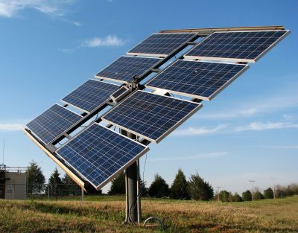
Community Energy Storage
www.icandoitmyself.com
www.aeptechcentral.com

Slide 22
Community Energy Storage Cont.
Advances in battery technology are beginning to make CES type technologies cost effective.
Enhancement of distributed / renewable generation support.
Provides the following capabilities:
Improved reliability and temporary islanding support
Peak shaving / congestion management
Load response to market signals
Reduced system losses
Power quality control
Local voltage control

Slide 23
Grid Influencing Energy Storage
In these systems the stored energy of the unit is not converted directly to electricity and tied to the grid via and inverter.
Instead, the energy storage is available to offset energy consumption.
Storing energy in the form of ice for later cooling use is one example.
Distribution level technology
Tied into HVAC units
Can be used to shift load or reduce peaks

Slide 24
Part 2: Energy Storage Uses
Storage Analysis
Transmission Level
Ancillary Services
Regulation
Load following
Distribution Level
Peak shifting
Peak shifting with Thermal Energy Storage (TES)

Slide 25
Storage Analysis-Storage Characteristics
Cell/stack voltage (electrical)
Electrical potential for individual cells, or a stack of cells
Measured in Volts
Energy capacity (electrical, mechanical, heat)
Stored electrical charge
Measured in Watt-hours, Ton-hours, or BTU

Slide 26
Storage Analysis-Storage Characteristics Cont.
Output rating (electrical, mechanical, heat)
Electrical output rate
Power: how much power can be provided at a single time.
Nominal: discharged at rated voltage and current
Peak: maximum power output
Energy: how much energy can be provided by the unit.
Because of the internal resistance higher discharge rates reduce the power that can be delivered by the battery.

Slide 27
Storage Analysis-Storage Characteristics Cont.
Internal resistance (electrical)
Internal losses in the battery that manifest as thermal losses.
Because of the internal resistance the efficiency of a battery will change with rate of discharge.
Measured in Ohms
Operating temperature
When in operation there is a band in which the unit must operate to ensure the proper chemical reactions.
There are also temperature requirements for storage to ensure the effectiveness of the reactants.

Slide 28
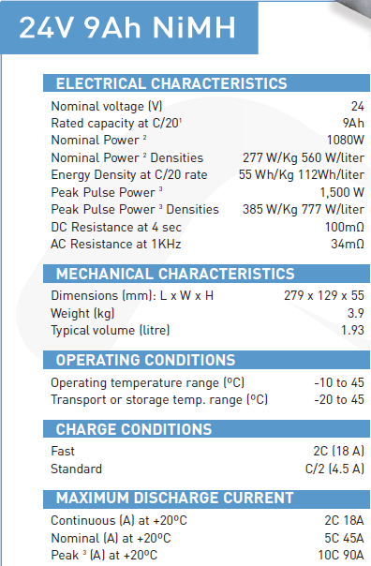
Storage Analysis Example
Nilar Membrane NiMH Battery
Cell Voltage
Energy Capacity
Power Output
Peak Power Output
Internal Resistance
Charging Information (Power Input)
Peak Output as “C” rating

Slide 29
Storage Analysis Example 1
Assume the Nilar 24V 9Ah battery
Suppose we have an application that requires a current draw of 8.0 Amps at nominal voltage. How long would we expect this battery to last under ideal conditions?
What is the “C” rate of the previous problem?

Slide 30
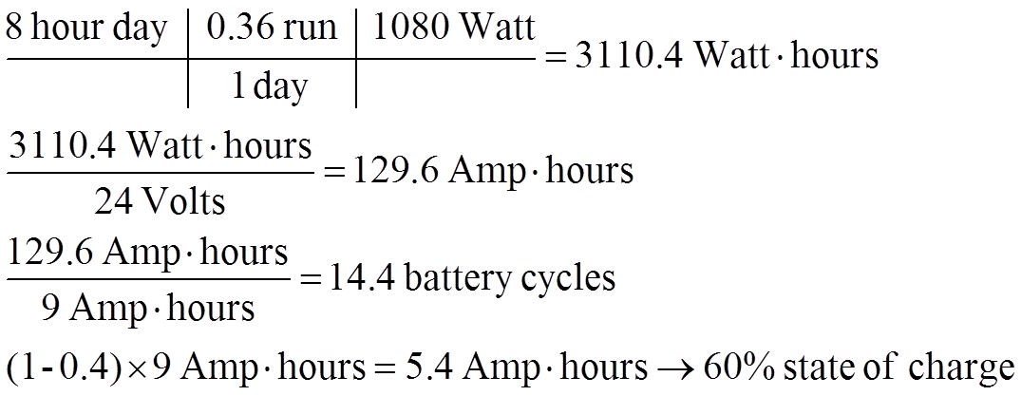
Storage Analysis Example 2
Suppose a go-cart runs on a single Nilar 24V 9Ah battery. Over the course of an 8-hour day, the go-cart is run at nominal power output for 36% of the time. Assuming an ideal cell and efficiency and voltage, will the battery need to be changed? What is the final capacity of the battery in the go-cart at the end of the 8-hour day?
Yes, it will need to be changed (14 times)
Final capacity

Slide 31
Transmission Level: Ancillary Services (AS)
Energy storage for transmission level ancillary services can be deployed at the transmission or distribution level.
These assets can be aggregated populations, or single installations.
Single installation: NaS
Aggregate installation: CES
Regulation and load-following abilities
Regulation: follows smaller, faster changes in power to balance the power (~4 seconds)
Load-following: follows slower changes in power (minutes)

Slide 32
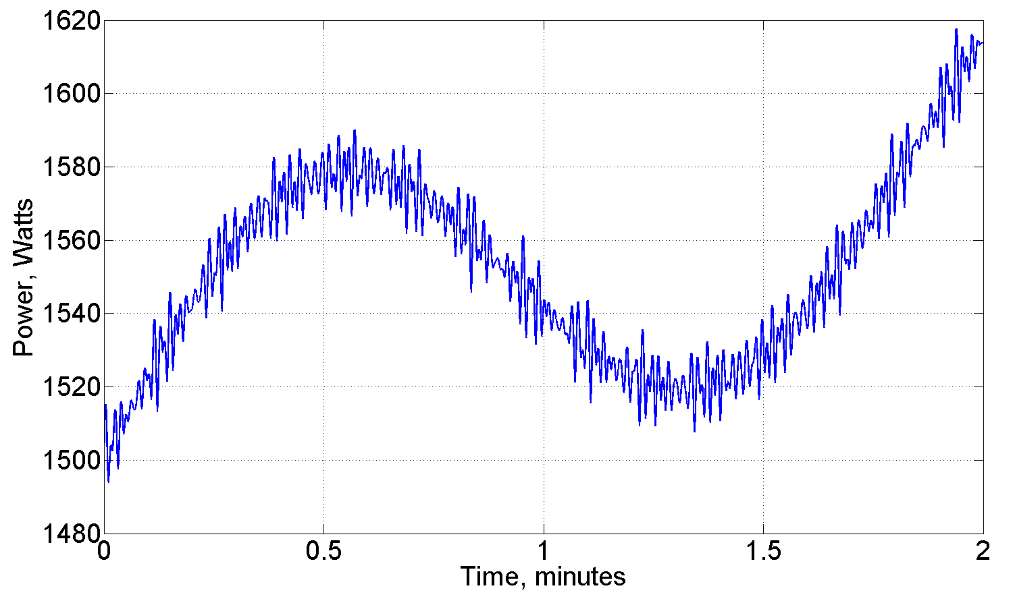
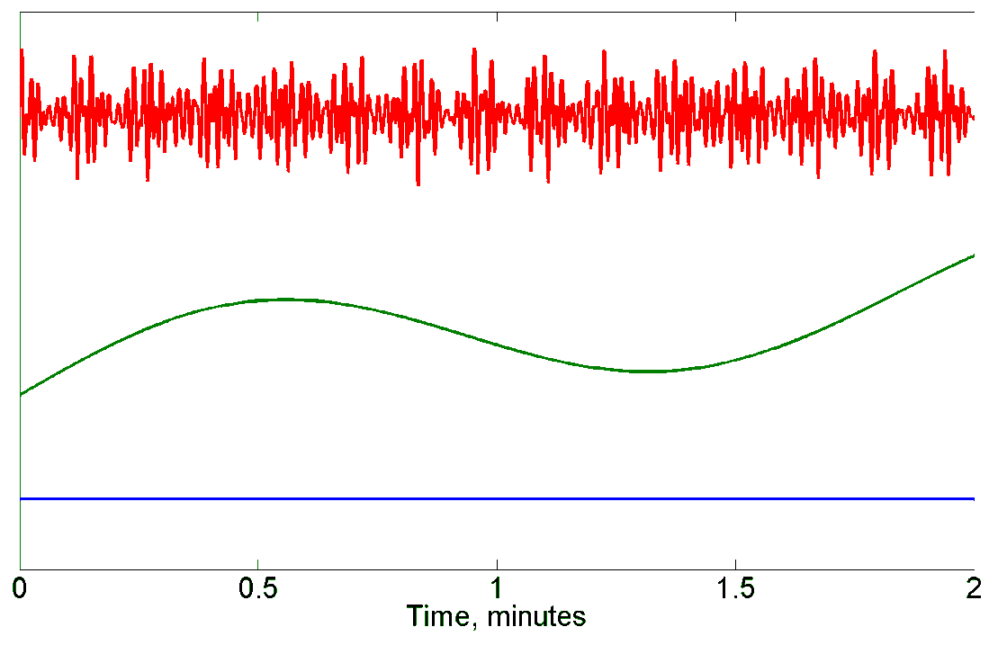
Transmission Level: AS – Example
Regulation
Fast variations
Load Following
Slow variations
Base Load
Constant

Slide 33
Transmission Level – AS: Regulation
Necessary Capabilities
Fast charge/discharge (4 seconds)
Varying power output levels
Small to moderate capacity
Ability to smooth intermittent power from renewables integration
Devices
Batteries
CES
PHEVs
Flywheel
Pumped Hydro & Compressed Air (Small scale theoretically possible, but not practical so far)

Slide 34
Transmission Level – AS: Load Following
Necessary Capabilities
Medium charge/discharge response time (minutes)
Varying power output levels
Larger capacity
Devices
Batteries
CES
PHEVs ← Not necessarily as well suited
Pumped Hydro & Compressed Air ← Small scale theoretically possible, but not practical so far

Slide 35
Distribution Level: Peak Shifting
Purposes
Peak shifting or “valley filling” is relative to the objective. The peak with respect to which peak?
Customer peak – reducing customer load during “expensive” power periods
Feeder peak – reducing customer load during peak utility periods
Possible carbon impacts (extremely region/instance dependent)
Implementations include:
Thermal Energy Storage (TES)
Community Energy Storage (CES)

Slide 36
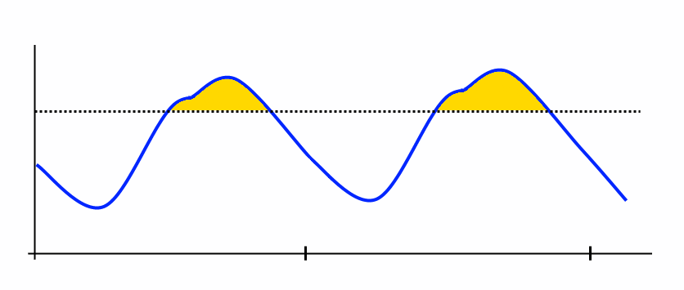
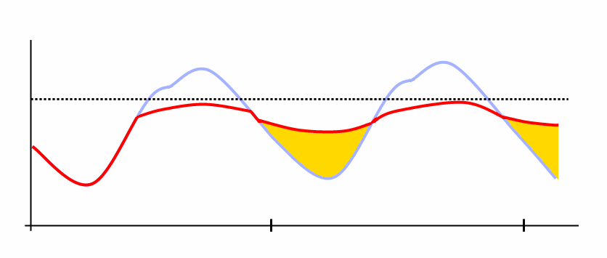
Distribution Level: Peak Shifting – Example
“Valley Filling”
Shift energy consumption from high demand time to low demand time

Slide 37
Distribution Level: Peak Shifting – Thermal Energy Storage
Smart Grid Investment Grant (SGIG) Projects
Thermal energy storage (TES) as a method for shifting feeder peak
Utility controlled
Larger units – deployed on commercial buildings
Cooling Thermal Energy Storage
5-ton storage capacity (5 cooling tons)
Make ice during off-peak, low demand times
Normal cooling load to make ice
Melt ice during on-peak, high demand times
Provides cooling to building, instead of air conditioner system
Small cooling load required – just a small circulating pump

Slide 38
Distribution Level: Peak Shifting – Thermal Energy Storage Cont.
Representative 12.47 kV distribution feeder with a peak load of just over 9 MVA.
457 houses, the majority with A/C units.
427 commercial building zones, with some commercial buildings having more than one zone.
On average, a 3% peak reduction in the peak load.

Slide 39
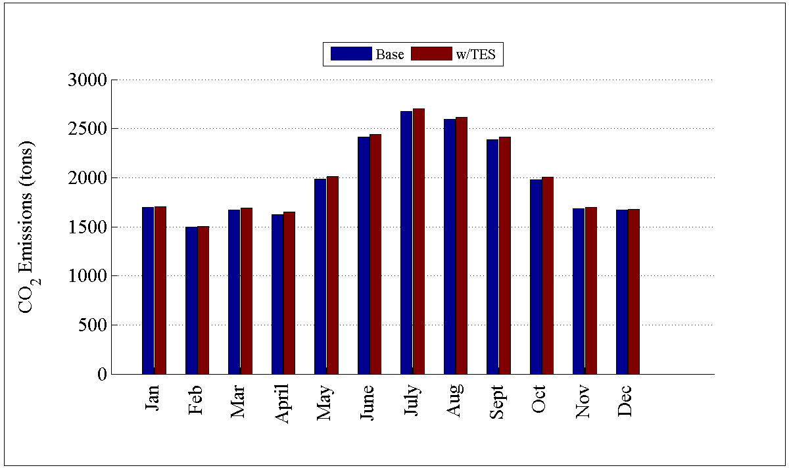
Distribution Level: Peak Shifting – Thermal Energy Storage Cont.
Despite the savings, CO₂ emissions actually increased slightly
Consistent increase in CO₂ emissions for all months

Slide 40
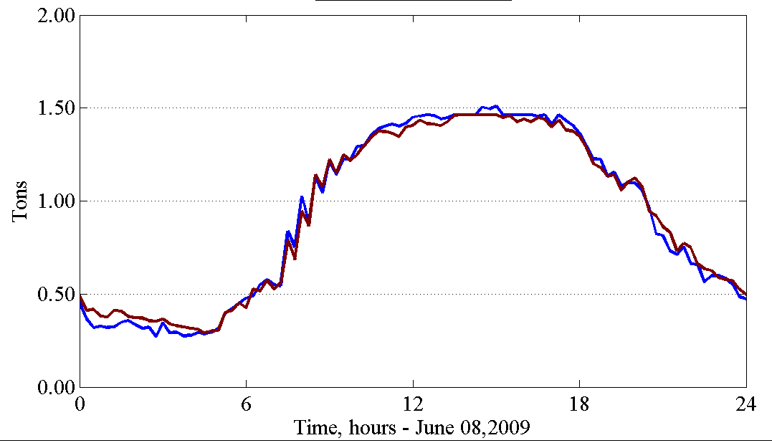
Distribution Level: Peak Shifting – Thermal Energy Storage Cont.
Emissions only slightly lower in during peak demand times
Emissions slightly higher in early morning hours – recharging of TES
Generator dispatch is key
Relatively “clean” natural gas or hydro during much of the peak demand
“Dirtier” coal generation during early morning hours

Slide 41
Part 3: Electric Vehicles
Overview
Electric vehicles on the distribution feeders
Usage potentials
Storage considerations
Implementation issues

Slide 42
Electric Vehicles – Overview
History
Classifications of electric vehicles
Hybrid Electric Vehicle
Plug-in Hybrid Electric Vehicle
Battery Electric Vehicle
Examples of the various vehicles
HEV
PHEV
BEV
Current deployment

Slide 43
History of Electric Vehicles
Electric vehicles were in existence as early as the 1830’s
Thomas Davenport – small drifter – 1835
Robert Davidson – electric locomotive – 1838
Robert Anderson – electric carriage (1830s – exact date unknown)
Before the proliferation of gasoline powered automobiles it was not clear which technology would become the dominate form of transportation.
In the late 19th/Early 20th century electric vehicles while not the mainstream were not unheard of.
Detroit Edison 1916

Slide 44
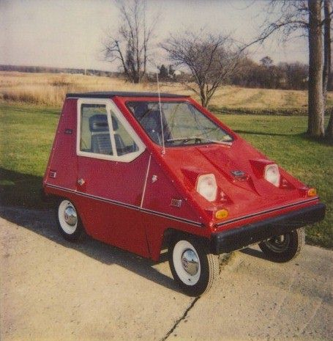
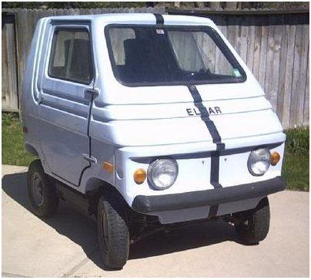
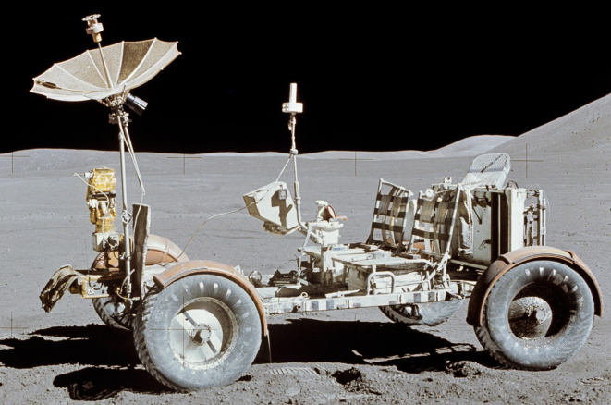
History of Electric Vehicles Cont.
CitiCar
1920s – 1990s
Decline in electric vehicles
Interstate system required longer range.
Mass production made cheaper gas engines (Henry Ford).
Discovery of crude oil deposits in Texas made gasoline cheaper.
Invention of the electric starter (Kettering – 1912).
Some experiments persisted
Zagato Zele / Elcar – 1975
Sebring-Vanguard CitiCar – 1974 – 1977
Lunar Roving Vehicle – 1971/1972
Elcar
Lunar Roving Vehicle

Slide 45
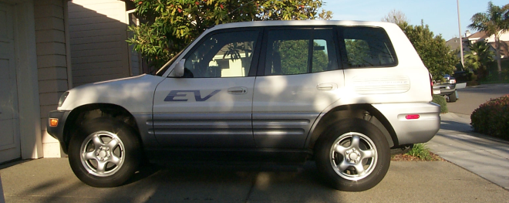
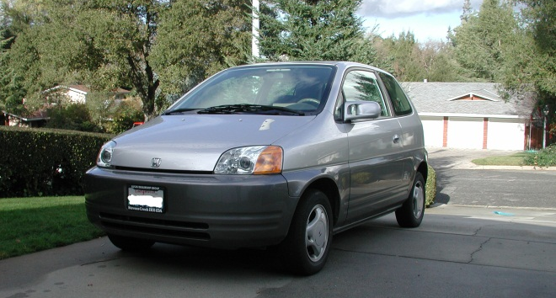
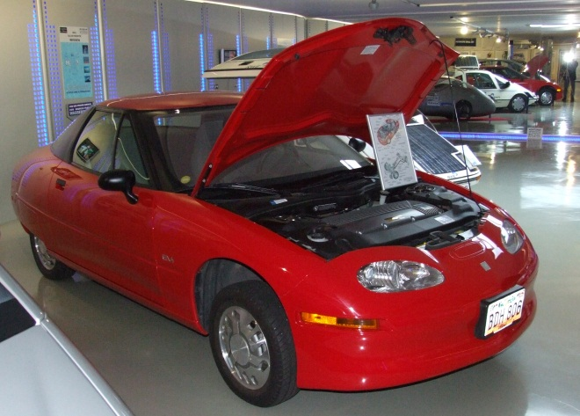
History of Electric Vehicles Cont.
1990s
California Air Resources Board (CARB) mandate for “zero emissions vehicles”
General Motors EV1
Toyota RAV4
General Motors S10 EV
Honda EV Plus
Chrysler TEVan
CARB mandate modified
Most vehicles destroyed by manufacturers
328 RAV4s sold to public
Toyota RAV4 EV
Honda EV Plus
GM EV1

Slide 46
History of Electric Vehicles Cont.
Late 1990’s to Present
Renewed interest
Battery technology has improved
Petroleum prices risen
Increased public interest in “sustainability”
Reliable Plug-in Hybrid Electric Vehicle technology
Production vehicles becoming available
Tesla Roadster
Nissan Leaf
Chevrolet Volt
Toyota Prius

Slide 47
Classifications of Electric Vehicles
Hybrid Electric Vehicle (HEV)
Combustion engine and electric motor both present.
Battery only chargeable via regenerative braking and combustion engine.
Plug-in Hybrid Electric Vehicle (PHEV)
Combustion engine and electric motor both present.
Battery chargeable through regenerative braking, combustion engine, and via external electrical source (plug).
Battery Electric Vehicle/Electric Vehicle (BEV)
No combustion engine.
Battery chargeable via regenerative braking and external electrical source.

Slide 48
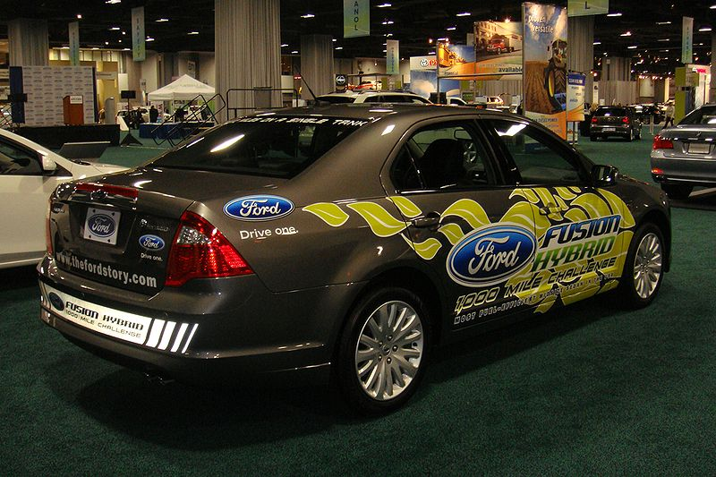
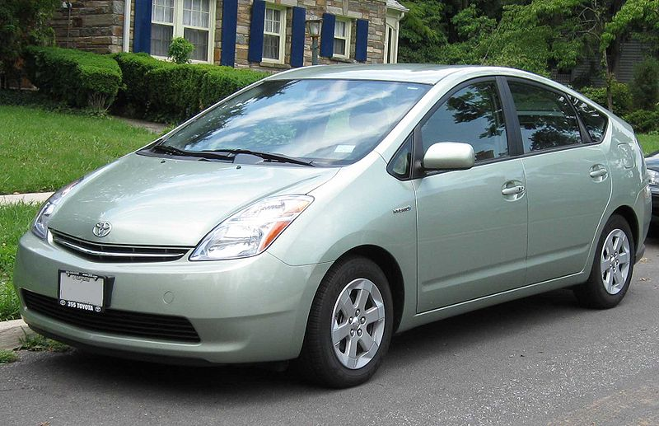
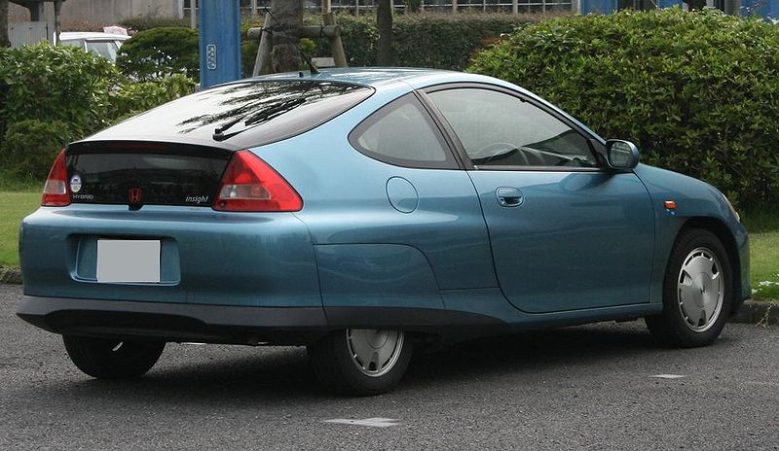
Hybrid Electric Vehicle
Toyota Prius
Honda Insight
Ford Fusion Hybrid
Ford Fusion Hybrid
Toyota Prius
Honda Insight

Slide 49
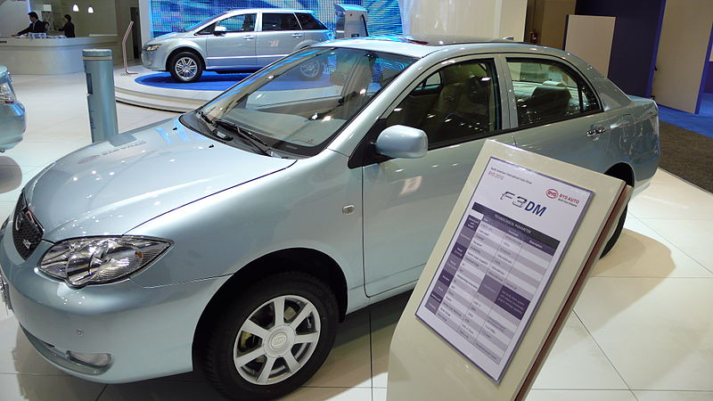
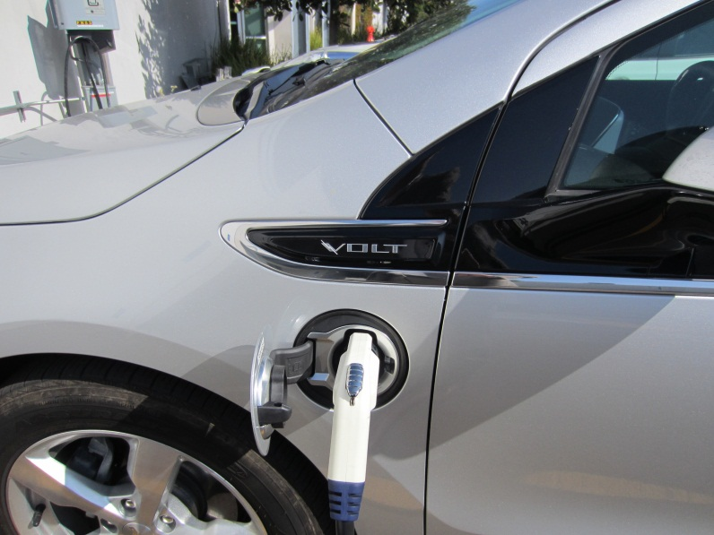
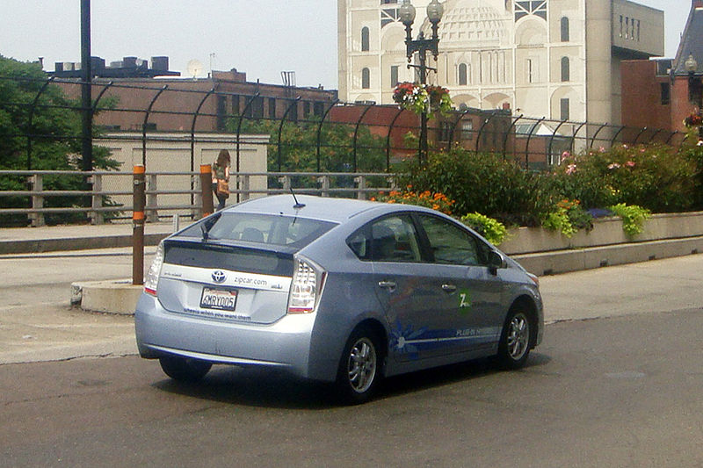
Plug-in Hybrid Electric Vehicle
Chevrolet Volt
Toyota Prius PHEV
BYD F3DM
BYD F3DM
Chevrolet Volt
Toyota Prius PHEV

Slide 50
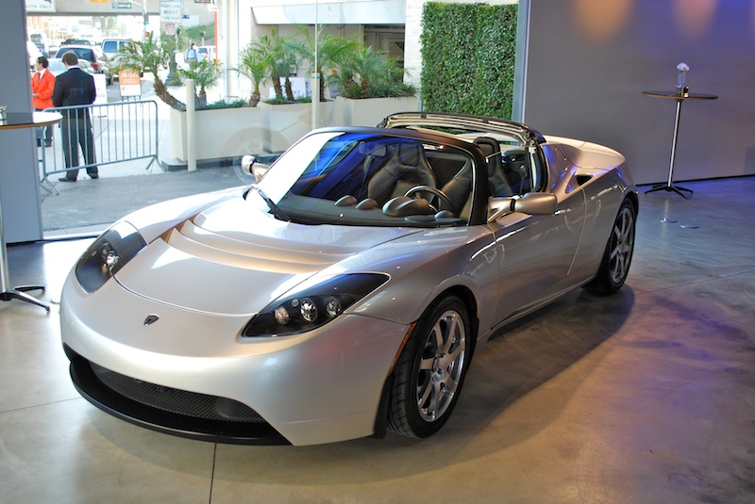
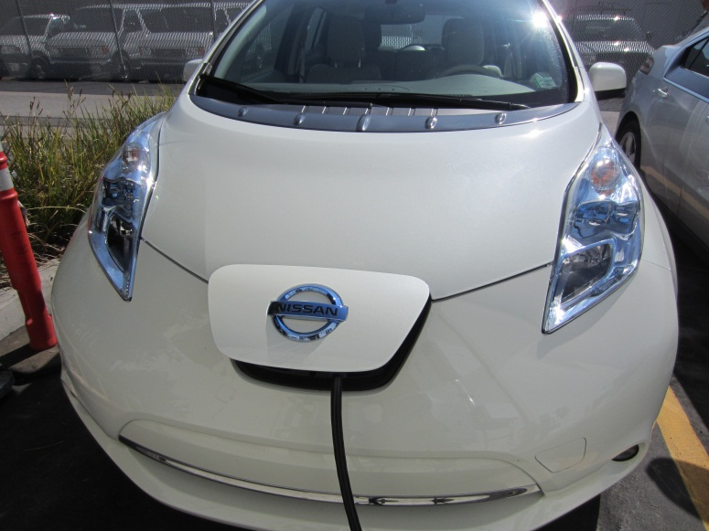
Battery Electric Vehicle
Nissan Leaf
Mini Cooper Mini-E
Tesla Roadster
Tesla Roadster
Nissan Leaf
Mini Cooper Mini-E

Slide 51
Current Deployment of Electric Vehicles
Electric Vehicle Numbers
27,000 – Estimated number on the road (2011)
496,000 – Expected number by 2015
Batteries
Li-ion chemistry in most
Capacities vary
Toyota Prius PHEV – 4.4 kWh
Nissan Leaf – 24 kWh
Chevrolet Volt – 16 kWh
Mini Cooper Mini-E – 35 kWh
If 2015 numbers and Chevy Volt battery sizes are used, the grid ideally has access to almost 8 GWh of storage!
Even a small fraction of this is a significant resource for the power grid.

Slide 52
Electric Vehicles on the Distribution Grid
Electric vehicles represent a new load at the distribution level and this can cause operational issues.
Can be an additional load equivalent an extra hot water heater in the house.
Level 1 Charging – 120 VAC @ 16 A = 1.92 kW
Level 2 Charging – 240 VAC @ 32 A = 7.68 kW
240 VAC @ 80 A = 19.2 kW
Operational system effects include:
Coincidental loading – commuters all plugging in when come home
Potential to overload distribution transformers
Possible peak generation issues
Potential solutions include:
Time-of-use rates for charging
Deferred (timer-based) charging
Regulation charging

Slide 53
Power System Engagement of Electric Vehicles
Because of the size of the light duty vehicle fleet in the United States, EVs represent a potentially massive energy storage resource.
Similar to DR, EVs must be engaged by the power system in a way that does not adversely affect the end-use customer, and the end-use customer must be compensated for their participation.
EVs have the potential to be engaged in power systems operations such as load leveling and providing ancillary services.

Slide 54
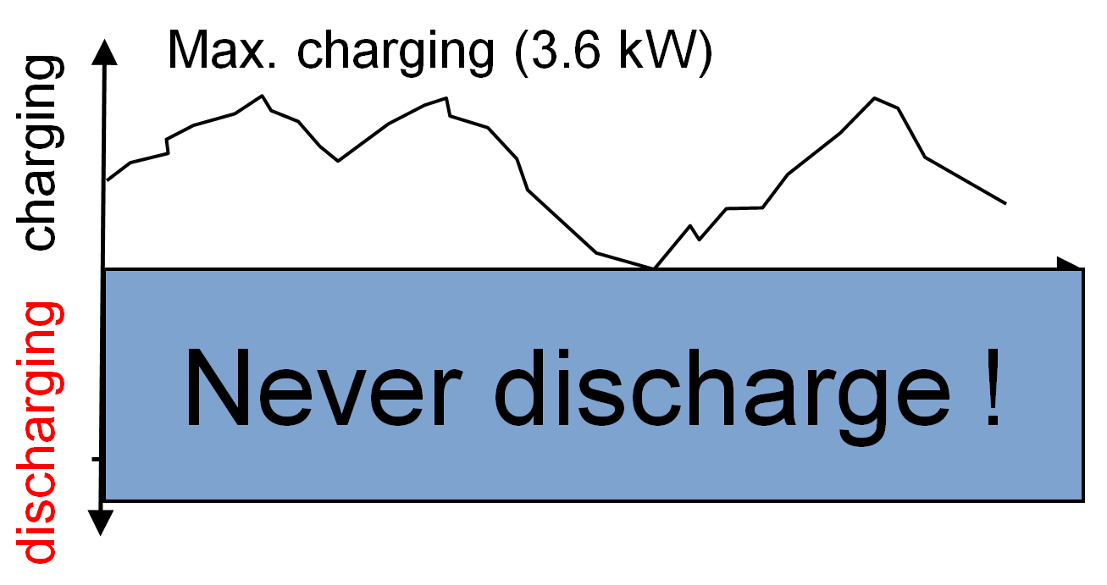
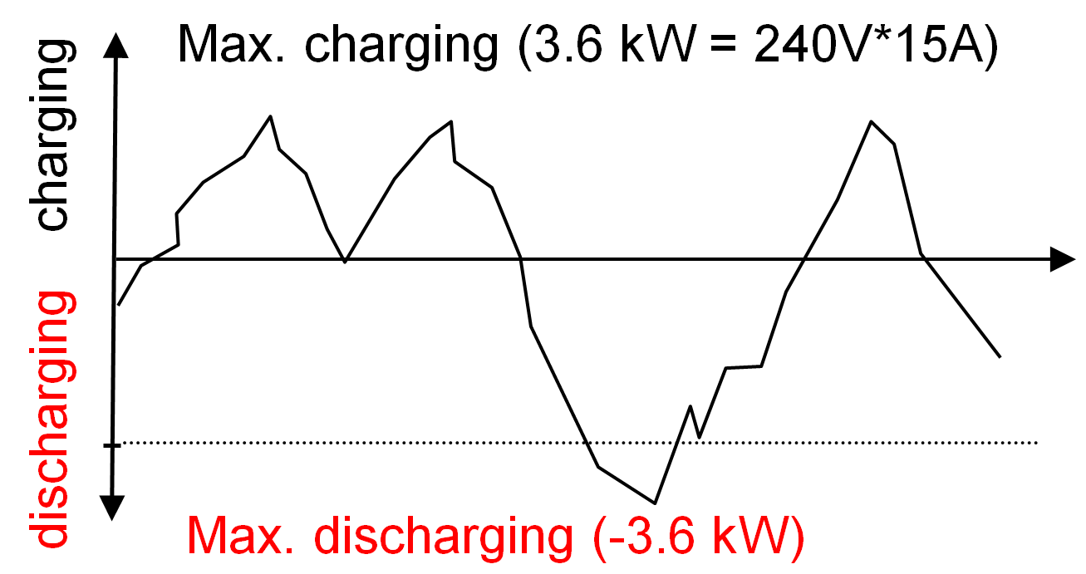
Overview of EV Potential
Electric vehicles as a grid resource
Potential as load (V2GHalf or G2V)
Charge rate can be varied to meet grid demands
“Load resource” availability dictated by charge needed
Potential as storage (V2GFull or V2G)
Charge rate and discharge rate can be varied to meet grid demands
Ability to discharge after 100% full – maintain longer “grid resource” availability
Electric vehicles as a customer item
Battery capacity
Spontaneous trips
“Charge by” requirements
Compensation for use as grid resource
Control location
Localized
Centralized
V2GHalf or G2V
V2GFull or V2G

Slide 55
Off-Peak Storage
V2G required
Direct Economics
Charge electric vehicle during cheaper night rates
Sell back into grid when prices higher
Feed load from electric vehicle battery
Distributed Renewable Generation
Charge during generation peak
Solar peak – daytime charging
Wind peak – often nighttime charging
Utilize during periods of low generation
Grid Stability
Charge during excess generation
Provide back into grid during generation shortfalls

Slide 56
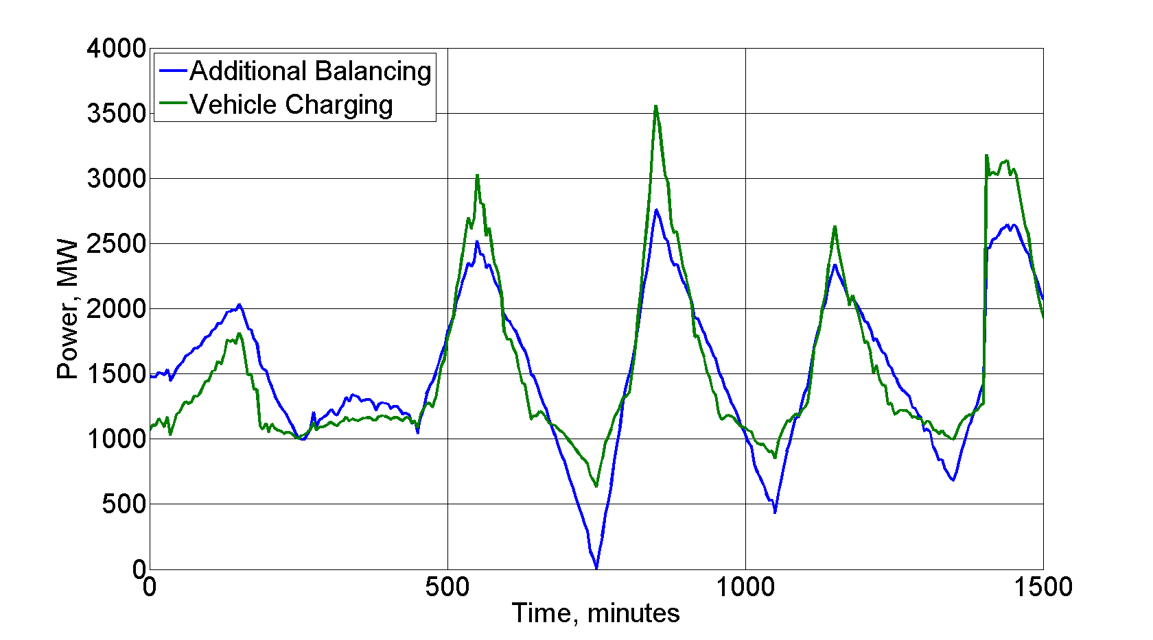
Ancillary Services
Type of service
Regulation – Fast response time – on the order of 4 seconds
Load following – Slow response time – on the order of 1 to 5 minutes
External control or frequency-based
V2G
Provide both “incremental” and “decremental” power to the grid
Incremental – charge for over-frequency/over-generation
Regulation Services – Balancing
Charging follows balancing requirements
Decremental – discharge for under-frequency/under-generation
Ability to maintain availability by discharging after 100% state-of-charge
G2V or V2GHalf
Provide mainly “incremental” power, but supply “apparent decremental”
Incremental – charge for over-frequency/over-generation
Apparent decremental – slow/stop charge rate for under-frequency/under-generation
Resource unavailable once 100% state-of-charge reached

Slide 57
Considerations for using Electric Vehicles for Power System Operations
Operational issues
Availability Constraints: vehicles are not always available.
Customer Requirements: the customer will want the EV to be used for driving primarily, and for the utility a distant second.
Life Cycle: the cycling operations initiated by the utility will impact the battery depending on the battery chemistry.
Battery “Second life” Usage: once batteries are done in an EV, there is still significant capacity that could be engaged in CES type systems once the batteries rare repurposed.
Implementation issues
Availability/Customer Requirements: same as above.
Hardware Location: where in the residence to locate the additional hardware?
Novelty: early adoption may be replaced by fatigue as time passes.

Slide 58
Availability Constraints
Availability dictated by when car is plugged in and has free charge capacity
Range anxiety may force “charge now” option always
Vehicle may not be connected when not charging – limits potential for emergency grid usage
Shorter commutes and constant charging may naturally limit electric vehicle as a resource
Customer travel expectations
Certain battery capacity by certain time (“charge by”) – drives overall charge/discharge cycle
Spontaneous trips – capacity to take these trips expected
Customer ownership
Incentives for usage of their vehicle
Relinquishment of control over charging (if centrally aggregated)
Additional wear and tear on battery and components

Slide 59
Customer Requirements
Electric vehicle is a vehicle as a first use – customer may want certain levels of charge by certain times
Dictates charging/discharging rates
Determines resource availability
Customer may override “storage-mode” charging
Pure charging of battery – no grid services
If expected as part of aggregation, will alter estimates
Customer may only connect when charging – no idle connections
Limits availability of electric vehicle as resource
Limits flexibility on charging scenarios due to time constraints

Slide 60
Life Cycle
Potential life cycle influences:
Extra charge/discharge cycles associated with grid use may shorten the life of the battery
Shallow discharge/charge cycles of regulation services may limit battery life
Excess cycling causing thermal considerations (overheating)
Potential overall effects:
Limit battery life as a “traction” battery
Voiding of battery/automotive warranty
Extra cycles on charging/discharging equipment

Slide 61
“Second Life” Usage
Batteries “unfit” for transportation usage still have significant capacity
Useful for community energy storage projects
Smaller (backyard or pad placement)
“Safe” – built for automotive use, so various containment/safety mechanisms in place
Reduces environmental impact of batteries by extending their useful life
Incentives to customers
Deals with utility/automotive manufacturers to recoup costs
On-site energy storage

Slide 62
Hardware Location
Storage usage control
Centrally located
Communications channel to aggregator
Additional hardware to handle communications
Decentralized
Cheaper, local hardware
Not as coordinated
Location of charging equipment
Charging equipment in the house, not on the vehicle
Not located on car
Higher infrastructure costs
Location tied, not vehicle tied
Charging equipment on the vehicle
Located on car
Higher vehicle costs
Follows vehicle – if appropriate service is available
Charging equipment split between the house and the vehicle
Higher costs on both sides
Communications over charging cable or some other medium

Slide 63
Novelty
Electric vehicles relatively new to modern market
Range anxiety issues most prevalent fear – manufacturers want to avoid anything that may augment this fear
Vehicle may fail to meet 100% state-of-charge due to excess grid needs
Long discharge cycle might occur right before “spontaneous” trip
Operation could impact battery range/life
When the novelty fades it may be replaced by fatigue if the above issues are not handled to the satisfaction of the end-use customer.
Electric vehicles currently more expensive that gasoline counterparts
Additional “storage-capable” hardware increases price
Utility incentives may offset, but not always available

Slide 64
Module 7 Concluding Comments
Energy storage for the purposes of utility applications can be achieved through a number of technologies:
Chemical batteries
Transfer of fluids
Use of rotating bodies
Thermal masses
Manipulation of electromagnetic fields
Stored energy can be used for a number of proposes:
Peak reduction
Load following
Regulation
Electric vehicles are a form of energy storage that represent a significant potential resource, but there are challenges associated with engaging the end-use customers.

Slide 65
Substation and Distribution Automation
Conclusion of Module 7: Energy Storage and Electric Vehicles

