Slide 1
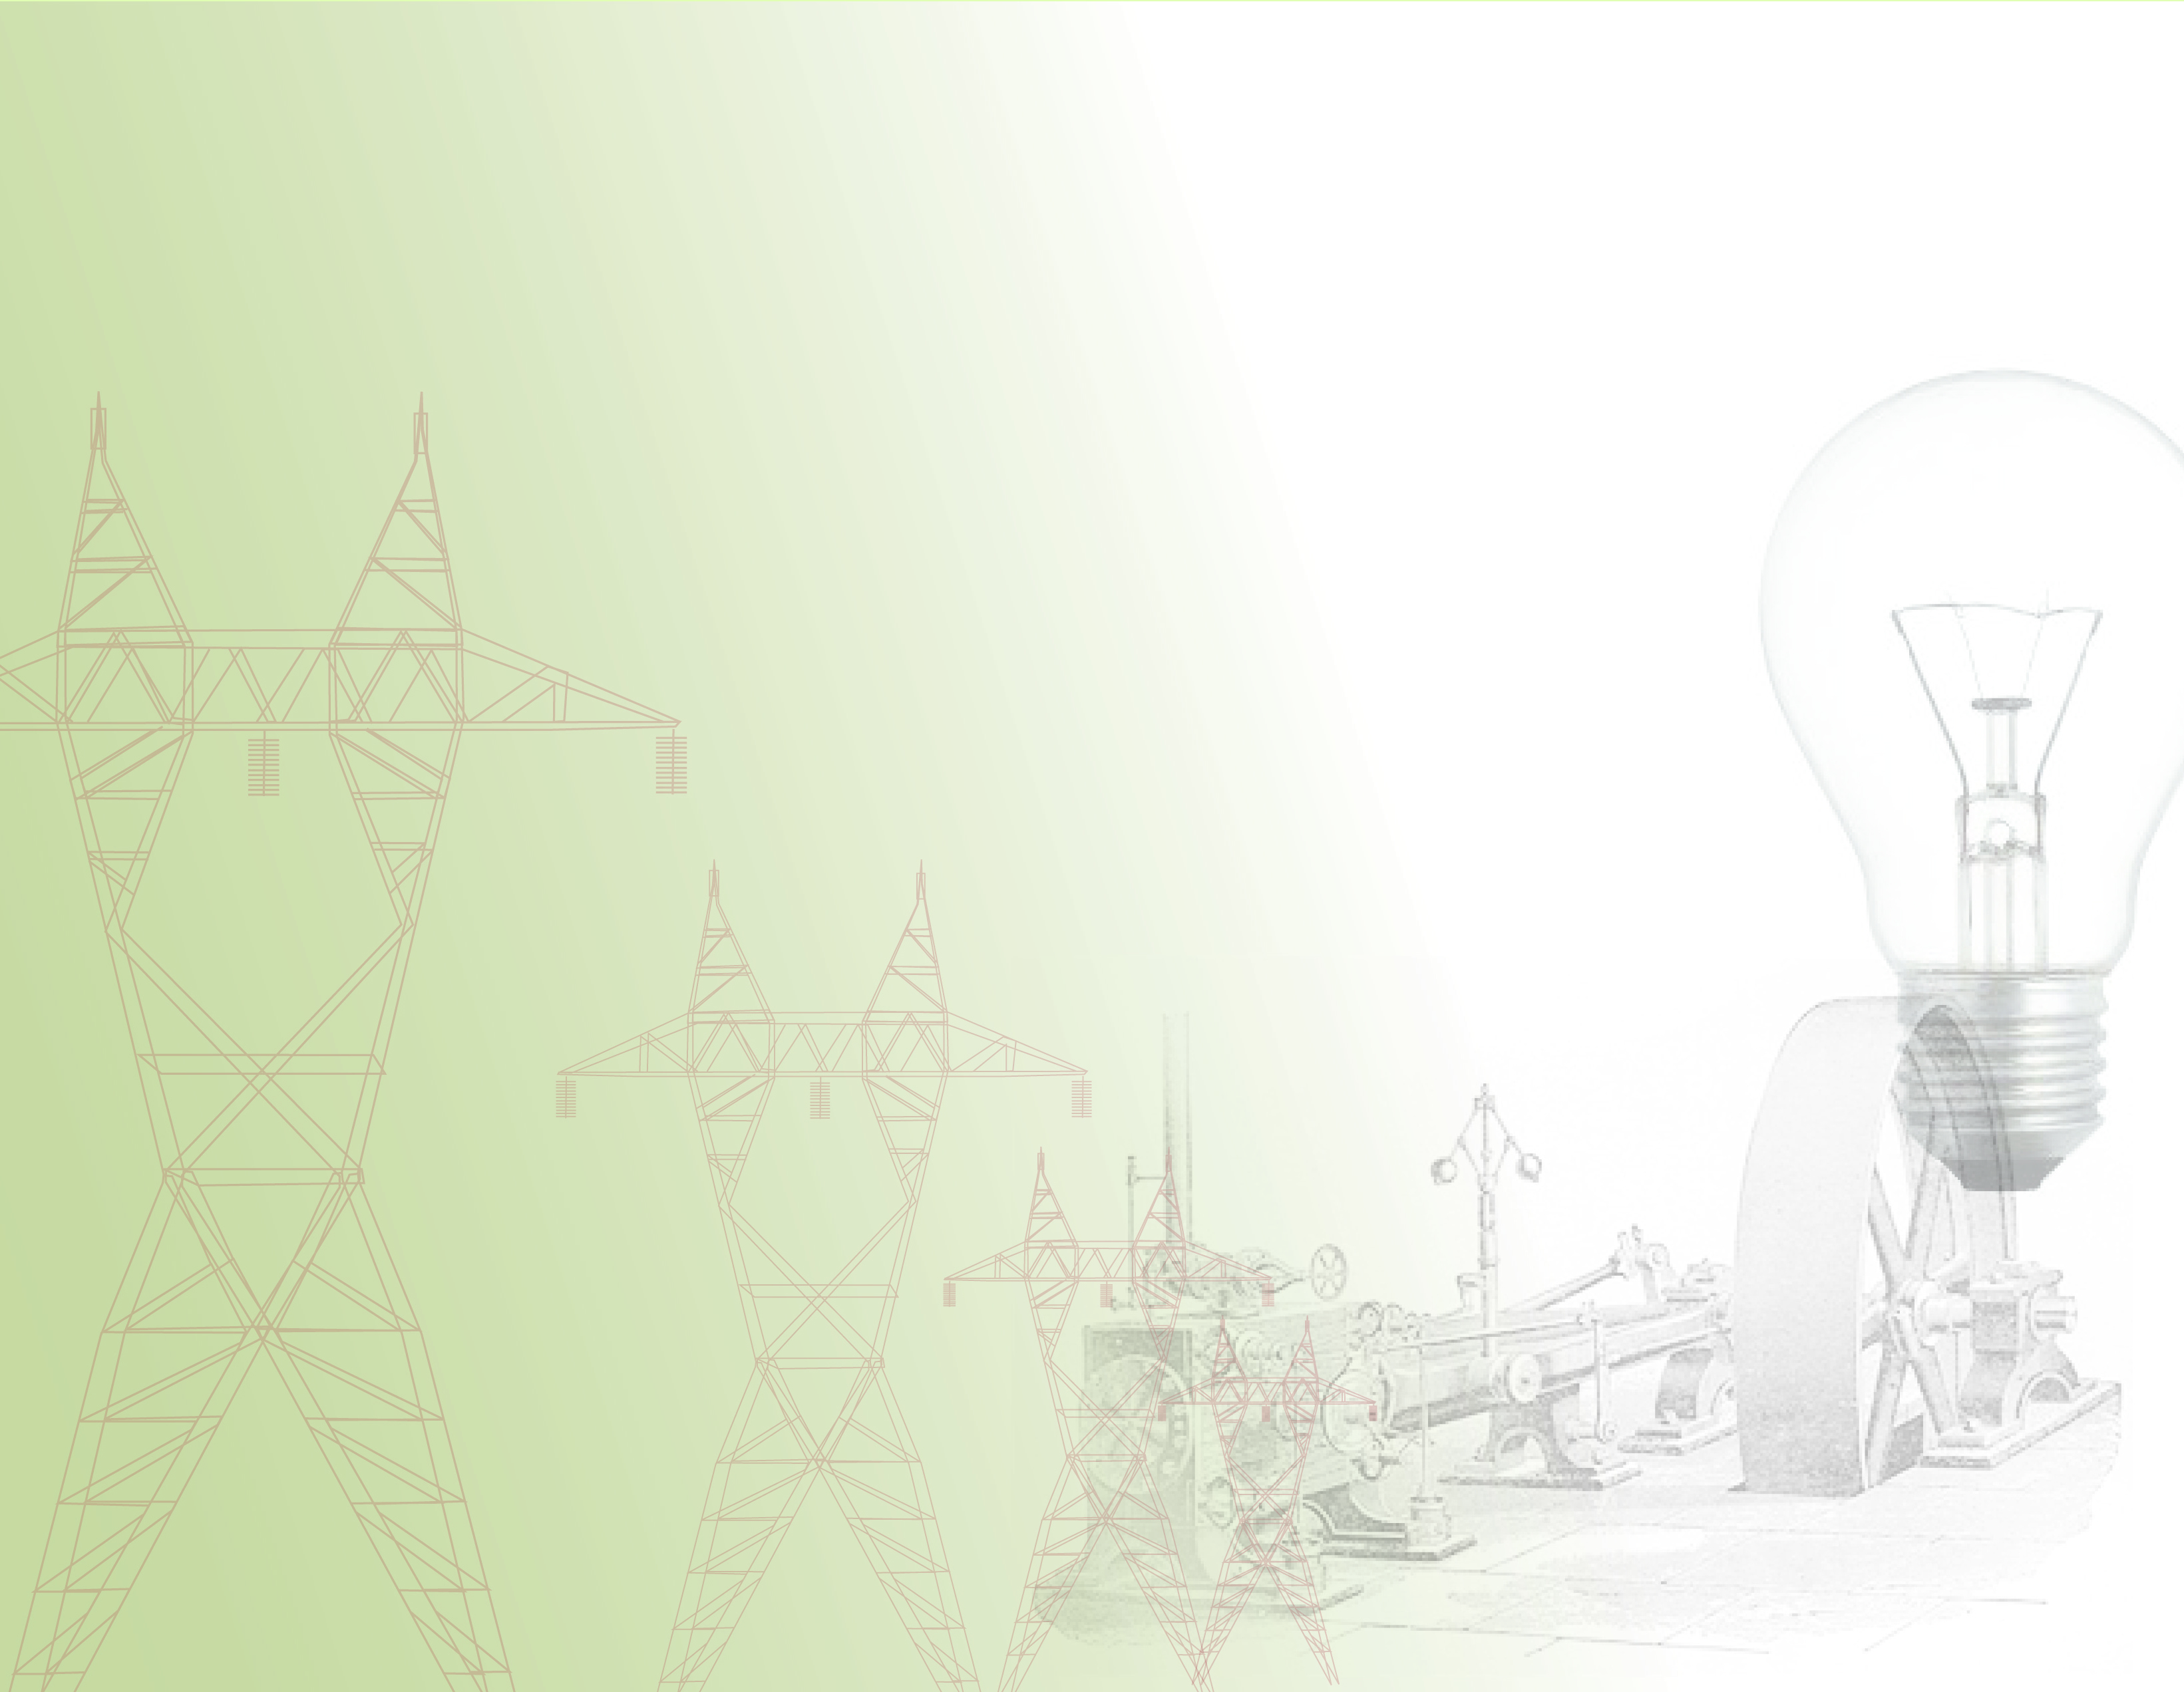
Development of the Electricity Industry in the Northwest
1-1

Slide 2

Overview – about this presentation
This training was prepared at the Pacific Northwest National Laboratory, for the Pacific Northwest Center of Excellence for Clean Energy at Centralia Community College. This work was funded through a United States Department of Energy workforce education grant.
This presentation is general to the Northwest, but specific to Washington State and interactions within the Seattle region. The focus on Washington, and the Seattle region in particular, is due primarily to the abundance of historical material for this region.
This presentation is not meant to be a comprehensive study of all the issues in the Northwest, but an introduction to many of the issues that have shaped the formation of the region’s electricity infrastructure.
The material in these slides is designed for a broad audience, and as such, a background in electrical engineering is not necessary. This material is appropriate for people with an interest in the general history of the electricity industry, or with an interest in understanding how past events have shaped the development of todays electrical infrastructure.
1-2
Notes:
UW Digital Archives, online: http://content.lib.washington.edu/
HistoryLink.org, online: http://www.historylink.org/
Paul Dorpat and Genevieve McCoy “Building Washington, A History of Washington State Public Utilities”
Neil McReynolds, “A Century of Service, The Puget Power Story”
Myra Phelps, “Public Works in Seattle, A Narrative History The Engineering Department 1875-1975”
Gene Tollefson, “BPA & The Struggle for Power at Cost”

Slide 3
Table of contents
Part 1: The Early Years of Electricity in the Northwest (Prior to 1900)
Part 2: Private Companies and Municipal Power (1900-1930)
Part 3: The Emergence of Federal Power (1930-1950)
Part 4: Post-War Growth Years (1950-1970)
Part 5: Challenges (1970-1985)
Part 6: The Modern Electric System in the Northwest (1985-present)
1-3

Slide 4

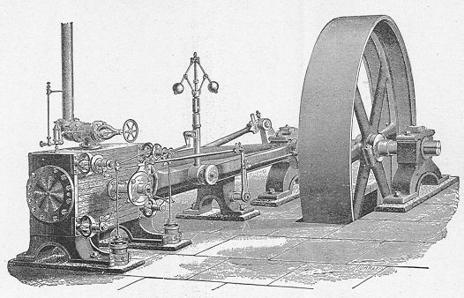
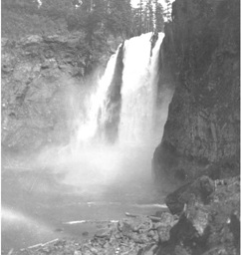
Part 1: The Early Years of Electricity in the Northwest
(Prior to 1900)
1-4
Notes:
Picture Details:
Left: Drawing of a Corliss Steam Engine.
Source: Wikipedia
Right: Snoqualmie Falls ca1901
Source: University of Washington Digital Libraries

Slide 5
Part 1 Overview
Early Power Systems in the Northwest
The First Electric Loads
Structuring and Financing the Early Systems
Local Consolidation of the Early Systems and the Shift to Central Power Generation
1-5

Slide 6
Part 1: The Early Years of Northwest Electricity
(Prior to 1900)
Section1: Early Power Systems in the Northwest
1-6

Slide 7
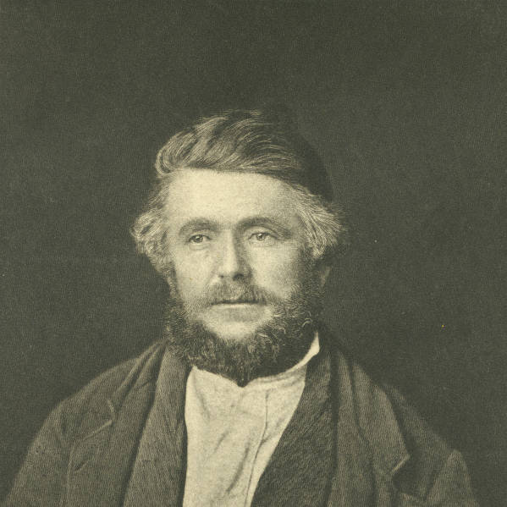
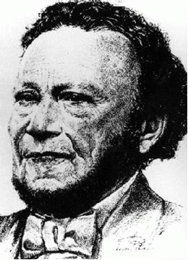
Part 1 (Prior to 1900): Early power systems in the northwest
Hydraulic (“Hydro”) Systems
In 1845 Michael Simmons and a group of emigrants established the first permanent settlement of “Americans” north of the Columbia River. The settlement was named New Market, now Tumwater, Washington.
This location was selected for 2 reasons:
Due to his ancestry, George Bush, one of the members of the party, was not allowed to own property in Oregon.
This location had access to the Deschutes River.
1-7
Notes:
Picture Details:
(top/left) Michael Simmons
Source: University of Washington Digital Libraries
(bottom/right) George Bush
Source: University of Washington Digital Libraries

Slide 8
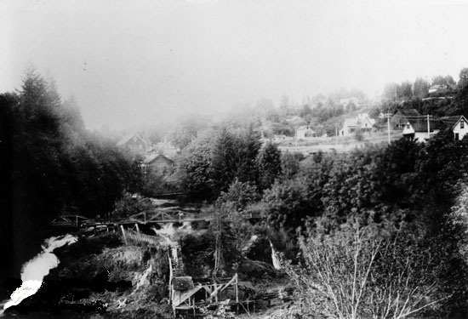
Part 1 (Prior to 1900): Early power systems in the northwest
Hydraulic (“Hydro”) Systems
After the first crop, the settlement constructed a water wheel fed by a hollowed out log in order to grind their wheat into flour. This mill was the first known hydro mechanical system in the Northwest.
This type of hydro mechanical system became common throughout the Northwest and it was the first means to harness hydro power in a mechanical form to perform work.
1-8
Notes:
Picture Details: This picture shows water-driven industries along Tumwater Falls. Michael T. Simmons' saw mill is
at the bottom of the photo.
Henderson House Museum photograph #600.
Source: City of Tumwater website http://www.ci.tumwater.wa.us/researchpioneerpg2.htm

Slide 9
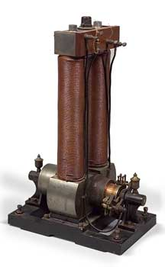
Part 1 (Prior to 1900): Early power systems in the northwest
The First Electricity in the Northwest
The first form of electric lighting to reach the Northwest was in the summer of 1879 when the S.S. California docked in Portland, OR.
The S.S. California had six arc lights that were powered by the ships dynamos. Dynamo was the name given to direct current generators.
Incandescent light would not arrive for another year, aboard the S.S. Columbia.
At this time Portland had a population of 40,000, Seattle only 10,000, and the total Northwest was less than 500,000.
Seattle did not see electricity for 2 more years (1881) when the S.S. Willamette anchored in Elliot Bay.
1-9
Notes:
Picture Details:
Photo of an Edison Long Legged Mary-Ann dynamo. These bipolar machines were generally 5-6 kW and produced 100V DC, primarily for lighting use. This is a picture of one of the four actual generators on the SS Columbia in 1880 for incandescent lighting.
Source: Edison Electric Institute

Slide 10
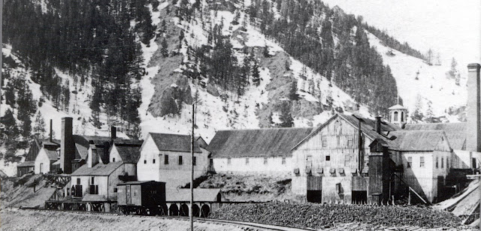
Part 1 (Prior to 1900): Early Power Systems in the northwest
The First “Central System” in the Northwest
The first Edison “central system” was built at the Philadelphia Companies Silver smelter in Ketchum, Idaho in 1882. In a central system the generation is located at a single fixed location.
The lighting provided by the system allowed the smelter to work around the clock, and two of the six lights it powered were contracted for use by the city.
The smelter closed down November of the same year, and so did the central system.
The system proved so popular that on Oct. 4th, 1886 the Boise City Electric Company was formed, and on July 4th 1887 the first light was lit.
The new system was powered by a small hydroelectric generator and the city contracted for 10 lights at $3 a month.
1-10
Notes:
Picture Details:
Philadelphia Smelter. No date.
Source: Ketchum Sun Valley Historical Society

Slide 11
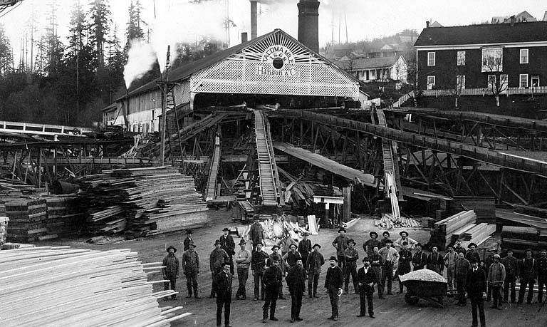
Part 1 (Prior to 1900): Early Power Systems in the northwest
Electrification of Hydraulic Systems
The first water-powered systems were hydro mechanical systems for performing mechanical work.
In 1882 the Tacoma Mill Company built a small plant on Galliher’s Gulch that included a dynamo to power a string of arc lamps, in addition to the existing mechanical load, so that workers could put in longer hours.
This was the first generator in the Washington Territory and the first example of using hydro for industrial, as well as electrical, purposes.
The power was only used at the mill, it was not transmitted any further.
For industrial locations that were already using hydraulic and/or steam, the addition of a dynamo was relatively easy, and cost effective, upgrade.
1-11
Notes:
Picture Details:
Tacoma Mill Company, 1893. This was one of the first Northwest industrial facility to use arc lights.
Source: University of Washington Digital Libraries

Slide 12
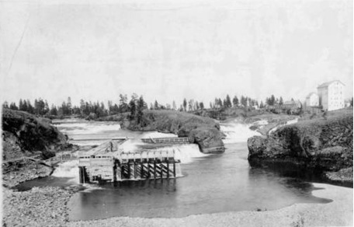
Part 1 (Prior to 1900): Early Power Systems in the northwest
The first Standalone Hydroelectric System
While it was easy to electrify industrial facilities with existing hydraulic capabilities, not all locations had these.
The first hydroelectric plant, without a corresponding industrial facility, in the northwest was built at Spokane Falls, WA in 1885.
A water wheel provided the motive force for a single dynamo that powered 12 arc lamps. The generated electricity only supplied local loads (e.g. within the same building).
1-12
Notes:
Picture Details:
C and C Mill at Spokane Falls. ca 1885. This was the first standalone hydroelectric facility in the Northwest.
Source: Spokane Public Library

Slide 13
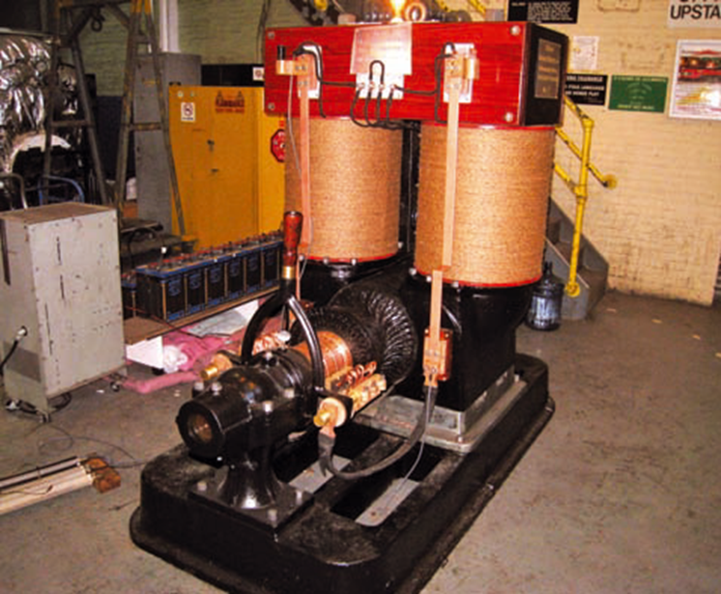
Part 1 (Prior to 1900): Early Power Systems in the northwest
First Urban “Central System” in the Northwest
In 1885 Thomas Edison sent Sidney Z. Mitchell west to be the exclusive agent of the Edison Electric Light Company - he was 23 years old.
That same year Sidney Z. Mitchell and F. H. Sparling formed the Seattle Electric Light (SEL) Company with a 25-year franchise, financed by the sale of 250 bulbs for a flat monthly fee per bulb.
The first full SEL generation station was built on Jackson street with:
2 steam Dynamos
600 DC amp capacity
And on March 22, 1886 they demonstrated the first incandescent light bulb to be energized west of the Rocky Mountains by a fixed system.
This demonstration consisted of eleven 16 candlepower lights in the Seattle headquarters and occurred 5 months before Edison began operation of his famous Pearl Street Station in New York.
1-13
Notes:
Picture Details:
Edison 100 kW Dynamo No. 16, originally installed at Edison's Brooklyn Pearl Street Station after a fire in 1890.
Source: Robert W. Lobenstein, “Saving History: the Story of Edison Dynamo No.16”, IEEE Power and Energy Magazine, Volume 10, Issue 3, pp. 72-82, 2011.

Slide 14
Part 1: The Early Years of Northwest Electricity
(Prior to 1900)
Section 2: The First Electric Loads
1-14

Slide 15
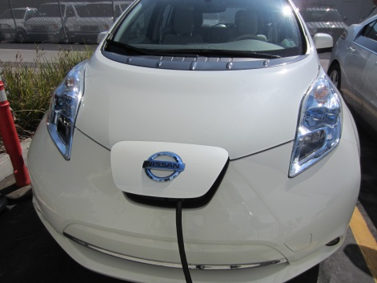
Part 1 (Prior to 1900): The First Electric Loads
What is an Electric Load?
Any device, or element of the system, that converts electricity into another form of energy can be considered an electric load. Some of these loads are in the form of system losses, but the majority reside with the end-use customs.
Losses occur in electric power systems in the form of heat. Electricity flowing through aluminum, steel, and copper result in thermal losses. Losses generally account for 5%-12% of the electricity generated in the United States.
At the end-use, electricity can be converted into mechanical work, light, and/or heat.
1-15
Notes:
Picture Details:
Clip Art

Slide 16
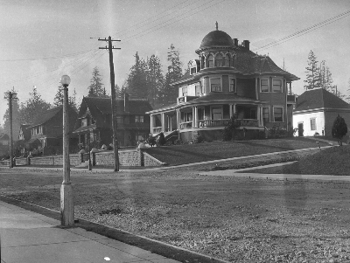
Part 1 (Prior to 1900): The First Electric Loads
Early Electric Loads
The first common electric loads were lights, for which there were three primary uses:
Street lighting
Commercial lighting
Industrial lighting
After lighting, traction loads were the next most common for early systems (Street Cars).
Industrial motor loads for factories were still served primarily by steam or water, but there was some movement towards non-motor electrification of industrial facilities (lights).
1-16
Notes:
Picture Details:
Seattle Street Lighting ca 1900.
Source: City of Seattle Municipal Archives

Slide 17
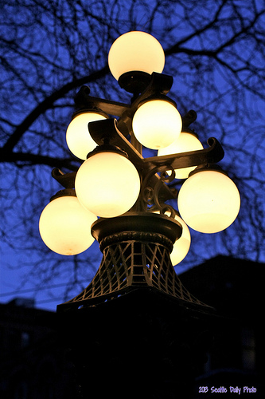
Part 1 (Prior to 1900): The First Electric Loads
Early Lighting Loads
Street lighting was the first large scale electrical load and was the focus of many early businesses.
These early systems provided street lighting and commercial lighting, but residential lighting was initially very expensive, and as a result, uncommon.
Electric lighting was competing directly with gas street lights, which had become a status symbol in affluent neighborhoods. The first gas street lighting franchise in Seattle was issued in 1873.
1-17
Notes:
Picture Details:
Image: These distinctive cluster street lamps grace Pioneer Square and illuminate the street with charm and period details from the late 1800s. They are one of Seattle's early expressions of civic pride. The first street lights in this area of Seattle were powered by coal gas.
Source: http://seattle-daily-photo.blogspot.com/

Slide 18
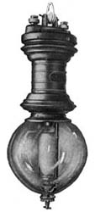
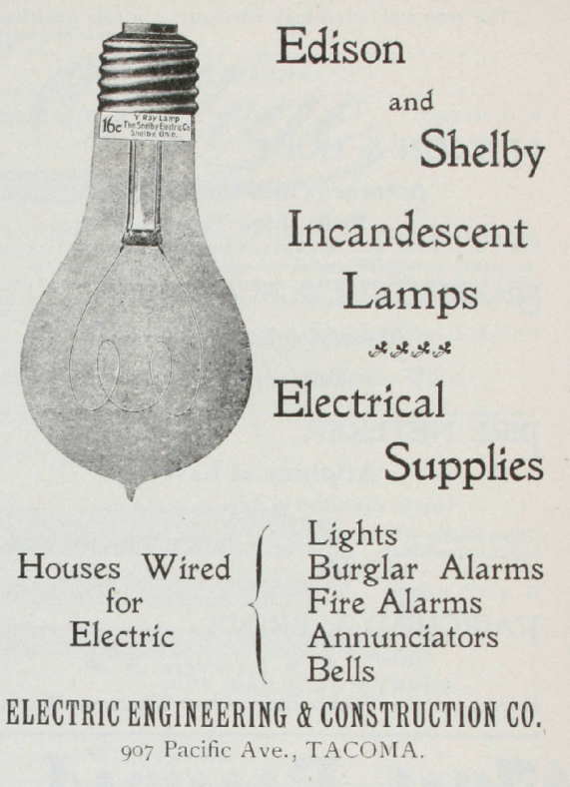
Part 1(Prior to 1900): The First Electric Loads
Early Lighting Loads
For electric lighting there were two competing technologies.
Arc Lamps
  Carbon arcs were the earliest example where an arc would be drawn between two carbon electrodes.
  Normal operation would consume the carbon.
Incandescent Lamps
  Current would heat a wire to incandescence, but would not consume the wire.
  Incandescent lamps were an improvement over arc lamps in that they were a simpler and more reliable technology than arc lamps. The incandescent light was also less “harsh”.
1-18
Notes:
Picture Details:
LEFT: Example of an GE Arc Lamp circa 1911
Source: http://electricmuseum.com/?p=279
RIGHT: Edison and Shelby light bulb advertisement.
Source: University of Washington Digital Libraries

Slide 19
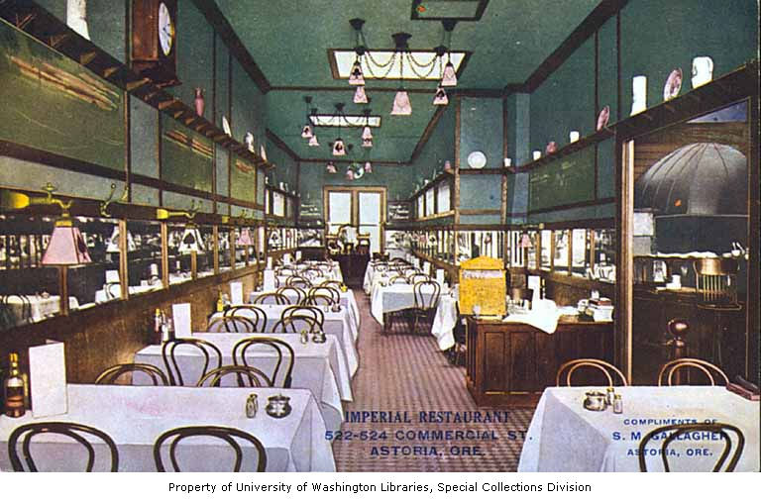
Part 1 (Prior to 1900): The First Electric Loads
Early Lighting Loads
Lighting was not billed with a service meter. Instead, common schedules were used (1885 Astoria rates):
10 o’clock lights $.75/light per night
12 o’clock lights $1.00/light per night
All night-lights $1.50/light (note: this is approximately $38.80 in 2012 dollars) per night
Lighting generally was only in demand during the evenings and nights, and as a result electric generating equipment was not making money during the day.
1-19
Notes:
Picture Details:
Astoria Imperial Hotel ca 1910.
Source: UW Digital Archives

Slide 20
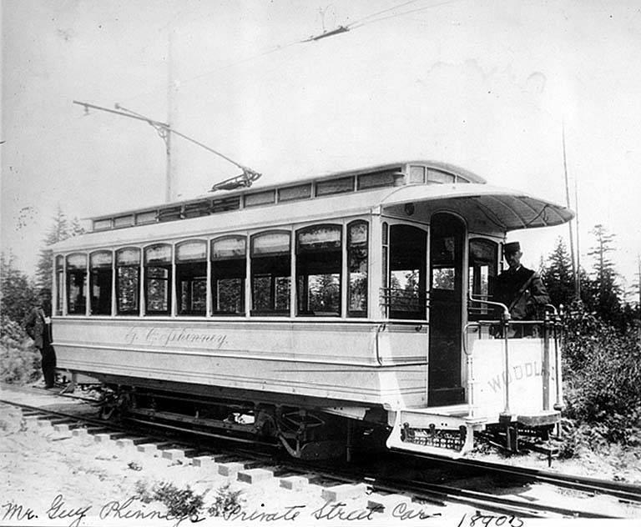
Part 1 (Prior to 1900): The First Electric Loads
Early Traction Loads – Street Cars
Electric street cars provided a demand for electricity during the day, which increased the utilization factor of electric generation equipment, thus making the systems more profitable.
Early electric street cars were Direct Current (DC) because of the ability to easily control the speed of DC motors. Variable speed AC motors were not in common use at this time.
Additionally, many street car lines were built specifically to provide transportation to new suburban communities. These early traction loads (street cars) were radial systems within urban centers or from urban centers to suburban communities.
1-20
Notes:
Picture Details:
Street car operated by Guy Phinney, Guy is seen on the car. Phinney Ridge, Seattle Washington.
Source: University of Washington Digital Libraries

Slide 21
Part 1 (Prior to 1900): The First Electric Loads
Early Motor loads
Prior to 1890, factories tended to use electricity only for lighting, using electricity for motor loads was adopted at a slower pace.
The lack of a good motor design, that avoided sparking, limited the use of early motor loads. Sparks could cause explosions in industrial applications where there was dust or fumes that might catch fire.
It was not until 1886 that Frank Sprague invented a DC motor with limited sparking and that could provide constant speed under varying load.
Early adaption of electric motors was limited by:
  High costs for buying and installing motors in conjunction with
  a lack of trained electrical engineers for installation and maintenance.
Local utilities could not supply factories motors because they needed too much electricity. In some cases a single factory would require more power than the total capacity of the local utility.
Instead, these early electric motors were often supplied power by electricity generating units within the factory
In 1900 less than 5% of factories were electrified but these factories produced, and consumed, over half of the electricity generated in the United States.
1-21
Notes:
Circuit diagram for a cumulatively compounded DC motor. The interpole windings can be seen between the series winding and the armature. It was these windings that adjusted the armature distortion in the air gap, due to load, and helped reduce sparking.

Slide 22
Part 1: The Early Years of Northwest Electricity
(Prior to 1900)
Section 3: Structuring and Financing the Early Systems
1-22

Slide 23
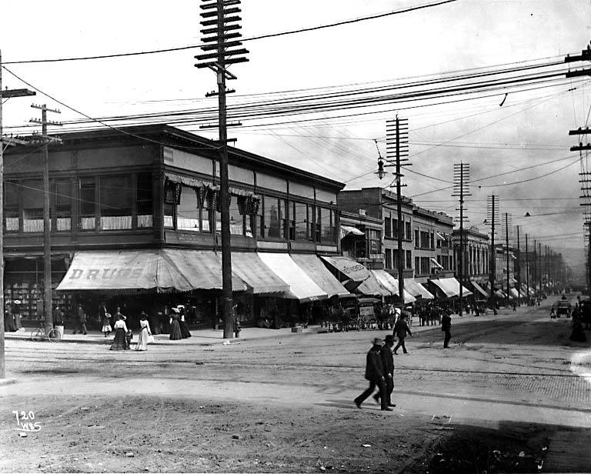
Part 1 (Prior to 1900): Structuring and financing the early Systems
Municipal Regulation and the Franchise System
In order to connect the electrical generators with the end-use loads, it was necessary to run wires and cables, which required access to city streets. A franchise was needed from the local municipality in order to obtain the right to use public right of ways for private use.
The franchise system was not unique to electricity, and it experienced corruption similar to other utility franchises such as water.
In many cases municipalities would issue short term, overlapping franchises with the idea that the market would determine the best price, capacity, etc.
This resulted in multiple redundant stacked power lines, like those shown in the picture, where franchises overlapped and more than one company provided power to the same area. This was both dangerous and inefficient.
1-24
Notes:
Picture Details:
Utilities poles with multiple sets of distribution lines. Pike Street, Seattle Washington, ca 1905.
Source: University of Washington Digital Libraries

Slide 24
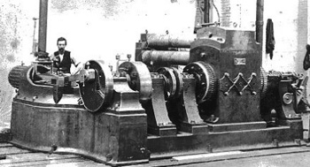
Part 1 (Prior to 1900): Structuring and financing the early Systems
Financing the Early Power Systems
For new electrical systems, all of the infrastructure had to be built before there could be a return on investment. As a result, the majority of early systems took on significant debt in order to begin operations.
Edison’s Pearl Street station required the invention of the Jumbo Dynamo, which was 27 tons and rated at 150 kW. This was 4 times larger than any previous dynamo. The dynamos were named after P.T. Barnum's famous elephant.
While the generators were a significant cost because of their size, the infrastructure for delivering power was a larger expense, the largest cost was often the copper mains and distribution lines.
The franchise system with its uncertainty, and in some cases corruption, further increased the cost of operations.
The overall effect was that early power companies had a relatively low rate of return on large fixed investments, and if the franchise was lost the assets would be stranded because it was not cost effective to move or sell the components of the system. These businesses were often high risk, with only moderate returns on investment.
1-25
Notes:
Picture Details:
One of six of the Pearl Street Station Jumbo Dynamos, each was rated at approximately 100 kW.
Source: Edison National Historic Site.

Slide 25
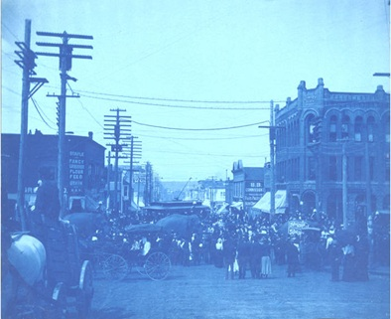
Part 1 (Prior to 1900): Structuring and financing the early Systems
Growth of the Isolated Stations
Despite the challenges of financing new systems, the number of systems grew rapidly at the end of the 19th century.
By 1899, within Seattle alone, there were 12 electric utilities and 22 street car providers, each of which were private companies.
In the 15 years following the establishment of the Seattle Electric Light Company (in 1885), Mitchell and Sparling built steam powered central systems in Tacoma, Spokane, Bellingham, and many smaller towns in Washington, as well as Portland, Oregon, Idaho, and even British Columbia, Canada.
These small central systems operated independently, with no interconnections to one another.
1-26
Notes:
Picture Details:
Bellingham Washington, 1900. (Note the elephant in the middle, Barnum & Baily was in town.)
Source: University of Washington Digital Libraries

Slide 26
Part 1 (Prior to 1900): Structuring and financing the early Systems
Summary of Early Isolated Systems Across the NW
Washington:
  1886 the first string of electric lights was energized in Seattle.
  Seattle, among other cities, supported multiple private utilities.
  Small steam systems supplying cities grew across the state.
Oregon:
  1880 George W. Weidler built the first system at his Portland saw mill.
  Additional systems were opened in Portland, along with smaller systems across the state.
Idaho:
  The first electric light in Idaho had been energized near Ketchum in 1882.
  Small systems across the state began operation primarily to support mining interests.
Montana
  Walkerville, a suburb of Butte, received the first electricity in the 1880’s.
  Similar to Idaho, the majority of the early systems were operated to serve mining interests, the Anaconda Company being one of the largest.
1-28

Slide 27
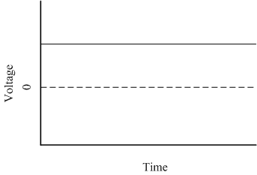
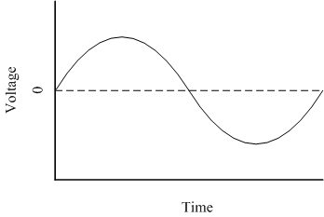
Part 1 (Prior to 1900): Structuring and financing the early Systems
DC vs. AC
Direct Current
Alternating Current
The voltage supplied is relatively constant over time, with minor variations due to transients.
At this time, there were no effective ways to change the voltage level of DC.
The voltage alternates at the system frequency and passes though the zero value multiple times a second.
Because of the zero crossings, it was possible to use transformers to efficiently change the voltage level as necessary.
1-31

Slide 28
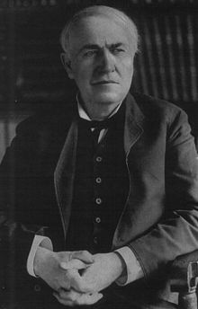
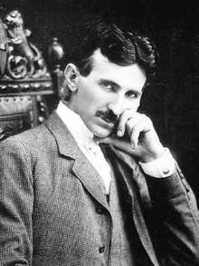
Part 1 (Prior to 1900): Structuring and financing the early Systems
Battle of the Currents
While the early isolated electrical systems were Direct Current (DC), North America almost exclusively uses 60 Hz Alternating Current (AC) today (2013).
For the early electrical systems, DC provided a number of benefits over the nascent AC systems, these included:
  Worked well with lights and motors
  Could be used directly with batteries
  DC generators, dynamos, could be easily paralleled allowing multiple machine operations
  Speed control is straightforward with DC motors
  Edison had developed a customer meter for DC
Despite these benefits, AC had a number of benefits that would win out in the long term:
  Voltages can be changed using transformers
  Higher voltages allowed for transmission over long distances with reduced losses
  Poly phase machines were more efficient
  At 60 Hz lighting flicker is not a problem
  60 Hz works for lighting and motors
Thomas Alva Edison (Direct Current)
Nikola Tesla (Alternating Current-Westinghouse)
1-29
Notes:
Picture Details:
Photos of Nikola Tesla (Alternating Current-Westinghouse) and Thomas Alva Edison (Direct Current)
Source: University of Washington Digital Libraries

Slide 29
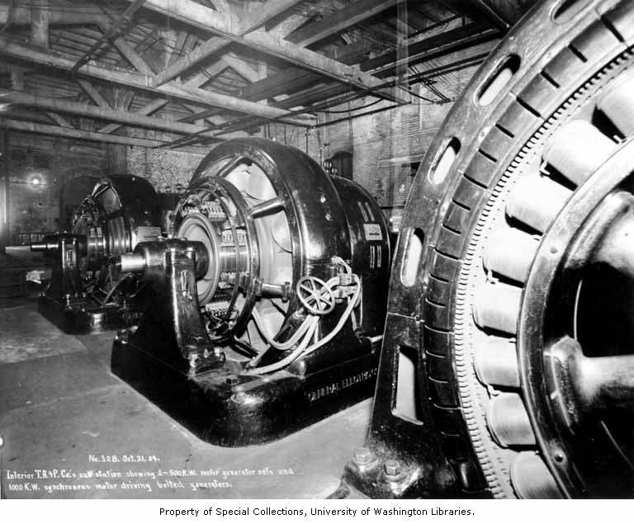
Part 1 (Prior to 1900): Structuring and financing the early Systems
Battle of the Currents in the Northwest
In the Northwest ,the battle of currents was not nearly as contentious as it was in the eastern regions of the U.S.
Initially, many of the small isolated systems in the Northwest were DC because of Edison's effective marketing strategies.
Without high population densities, and with long distances between hydroelectric generation and load, expanding the early isolated systems was challenging.
In 1889 when the Willamette Falls damn in Willamette Falls, OR became the first AC hydroelectric plant in the nation, 2 phase ,it was primarily because of the geography of the Northwest . Specifically, the generation and load were separated by distance that were prohibitive for DC.
Where needed, DC could be obtained from AC through the use of motor generator sets, also known as rotary converters.
1-31
Notes:
Picture Details:
Motor generator sets at a Tacoma Power receiving substation, from Electron. ca 1904
Source: University of Washington Digital Libraries

Slide 30
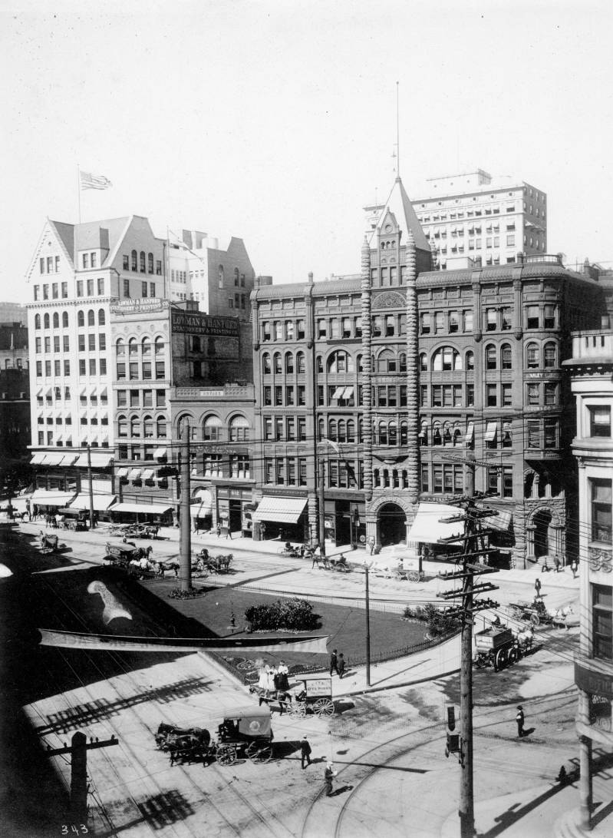
Part 1 (Prior to 1900): Structuring and financing the early Systems
Financial Challenges of early Power
The early power systems faced numerous financial challenges. The construction of an electric power system required a large capital investment before the first kilowatt could be sold.
The municipal franchise system with its often corrupt structure introduced uncertainty that made investment less attractive to investors.
Because of the large number of small companies, there was significant duplication of infrastructure and economies of scale could not be leveraged.
As a result, many of the early companies were required to sell high interest bonds to raise capital.
1-32
Notes:
Picture Details:
Seattle Washington, Pioneer Square ca 1900.
Source: University of Washington Digital Libraries

Slide 31
Part 1 (Prior to 1900): Structuring and financing the early Systems
Financial Panic of 1893
In the United States the 1880’s was a period of rapid expansion. There were numerous electric companies providing lighting, traction and power, which were heavily financed with high interest bonds.
The financial panic of 1893 was caused by the collapse of railroads overbuilding in conjunction with questionable financing that resulted in a series of bank failures.
Additionally, the Sherman Silver Purchase Act of 1890 had the government buying silver to drive up the price. Eventually, the U.S. reached the minimum gold limits, and U.S. notes could not be redeemed for gold.
This further increased the costs of borrow money for utilities, and pushed the cost of borrowing money even high. As a result, many of the newly-started electric companies were wiped out by this financial panic.
1-33

Slide 32
Part 1: The Early Years of Northwest Electricity
(Prior to 1900)
Section 4: Local Consolidation of the Early Systems and the Shift to Central Generation
1-34

Slide 33
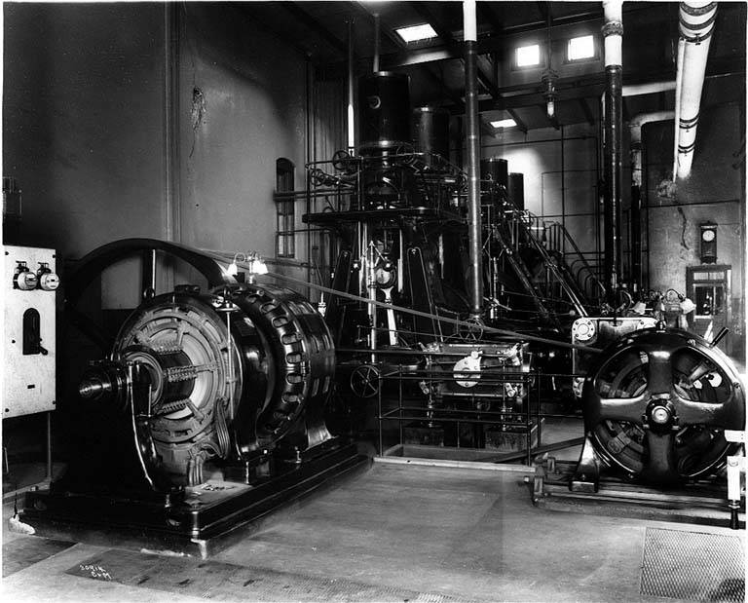
Part 1 (Prior to 1900): Local Consolidation of early Systems and the Shift to Central Generation
The Collapse of the Early Systems
In addition to the unsound financial basis of many of the early electricity companies, there were technical issues that made them unviable.
One of the largest problems was the amount infrastructure required by each company. Each company maintained its own power generation for a relatively small amount of load. Because of the need for duplicate equipment, economies of scale could not be taken advantage of.
Eventually consolidation was necessary and made viable because large-scale power generation allowed economies of scale that weren’t possible with smaller generators.
While the systems collapsed financially, their infrastructure was still in place and could be purchased for a fraction of their original costs.
High capital costs are still a defining characteristic of the modern electric power system.
1-35
Notes:
Picture Details:
Seattle Brewing and Malting Company ca 1914. This is an example of the generators required for a small system; a stand alone industrial system in this case.
Source: University of Washington Digital Libraries

Slide 34
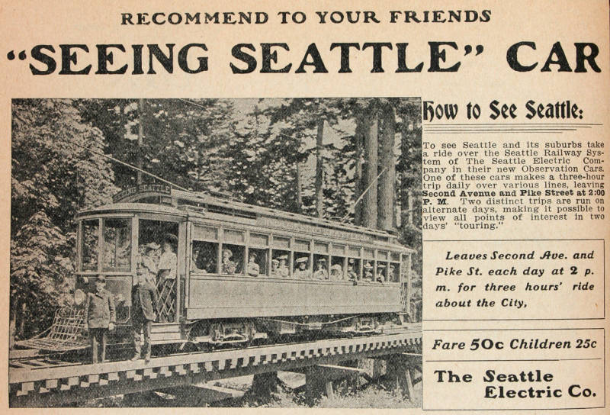
Part 1 (Prior to 1900): Local Consolidation of early Systems and the Shift to Central Generation
Formation of the Seattle Electric Company
While the panic of 1893 resulted in the failure of many electric utilities, there was still a demand for service, which presented the opportunity for consolidation.
By 1900, most of the isolated systems in Seattle were purchased and consolidated by Stone & Webster, under the Seattle Electric Company (SEC). This also included 22 electric street car lines. Other regions saw similar consolidations.
Stone & Webster was one of the nation’s earliest electrical engineering consulting firms in the nation, but they acted very much like a holding company that were common by the 1930’s.
Consolidations under the Seattle Electric Company represented consolidation at the local level, within a small geographic region. Consolidation at larger levels would have to wait for the proper business environment, and the necessary technical advances.
1-36
Notes:
Picture Details:
Advertisement for the one of the Seattle Electric Companies street cars. In 1901 SEC owned all 22 of the cities street car lines.
Source: University of Washington Digital Libraries

Slide 35
Part 1 (Prior to 1900): Local Consolidation of early Systems and the Shift to Central Generation
Formation of the Seattle Electric Company
1-37
Notes:
Picture Details:
The companies that formed the Seattle Electric Company in 1900, a Stone & Webster.
Source: Duplicated based on Neil McReynolds, “A Century of Service, The Puget Power Story”

Slide 36
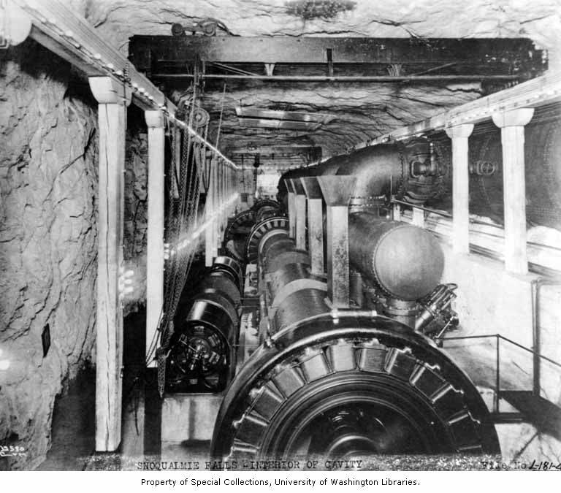
Part 1 (Prior to 1900): Local Consolidation of early Systems and the Shift to Central Generation
The Rise of Larger Generation Stations
Prior to consolidation, each individual company provided enough generation to meet “load plus losses”. This resulted in a significant amount of duplication, and machines running at inefficient levels, especially steam units.
Once the many failed smaller companies were consolidated, it was necessary to develop larger and more efficient generators to supply the load.
One of the first large generation stations to supply multiple companies was the Snoqualmie Falls Power Plant in WA state.
Originally envisioned by Charles Baker in the 1880’s, Snoqualmie Falls began operation in 1898 with four 1,500 kW turbines. Each unit was 10 times larger than the Jumbo dynamos that Edison used at Pearl Street Station 15 years earlier.
32,000V AC lines ran from the power house to Seattle (32 miles), Tacoma (44 miles), Everett (36 miles), and locations in between. This was an improvement as compared with DC power, where 100V systems were limited to transmitting over distances of about a mile.
1-38
Notes:
Picture Details:
Interior of the Snoqualmie Falls underground chamber. No Date.
Source: University of Washington Digital Libraries

Slide 37
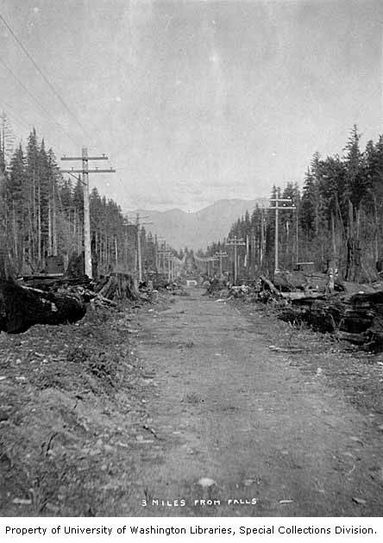
Part 1: The Early Years of Northwest Electricity (Prior to 1900)
The Closing of the 19th Century
  Public Perception
  The financial panic of 1893 has shaken peoples confidence in utilities as a business, but the publics increasing demand for electricity was changing this option by the end of the century.
  End-use Loads
  The early end-use loads were predominantly street lighting, but new loads such as street cars were becoming the dominant load.
  Infrastructure
  Consolidation was the trend and generators were becoming larger and line voltages were increasing to accommodate the larger transfers of power.
  Utility Companies
At the end of the 19th century, private companies were the primary providers of lighting and traction loads, with many power loads supplied locally. Utilities were operated based on franchises received from municipalities, and they were vertically integrated companies.
Local consolidation of electric utilities was underway in Washington and Oregon, but had not occurred at a significant level in Idaho and Montana because of low load densities.
Consolidation had lowered costs, but electricity rates were still significantly higher than they are today (2013). Additionally, many of the electric companies were owned through Stone and Webster, which was an “East Coast Concern” and was not perceived by the public as having the region’s best interest in mind.
  Current Events/Regulation
By the end of the 19th century, the Northwest Territories had become states:
Washington: Became the 42nd State Nov. 11^{th,} 1889
Oregon: Became the 33rd State Feb 4th 1859
Idaho: Became he 43rd State July 3rd, 1890
Montana: Became the 41st State Nov. 8th, 1889
1-39
Notes:
Picture Details:
Road to Snoqualmie Falls, including the power lines connecting the generators. 1901.
Source: University of Washington Digital Libraries

