Slide 1
Transactive Control in the Pacific Northwest Smart Grid Demonstration
PNWD-SA-91644
Presentation for:
Portland State University
March 14, 2013
Ron Melton
Battelle / Pacific Northwest National Laboratory
Notes:
Good afternoon. Thanks <who ever introduces me>.
This afternoon I will give you an overview of the Pacific Northwest Smart Grid Demonstration project.
I will start with some background to set the context for the work we are doing. Then I will get into the description of the project itself with a focus on the smart grid technique we call “transactive control” but also with a look at the efforts of the eleven utilities involved in the project.
So, lets get started.

Slide 2
Challenges & Opportunities Facing the Power Grid
The challenges we face are significant …
Increase asset utilization
Integrate renewables and low-carbon sources
Maintain and increase reliability
Keep costs as low as possible
Accommodate potential electrification of transportation (& other end uses)
So is the opportunity presented by smart grid …
Fully engage all resources at all levels of the system to meet these challenges: the fundamental purpose of transactive control & coordination
  Coordinate new distributed smart grid assets (demand response, distributed generation & storage)
  Seamlessly integrate their use in conjunction
  with traditional grid assets
Notes:
In modernizing our electric power system we face a variety of challenges – but along with the challenges some interesting opportunities.
This slide summarizes the challenges – increasing efficiency, integrating renewable energy resources and reducing carbon footprint, but not sacrificing reliability to do so, keeping costs low, and enabling the future – for example the electrification of transportation and other uses of electrical energy that we haven’t even imagined yet.
In meeting these challenges we have a significant opportunity to use so called smart grid technology to fully engage all resources at all levels of the power system. Achieving this goal of fully engaging all resources is the fundamental purpose of what we refer to as transactive control and coordination. As shown on the slide this includes coordinating new distributed smart grid assets such as demand response, distributed generation and storage with seamless integration of their use coordinated with traditional grid assets..

Slide 3
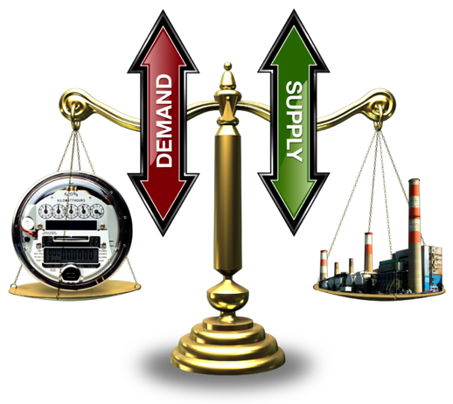

Managing Stochasticity of Loads & Renewables
Historically, the power grid:
  had deterministic control of supply assets
  responded to varying & stochastic
  fluctuations from demand
With renewables, it is now
variable & stochastic on both sides
Markets
Transactive control & coordination
Coordinates operation of distributed assets to meet multiple generation, transmission, & distribution objectives
Manages controllable assets at the distribution level to mitigate load variability & that of supply-side as well
Notes:
Put simply – large scale use of renewable energy changes the historical assumptions about the electric power system. Where we once could think of the bulk power system as deterministic and the load side as stochastic, we now have stochastic environments on both sides.
We are faced with a challenge – do we put ever more effort into trying to absolutely control or counter the expanded stochastic nature of the system – or do we engage the system itself in managing the stochastic nature. If we can affect the stochastic behavior on the load side we can use its ability to respond as a feature of the system that works to our benefit.
This is the basic idea of how we use the TC2 approach to help manage the integration of ever increasing amounts of renewable energy.

Slide 4
Definition of Transactive Control & Coordination (TC2)
Notes:
With that background let me more specifically define what is meant by “transactive control and coordination”

Slide 5
Transactive control & coordination (TC2)
Uses economic or market-like constructs …
to manage generation, consumption, & flow of electric power including reliability constraints
by coordinating assets from generation to end use.
Transactive
Network
TC2 blends elements power markets and energy control systems
Markets
(5-min – day)
  To form a transactive network
  organizing millions of smart grid assets
  into a virtual control system, with distributed decision making
  that respects natural enterprise boundaries between the grid, customers & 3rd-parties.
Control
(msec – min)
Notes:
Today, we engineers tend to talk about control, while the economists talk about markets.
I’d like you to think about an integrated approach, that we call “Transactive Control and Coordination” or TC2. TC2 uses economic or market like constructs to manage the grid from end-to-end. This includes managing all elements from generation, consumption, and flow of electric power including reliability constraints. This is accomplished by coordinating all responsive assets or elements of the power system.
---Transition---
One can think of this as bringing together markets, operating on relatively long time frames, with control, operating on the shortest time frames, into what we have sometimes called a transactive network.
--- Transition ---
The transactive network is implemented throughout the power system using distributed decision making to achieve the desired coordination of all assets.
With this in mind let us look in a little more detail at the elements of such a transactive network.

Slide 6
TC2 Nodes, Feedback & Incentive Signals
Uses local conditions and global information to make local control decisions at points (nodes) where the flow of power can be affected.
Nodes indicate their response to the network
  In the form of a feedback signal as a forecast of their projected net flow of electricity (production, delivery, or consumption)
  As a function of the incentive signal from the node(s) that serve them
Node can then set the incentive signal with precision to obtain the desired response from nodes they serve
Node’s responsiveness is voluntary (set by the node owner)
Node’s response will be typically be automated by considering local needs vs. the incentive signal and reflected in the feedback signal
Notes:
Some of you may recall one of the slogans from the global climate change community – “Think Globally and Act Locally” We are applying a similar idea with the Transactive Control and Coordination approach. The trick is to provide global information about the state of the power system to those points where decisions can be made affecting the flow of power. We call these points nodes. At these nodes local decisions are made based on the global information and related local information.
In our work we’ve defined two signals used to provide global information in the form of a forecast of intent. The first is a feedback signal that describes the intended consumption of electricity or the flow through nodes feeding consumers.
The second is an incentive signal reflecting the intended future cost of electricity. At any given node the incentive is varied to elicit the behavioral response desired from the nodes or consumption points served.
Two important points with our approach – the responsiveness of a node is voluntary, determined by the node. Second, a nodes response will typically be automated with algorithms that consider local needs vs. the incentive signal.

Slide 7
What Problems or Issues is Transactive Control and Coordination
Designed to Address?
Notes:
So, why might one want to take this approach. I will discuss several reasons why we think this makes sense and then I will tell you how we are implementing this type of approach on the Pacific Northwest Smart Grid demonstration

Slide 8

Principal Challenges Addressed by TC2
Principal Challenge | Approach
Centralized optimization is unworkable for such large numbers of controllable assets, e.g. ~10⁹ for full demand response participation | Distributed approach with self-organizing, self-optimizing properties of market-like constructs
Interoperability | Simple information protocol, common between all nodes at all levels of system: quantity, price or value, & time
Privacy & security due to sensitivity of the data required by centralized techniques | Minimizes risks & sensitivities by limiting content of data exchange to simple transactions
Scalability | Self-similar at all scales in the grid Common paradigm for control & communication among nodes of all types Ratio of supply node to served nodes to ~10³

Slide 9
Principal Challenges Addressed by TC2 (cont.)
Principal Challenge | Approach
Level playing field for all assets of all types: existing infrastructure & new distributed assets of all types | Market-like construct provides equal opportunity for all assets Selects lowest cost, most willing assets to “get the job done”
Maintain customer autonomy “Act locally but think globally” | Incentive-based construct maintains free will customers & 3rd-parties fully control their assets yet collaborate (and get paid for it)
Achieving multiple objectives with assets needed to be cost effective | Allows (but does not require) distribution utility to act as natural aggregation point addressing local constraints while representing their capabilities to the bulk grid
Stability & controllability | Feedback provides predictable, smooth, stable response from distributed assets Creates what is effectively closed loop control needed by grid operators

Slide 10
Links All Values/Benefits in Multi-Objective Control
Long-term objective for TC2 is to simultaneously achieve combined benefits
Reduce peak loads (minimize new capacity, maximize asset utilization) – generation, transmission, & distribution
Minimize wholesale prices/production costs
Reduce transmission congestion costs
Provide stabilizing services on dynamically-constrained transmission lines to free up capacity for renewables
Provide ancillary services, ramping, & balancing (especially in light of renewables)
Managing distribution voltages in light of rapid
fluctuations in rooftop solar PV system output

Slide 11
Transactive Control & Coordination in the Pacific Northwest Smart Grid Demonstration Project
Notes:
Now that we have some background and motivation for the use of transactive control and coordination let me tell you about how we are applying it in the Pacific Northwest Region of the United States.

Slide 12

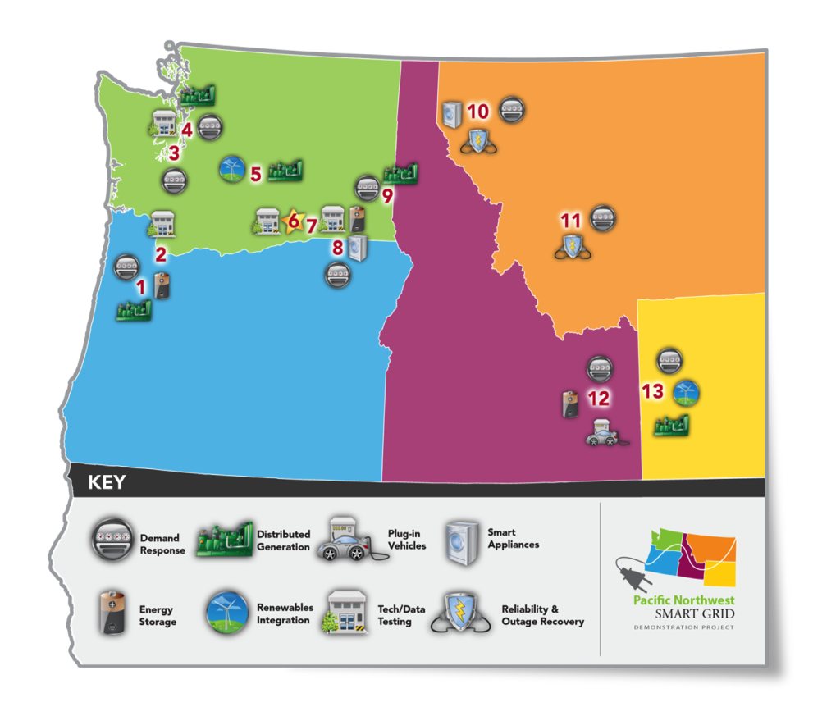
Pacific Northwest Smart Grid Demonstration Project
What:
$178M, ARRA-funded, 5-year demonstration
60,000 metered customers in 5 states
Why:
Develop communications and control infrastructure using incentive signals to engage responsive assets
Quantify costs and benefits
Contribute to standards development
Facilitate integration of wind
and other renewables
Who:
Led by Battelle and partners including BPA, 11 utilities,
2 universities, and
5 vendors
Notes:
The PNW Demo has been designed to answer some …but certainly not all of those questions.
1 = PGE | 2 = Bonneville Power Administration | 3 = Peninsula Light Co. | 4 = Seattle City Light/University of Washington
5 = City of Ellensburg | 6 = Battelle | 7 = Benton PUD | 8 = Milton Freewater | 9 = Avista | 10 = Flathead Electric
11 = Northwestern Energy | 12 = Idaho Falls Power | 13 = Lower Valley Energy
12

Slide 13
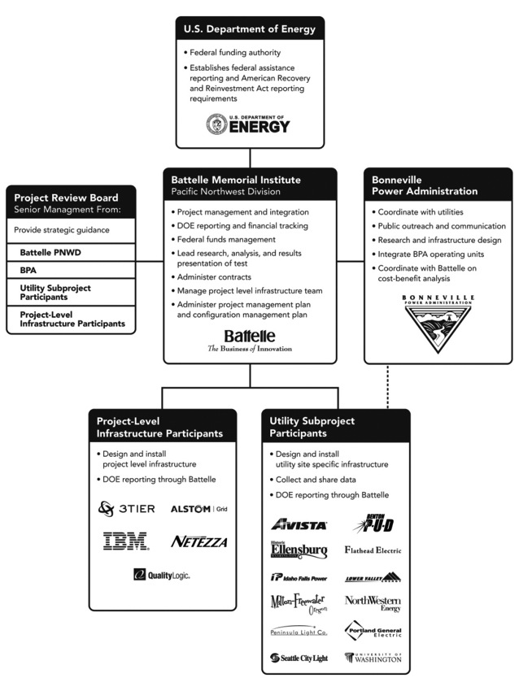
Project Structure / Roles
Battelle Memorial Institute, Pacific Northwest Division
Bonneville Power Administration
11 utilities (and University of Washington) and their vendors
5 technology infrastructure partners
Notes:
The project team includes a number of participants. The Department of Energy provides funding via the DOE National Energy Technology Laboratory. Additional funds are provided by the Bonneville Power Administration – the regional power marketing agency.
My organization, Battelle (operator of the Pacific Northwest National Laboratory) leads the technology development and also manages the overall project.
Five technology providers are a part of our technology development team. They include IBM’s Thomas J. Watson Research Center, Alstom Grid, IBM Netezza, 3TIER and Quality Logic. IBM Research is providing the core software for implementing the project infrastructure using their Internet Scale Control system software and other “Big Data” products. Alstom Grid is modeling the regional power system using their market management system and energy management system tools. Netezza provides a large scale data management appliance capable of managing terabytes of data. 3TIER provides wind forecasts and Quality Logic performs interoperability and conformance testing.
As I previously mentioned, there are 11 utilities involved – though one of the organizations we count as a utility is the University of Washington.

Slide 14
Typical BPA Control Area Generation
MW
Source: BPA
Website

Slide 15
Zoom in on Wind
MW

Slide 16
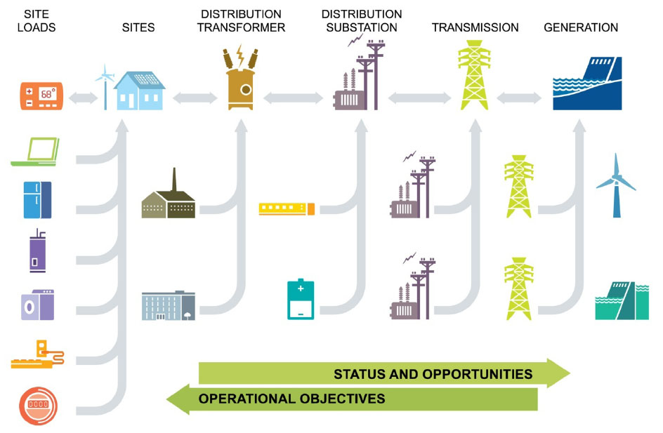
Project Basics
Operational objectives
Manage peak demand
Facilitate renewable
resources
Address constrained
resources
Improve system
reliability and
efficiency
Select economical
resources (optimize
the system)
Aggregation of Power and Signals Occurs
Through a Hierarchy of Interfaces
Notes:
Building on our earlier discussions on transactive control and coordination let me describe our basic approach. The cartoon shows a simplified representation of the topology of the electric power system. Imagine you are standing at a point in this system – say the distribution transformer. You are receiving inputs regarding the operational objectives, or needs, from above you in the system. You are interpreting your local situation and making several decisions. First – given the inputs you’ve received is there something you are going to change locally in response? Second – is there some operational objective you need to achieve? Say you are overloaded – you may want to incentivize the loads you serve to reduce and thus reduce your overloaded state. If you want loads below you to drop – you increase the incentive signal, if you want them to add load for some reason you reduce the incentive signal.
Looking from the other direction the loads are expected to communicate what they plan to do – how much power will they consume through time periods into the future.
With this more concrete example I hope you are beginning to see how we apply the concepts I described earlier. As I also discussed earlier some of the benefits of this approach are listed in the bullet items.
16

Slide 17

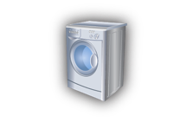
Transactive Control 101
What is it?
  Transactive control is a distributed method for coordinating responsive grid assets wherever they may reside in the power system.
Incentive and feedback signals
  The incentive signal sends a synthetic price forecast to electricity assets
  The feedback signal sends a consumption pattern in response to the incentive.
Upstream
(toward generation)
Downstream
(toward demand)
Incentive
Signal
Modified
Incentive
Signal
Modified
Feedback
Signal
Feedback
Signal
17
Notes:
17
What is it?
A flexible method for combing multiple objectives and constraints (both economic and operational) using uniform incentive and feedback signals throughout an electricity grid.
Incentive and feedback signals
An incentive signal is used by electricity assets to make decisions about their future consumption pattern – it is a forward signal with information for the next few days.
A feedback signal represents that consumption pattern over the same few days, in response to the incentive.
Creation of the incentive signal
Regional and local objectives are “monetized” and incorporated into the signal as it flows through each transactive control node in the system.
Objectives could include:
Congestion relief
Encouraging the use of wind power
Reducing peak load
Reducing phase imbalance on a transformer
Avoiding overloading a distribution line

Slide 18
An Incentive Signal
Predict and share a dynamic, price-like signal—the unit cost of energy needed to supply demand at this node using the least costly local generation resources and imported energy. May include
  Fuel cost (consider wind vs. fossil vs. hydropower generation)
  Amortized infrastructure cost
  Cost impacts of capacity constraints
  Existing costs from rates, markets, demand charges, etc.
  Green preferences?
  Profit?
  Etc.
Example “Resource Functions”: Wind farm, fossil generation, hydropower, demand charges, transmission constraint, infrastructure, transactive energy, imported energy

Slide 19
A Feedback Signal
Predict and send dynamic feedback signal—power predicted between this node and a neighbor node based on local price-like signal and other local conditions. May include
  Inelastic and elastic load components
  Weather impacts (e.g., ambient temperature, wind, insolation)
  Occupancy impacts
  Energy storage control
  Local practices, policies, and preferences
  Effects of demand response actions
  Customer preferences
  Predicted behavioral responses (e.g., to portals or in-home displays)
  Real-time, time-of-use, or event-driven demand responses alike
  Distributed generation
Example “Load Functions”: Battery storage, bulk inelastic load, building thermostats, water heaters, dynamic voltage control, portals / in-home displays

Slide 20
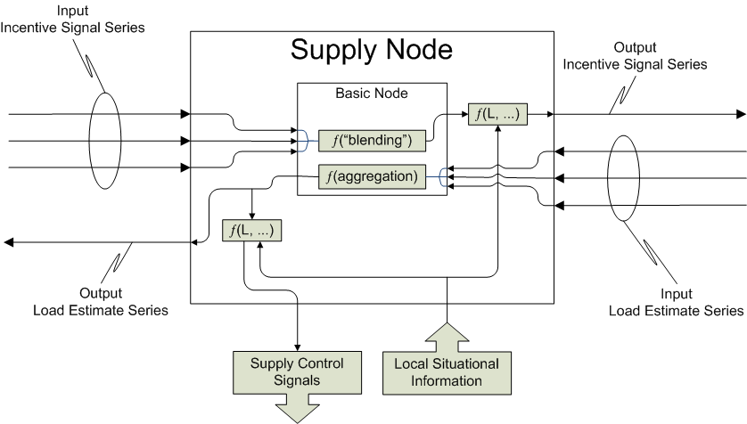
Transactive Node Inputs & Outputs
The system is distributed, predictive, scalable, and its signals track the energy that it represents.

Slide 21
Transactive Control – Electric Vehicle Charging Example

Slide 22
Simple Example – Local Electric Vehicle Charging
Imagine the following situation:
  Three neighbors with electric vehicles and different charging strategies
  All three fed by same distribution transformer
  All three come home and want to do a fast charge at the same time!
Problem – transformer is overloaded if all three fast charge at the same time
Transactive control solution –
  Transformer sees in feedback signal that all three plan to fast charge
  Transformer raises value of incentive signal during planned charging time to reflect decreased transformer life
  Smart chargers and transformer “negotiate” through TIS and TFS until an acceptable solution is found
Notes:
Let us now consider a simple example. In our example we have three houses whose owners have electric vehicles. The three are served by the same distribution transformer. The problem is that if they all want to do a fast charge at the same time, then the transformer is overloaded!
In our example we will see conceptually how the interplay between the incentive signal from the transformer to the smart chargers and the corresponding feedback about load, results in charging actions that are acceptable.

Slide 23


Our Example
House 1:
I’m flexible
House 2:
I want it now!
House 3:
I’m a bargain hunter

Slide 24
Start – house loads

Slide 25

House 1 plan revealed

Slide 26
House 2 plan revealed

Slide 27
House 3 plan revealed

Slide 28
TIS changed in response to charging plans
$$$!

Slide 29
House 1 responds to TIS change
House 1:
I’m flexible

Slide 30
House 3 responds to TIS change - shift
House 3:
I’m a bargain hunter

Slide 31
TIS responds to new plans – agreement
House 2:
I want it now!
I didn’t make any change.
I will pay the higher price.

Slide 32
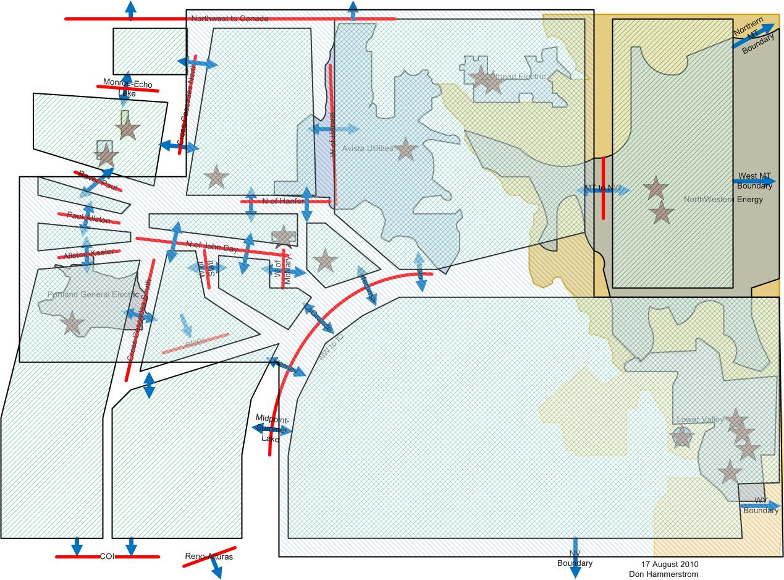
NW Region “Influence Map”--Topology
Cut Plane
Flowgate
Notes:
So, how are we applying this to our region. This map shows the large scale topology with balancing area “cut planes” separating the areas that the Bonneville Power Administration manages. The flowgates representing the combined power flows between regions are also shown.
This topology is our starting point for what Alstom Grid is modeling using their tools. For some reason Bonneville Power Administration isn’t quite ready for us to put transactive control nodes into their transmission substations. We are, of course, wild-eyed researchers and they are conservative utility operators. As a result, we have to use a data driven model to approximate what is happening in the bulk power system.

Slide 33
Regional Modeling
BPA
Alstom MMS
Future state
Estimation by
optimization
Transmission Zone TC Node Inputs
Load Forecast
Generation Schedules
Outages
3TIER
Renewable Generation
Forecasts
Network
State
Gen. schedules
Load forecasts
Alstom EMS
Notes:
The approach to this regional modeling is shown on this slide. Bonneville Power Administration or BPA, provides load forecasts, generation schedules, outage information and so forth. In parallel 3TIER provides renewable generation forecasts. These are used by the Alstom models to estimate the states of the bulk power system and provide inputs to transactive control nodes representing each of the transmission zones shown on the previous slide.

Slide 34
Project Nodes
Regional Conditions
Alstom Grid Models
“Local Conditions” for
Transmission Zone Nodes
Transmission Zone 5 Node
Transmission Zone 14 Node
•••
•••
TIS – down arrow
TFS – up arrow
Portland General Node
Lower Valley Node
Idaho Falls Node
Asset system input – down arrow
Local inputs – up arrow
Salem Site Asset Systems
Lower Valley Asset System(s)
Idaho Falls Asset System(s)
Notes:
Looking at the next level of detail we see the transmission zone nodes and how they in turn are providing transactive incentive signals to the utility nodes below them and receiving transactive feedback signals from those nodes. Below each of the utility nodes are one or more sets of responsive elements that we refer to as “asset systems.”

Slide 35
Formalizing Transactive Control
A formal model of transactive control has been designed with the following features:
  Scalable
  Algorithmic
  Support for interoperability
A standardized approach is being promoted through design and implementation of a toolkit
  Well defined interfaces for utility asset systems
  Simple, common, algorithms for updating transactive signals and determining “control” signals to responsive asset systems
Notes:
I won’t go into detail, but I do want you to know that this approach is being well formalized as a part of our project. We have developed formal functional requirements and through them a formal model of the technique has been designed. Through this design we have incorporated features to assure that the technique is scalable, is based on defined algorithms and supports interoperability considerations. One of the underlying technical elements is, for example, ISO 18012 which has just been approved as an interoperability standard.
To support broad implementation by our utility participants Battelle, IBM, and Alstom have worked to define an implement a modular toolkit that provides a menu of algorithms. The utility chooses the algorithms that match their asset system or systems and any local operational objectives. For example, many of our utility participants are subject to peak load demand charges – so an algorithm for managing load to avoid these charges is available to them. The utilities primary implementation tasks are to install the toolkit software and write the software interfaces between the toolkit and their asset systems.

Slide 36
Progress Towards Project Objectives
Notes:
Now I am going to shift gears and tell you how we are doing.

Slide 37
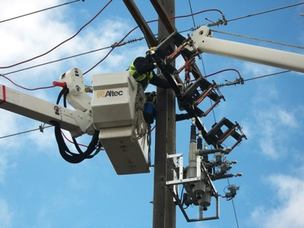
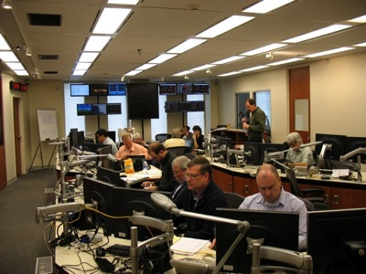

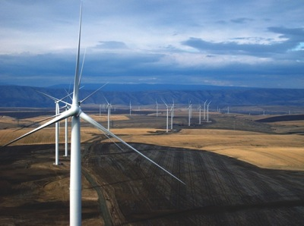
Project Objectives
$
Lay the foundation for a regional Smart Grid
Develop Standards for interoperable Smart Grid
Measure and validate costs and benefits
Develop and validate communications and control infrastructure using incentive signals
Integrate renewable Energy
Notes:
As illustrated on this slide we have five primary project objectives:
Create the foundation of a sustainable regional smart grid that continues to grow following the completion of this demonstration project. – We are laying the foundation for a regional smart grid through the equipment the utilities have been purchasing and installing.
Develop and validate an interoperable communication and control infrastructure using incentive signals to: coordinate a broad range of customer and utility assets, including demand response, distributed generation and storage, and distribution automation; engage multiple types of assets across a broad, five-state region; and reach from generation through customer delivery.
Measure and validate smart grid costs and benefits for customers, utilities, regulators, and the nation, thereby laying the foundation of business cases for future smart grid investments.
Contribute to the development of standards and transactive control methodologies for a secure, scalable, interoperable smart grid for regulated and non-regulated utility environments across the nation.
Communications and standards are achieved through the implementation efforts that we will complete at the end of August.
Starting on September 1 we enter a 2 year operational period in which we will gather the data to further understand costs and benefits and to validate the effectiveness of the smart grid technology.
Our Integration of renewable resources objective will be achieved as we demonstrate the correlation between the incentive signals and their incorporation of variability from wind energy and the response behaviors of the asset systems.

Slide 38
Smart Grid Asset Systems
 | CVR | Building & Comm. DR | In-home displays | Program.T'stats | Dist Generation | Storage | Photovoltaics | Wind | Residential DR | PHEV | Power Factor | DA | Static VAR | Smart Transformer
Avista
Benton PUD
Ellensburg
Flathead
Idaho Falls
Lower Valley
Milton-Freewater
NorthWestern
Pen Light
Portland Gen. El.
U of Washington
Asset System Investments:
Subprojects:
~$77 M
Central Data Center:
~$11 M
Response Ranges:
Total Load Reduction:
-56 MW
Total Load Increase:
+7 MW
Efficiency Impact:
-10 MW

Slide 39
Subproject Test Case Summary
 | Transactive Control | Reliability | Conservation /Efficiency | Social | Totals
Avista Utilities | 4 | 3 | 5 | 3 | 15
Benton PUD | 1 | 1 | 1 | 0 | 3
City of Ellensburg | 1 | 0 | 8 | 0 | 9
Flathead Electric | 6 | 2 | 0 | 0 | 8
Idaho Falls Power | 8 | 2 | 3 | 3 | 16
Lower Valley Energy | 3 | 2 | 6 | 1 | 12
Milton-Freewater | 3 | 0 | 0 | 0 | 3
NorthWestern Energy | 4 | 1 | 3 | 1 | 9
Peninsula Light | 2 | 1 | 1 | 0 | 4
Portland General Electric | 4 | 1 | 1 | 2 | 8
UW/Seattle City Light | 5 | 0 | 3 | 0 | 8
Totals | 41 | 13 | 31 | 10 | 95
Notes:
The range of test cases that will be evaluated during the 2 year operational period are shown on this slide – utility by utility. One important thing to note is that while we have a large number of transactive control test cases, we also have reliability and conservation / efficiency test cases that are not based on transactive control. In some cases we have pairings of transactive control driven and non-transactive control driven. For example there are several conservation voltage reduction test case pairings of this type.

Slide 40
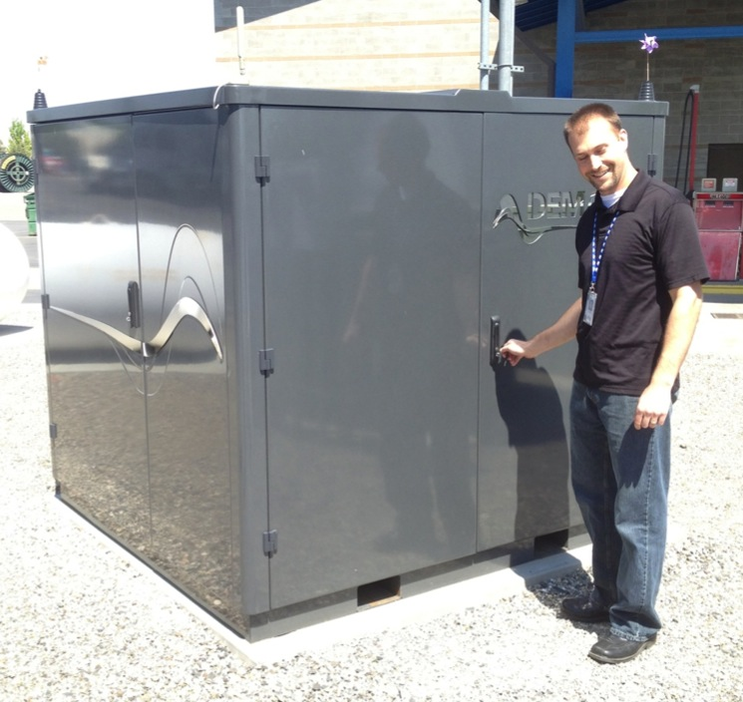

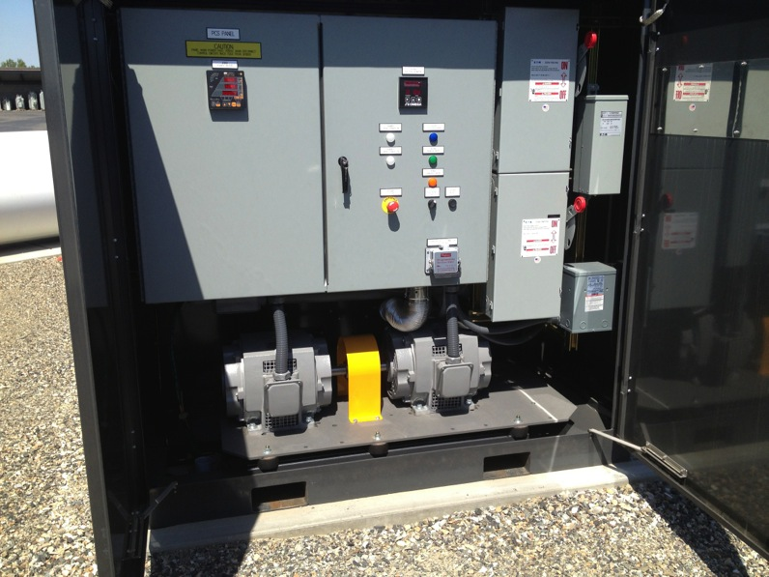
Benton PUD – Demand Shifter

Slide 41




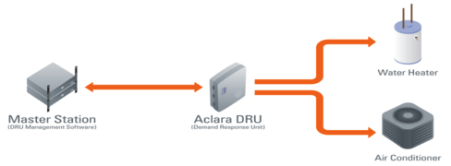
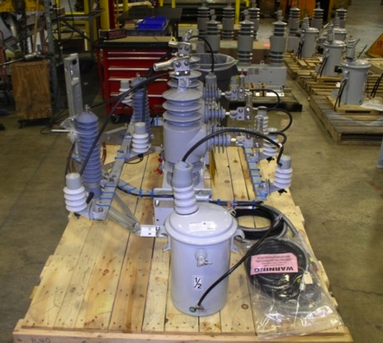
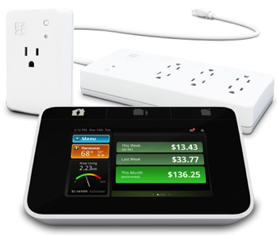

Slide 42



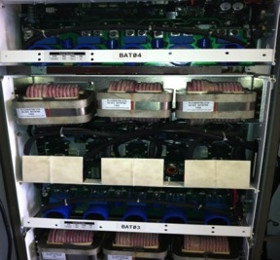
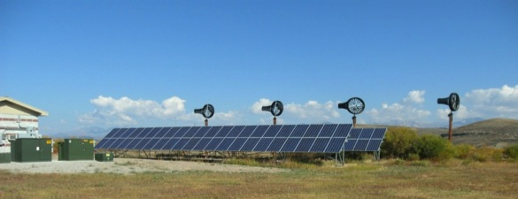


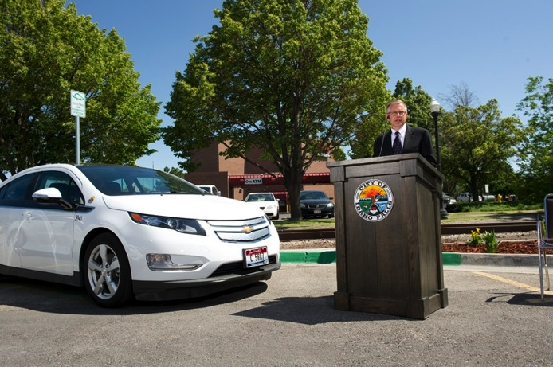

Slide 43

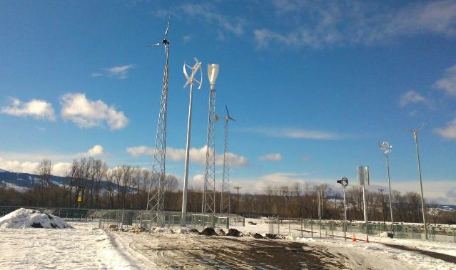
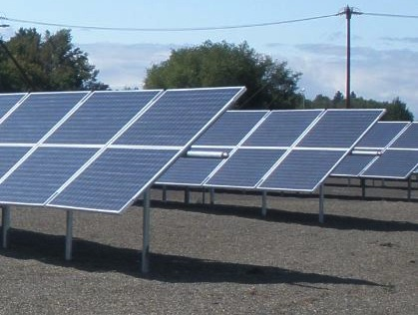
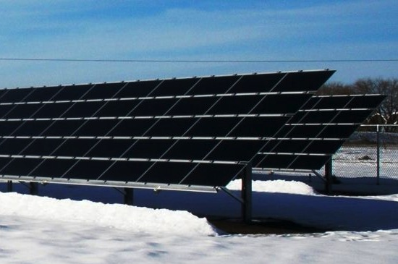
Renewable
Energy
Park

Slide 44
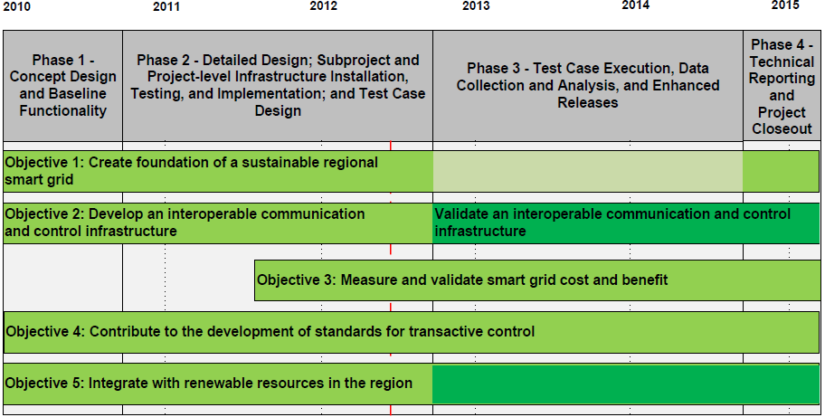
Progress Towards Project Objectives

Slide 45
Summary – Project Benefits
Opportunity to leverage smart grid assets installed by regional utilities using an innovative incentive structure
Extend and validate the concepts demonstrated in Oly-Pen project
  Flexible approach to integrating BPA’s and Utility’s operational objectives and responsive resources
  Standardized, interoperable approach to facilitate broad application
Prove and refine the transactive approach
  Gather regional cost-benefit information
  Understand scale-up challenges and opportunities
Continue the region’s legacy of national leadership in power system innovation
Notes:
This project and all of the regional demonstrations in the United States are all about demonstrating the various benefits of smart grid technology so that decision makers have the information they need to make sound investment decisions.
This project provides regional benefits by leveraging smart grid assets already installed by regional utilities or being installed by this project to use our innovative transactive control approach.
The project extends work performed in the 2006 time frame where we demonstrated the use of a real-time price signal and a double auction market to manage constraints in a distribution system. This project expands on that work providing a approach that can be used throughout the power system and that is scalable and standardized.
The project will refine our work on transactive control and coordination and give us valuable information about the challenges in applying these techniques on a large scale.
Finally, the project continues our region’s legacy of national leadership in power system innovation.

Slide 46
2015 and beyond
At the end of the demo project:
  ~ 100 Megawatts of distributed responsive assets engaged
  Transactive control validated as a means of balancing intermittent renewable resources
  Base of smart grid equipment installed at 11 utilities
Beyond the demo project
  Scale up to engage additional responsive assets
  Transition from R&D to operations
  Operationalize for balancing authorities (regional value)
  Further deployment with energy service providers to enhance value to their operations (local value)
Notes:
Let me close by noting that there will still be much work to be done at the end of our project.
We will have engaged about 100 megawatts of responsive assets that are geographically distributed, validated the transactive control technique and engaged 11 utilities in use of the technique.
There will still be a need to scale up the use of the technique to provide enough geographically localized response to be of use to the transmission system operators. We will also have to make a transition from research and development to ongoing operation. This requires us to understand how to operationalize the technique for balancing authorities and to help energy service providers, such as distribution utilities, identify specific local operational value.

Slide 47
Acknowledgement & Disclaimer
Acknowledgment: "This material is based upon work supported by the Department of Energy under Award Number DE-OE0000190.”
Disclaimer: "This report was prepared as an account of work sponsored by an agency of the United States Government. Neither the United States Government nor any agency thereof, nor any of their employees, makes any warranty, express or implied, or assumes any legal liability or responsibility for the accuracy, completeness, or usefulness of any information, apparatus, product, or process disclosed, or represents that its use would not infringe privately owned rights. Reference herein to any specific commercial product, process, or service by trade name, trademark, manufacturer, or otherwise does not necessarily constitute or imply its endorsement, recommendation, or favoring by the United States Government or any agency thereof. The views and opinions of authors expressed herein do not necessarily state or reflect those of the United States Government or any agency thereof.”
Notes:
As I thank you for your attention I also need to acknowledge the US Department of Energy’s funding in support of this project and that the views I expressed are my own, not the US Department of Energy’s.

Slide 48
For further information
Dr. Ron Melton
ron.melton@battelle.org
509-372-6777
www.pnwsmartgrid.org
  “Annual Report”
  Quarterly newsletters
  Participant summaries
  Background on technology
Notes:
Thank you for your attention. My contact information is shown here along with the link to our project website where further information is available,
Thank you very much.

